Slide 1
GAA Webinar
“Gaining Approval for Non-Aeronautical
Events at Your Airport”
May 16, 2023
Presenters:
Steve Brian, C.M., Manager, Aviation Programs, GDOT
Terra H. Winslett, C.M., Airport Property & Marketing Manager
Glynn County Airport Commission
Billy Ragan, Airport Manager, Vidalia Regional Airport

Slide 2
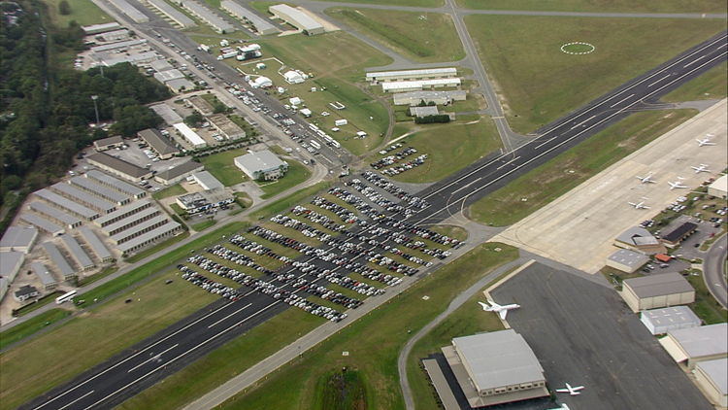
Gaining Approval for Non-Aeronautical Events at Your Airport
Activities that Trigger Non-Aeronautical Event Approval
FAA Non-Aeronautical Event Policy Guidance
GDOT Non-Aeronautical Event Submittal Process
Fair Market Value Determination Concepts
Non-Aeronautical Event Example Submission (Vidalia Onion Festival)
GDOT No Objection Letter
Common Questions/Issues
Questions from Participates

Slide 3

Activities that Trigger Non-Aeronautical Event Approval
Federal Obligated Airport Sponsors are Required to Gain Non-Aeronautical Event No Objection from FAA/GDOT if an Event will:
Close an Operational Surface such as a Runway or Taxiway,
Close a Substantial Portion of an Apron
used by the Flying public,
Potentially Create a Safety Hazard to the Flying
Public,
Render the Airport Unusable to the Flying
Public.

Slide 4
FAA Non-Aeronautical Event Policy Guidance
Grant Assurance 19, Operations and Maintenance
  “Any proposal to temporarily close the airport for non-aeronautical purposes must first be approved by the Secretary.”
FAA 5190.6B, Airport Compliance Manual, Section 7.21
  Nonaeronautical Events. An airport developed or improved with federal funds may not be closed to use the airport facilities for special outdoor events, such as sports car races, county fairs, parades, car testing, model airplane events, etc., without FAA approval. In certain circumstances where promoting aviation awareness through such nonaeronautical activities as model airplane flying, etc., the FAA does support the limited use of airport facilities so long as there is not total closure of the airport. In these cases, safeguards need to be established to protect the aeronautical use of the airport while the nonaeronautical activities are in progress and to ensure that safety is not compromised.

Slide 5
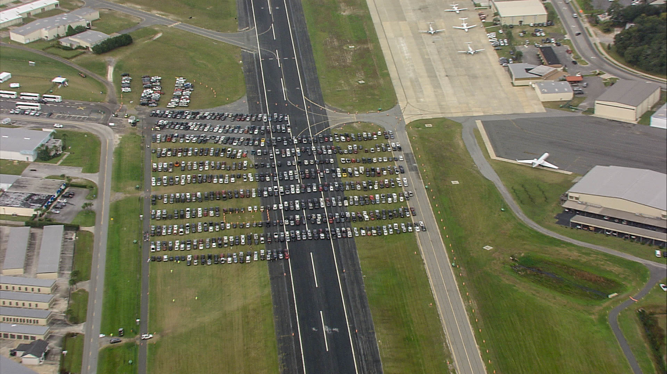
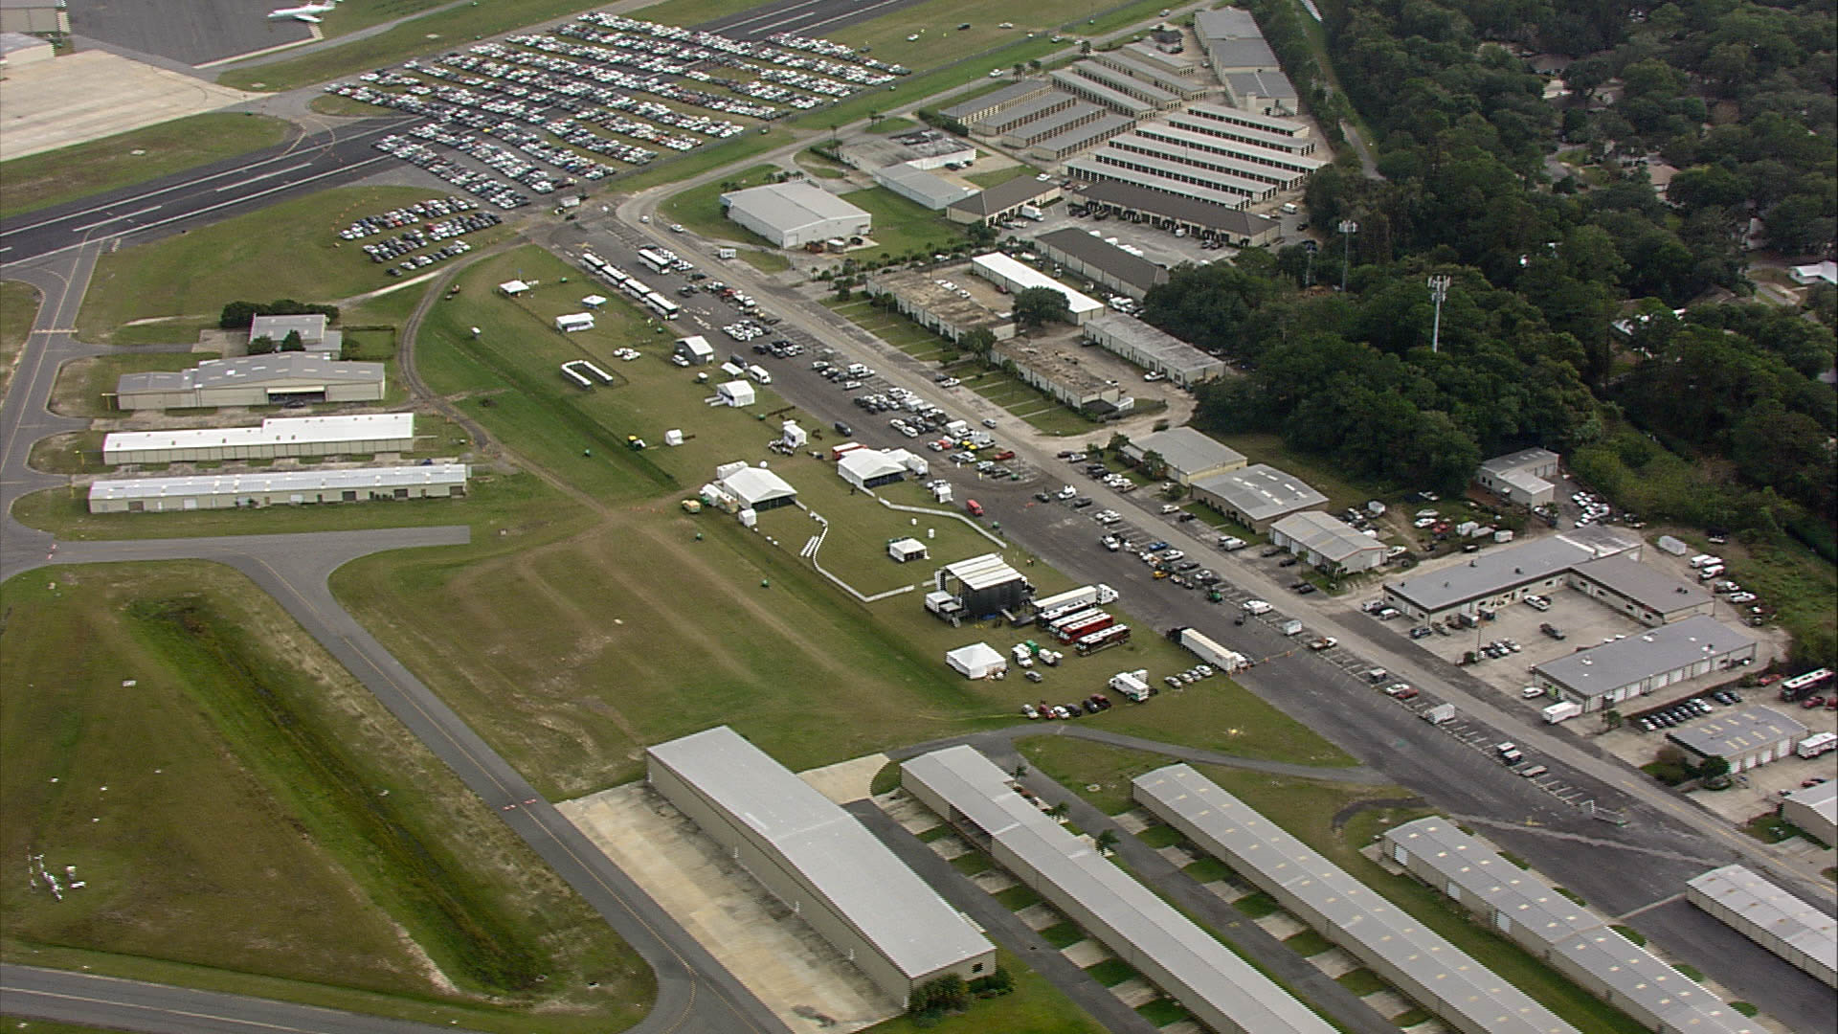
FAA Non-Aeronautical Event Policy Guidance (Cont.)
Grant Assurance 25, Airport Revenues
  “All revenues generated by the airport will be expended by it for capital or operating costs of the airport.”
  - Use of airport facilities are also subject to FAA Revenue Use policy
FAA 5190.6B, Airport Compliance Manual, Section 15.13
“Rental of land to, or use of land by, the sponsor for nonaeronautical
purposes at less than fair market value rent is considered a subsidy of
local government and is a prohibited use of airport revenue.”

Slide 6
GDOT Non-Aeronautical Event Submittal Process
Non-aeronautical event requests must be submitted no later than 120 days prior to the requested event.
Non-aeronautical event requests must be submitted via OE/AAA for processing. Please provide an email copy to Aviation Programs Staff prior to submittal (ncoyle@dot.ga.gov or cdupre@dot.ga.gov) so the staff can assist with any correction to prevent FAA questions.
Consideration of a request to close part of a federally obligated airport for a nonaeronautical event shall be based on:
- Safety
  - The impact of the closure on aviation and the airport’s
  aeronautical users
  - Safeguards use to protect the aeronautical infrastructure
  - Benefits that will accrue to the airport
  - Financial considerations
  - The airport sponsor’s ability to protect its rights and powers

Slide 7
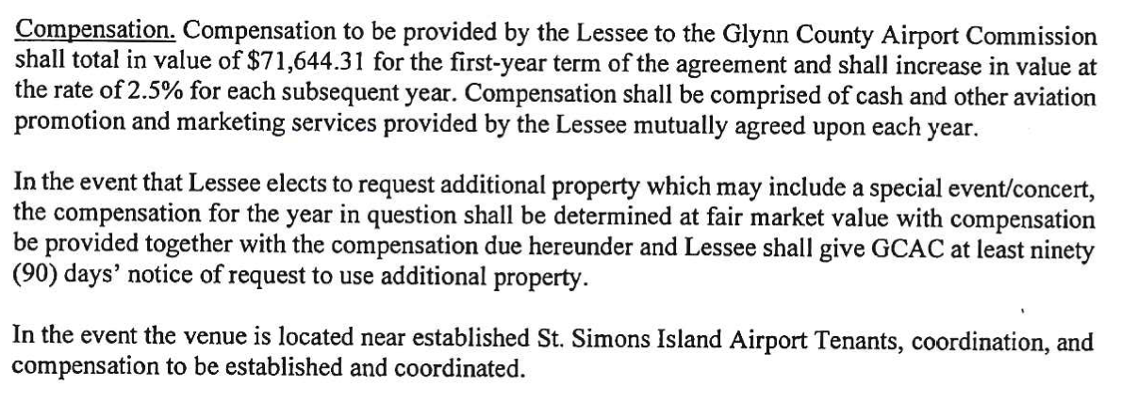
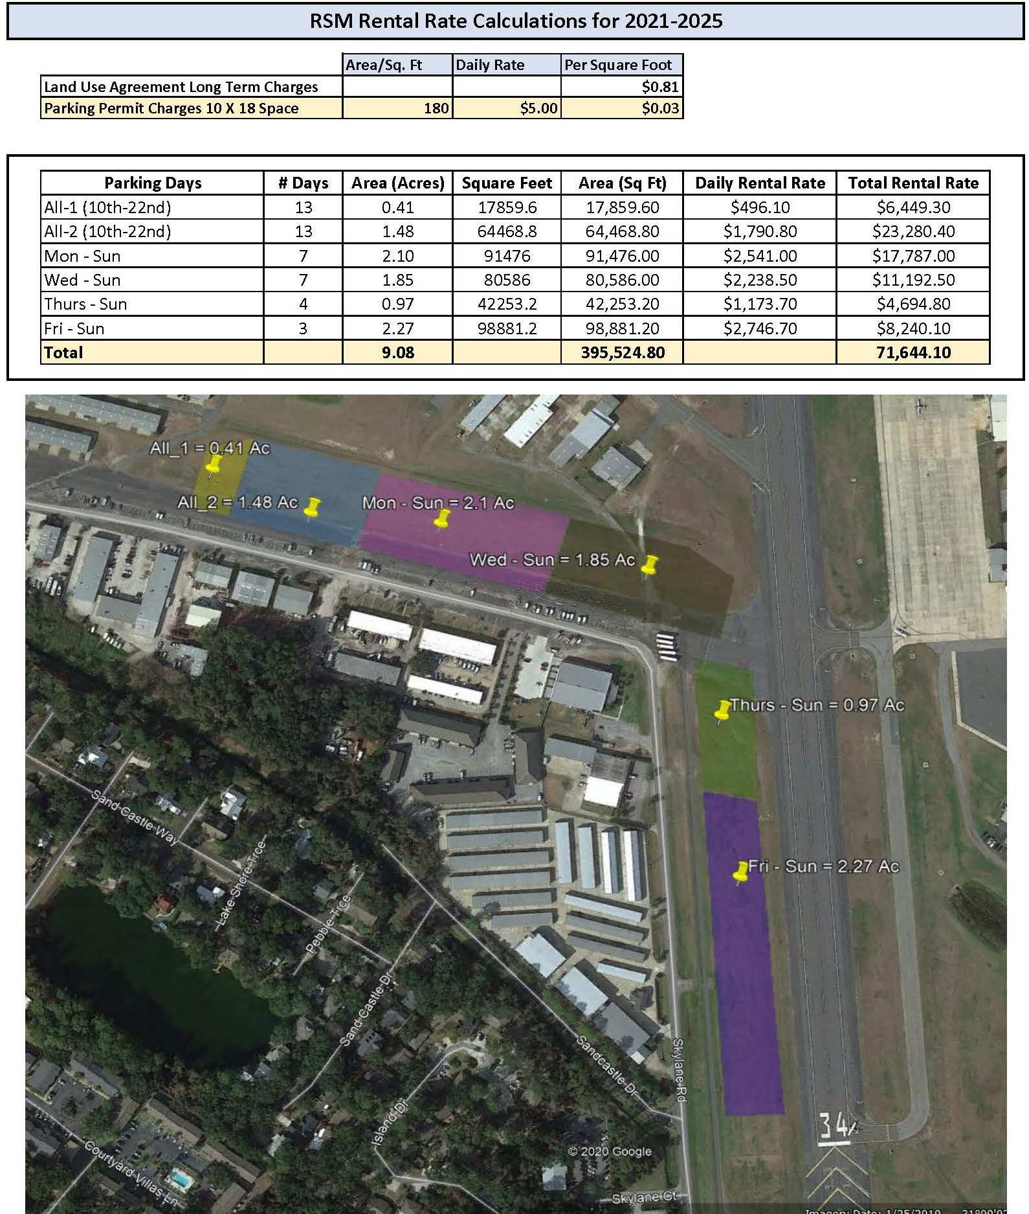
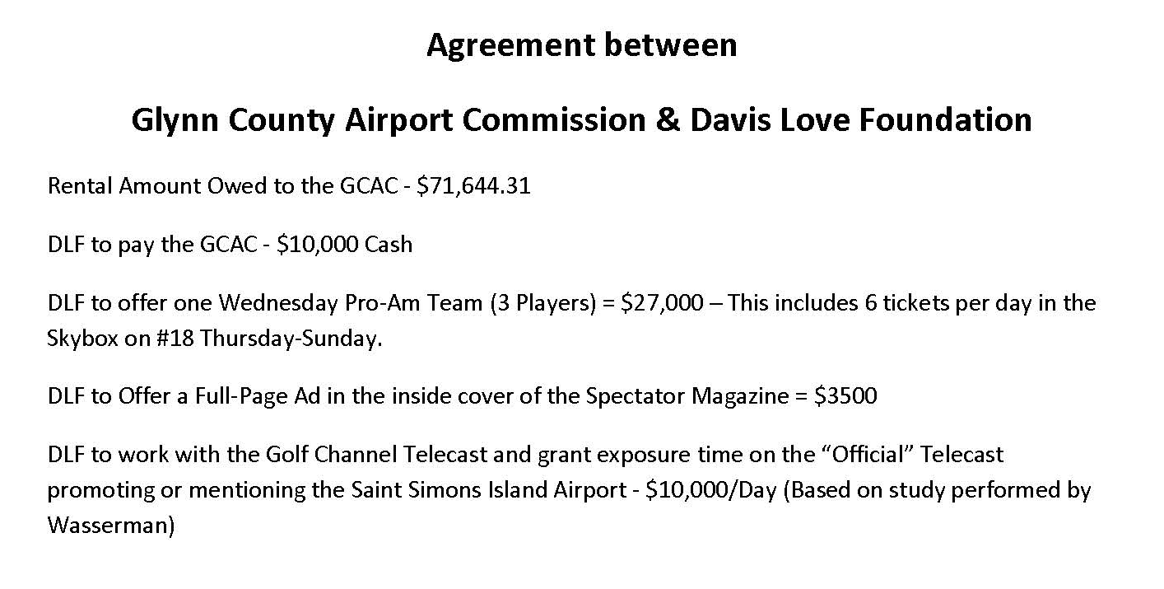

Fair Market Value Determination Concepts
Airport funds should not be used to subsidize a nonaeronautical event. The event sponsor should cover costs associated with the event.

Slide 8
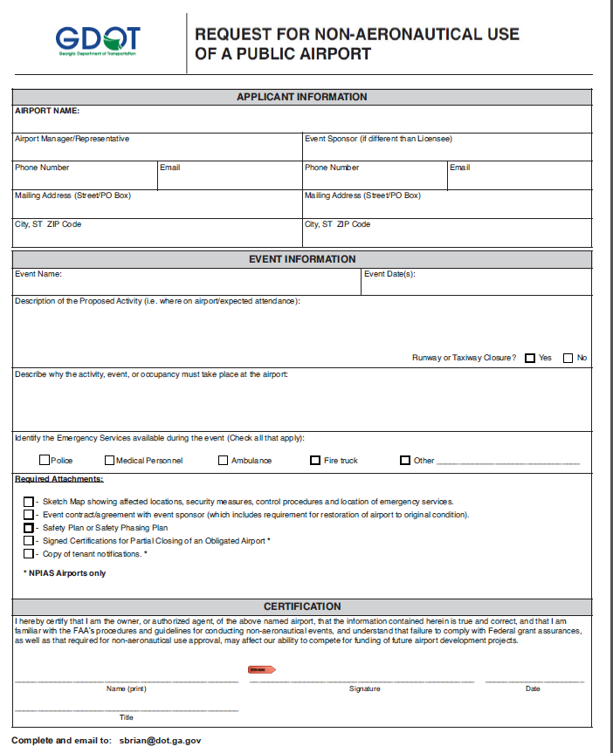
GDOT Submittal Process (Cont.)
Airport sponsor should fill out the “Request for Non-Aeronautical Use of a Public Airport” Form. A copy of this form can be found on the GDOT Airport Aid page under sample forms or it can be requested from GDOT.

Slide 9
GDOT Submittal Process (Cont.)
Instructions for Completion of Request Form
List the Airport Name in the top block
Enter the name, mailing address, phone number and email address of the airport representative submitting the request, as well the event sponsor
Required event information:
  Event name and date
  Description of proposed event including location and anticipated attendance
  State if Runways/Taxiways/Aircraft Aprons will need to be closed
  Describe why event must take place at the airport
  Annotate if emergency personnel will be present at the event
  https://www.dot.ga.gov/InvestSmart/Aviation/Forms/GDOT%20Non%20Aeronautical%20Event%20Request%20Form.pdf

Slide 10
GDOT Submittal Process (Cont.)
Required Attachments to Accompany Submittal
Submittal package should include the following attachments:
  Map showing affected areas of the airport, location of emergency personnel, and physical controls measures to be in place
  Event contract or agreement with sponsor, which must include restoration of airport back to original condition
  Event specific liability insurance, which lists Airport Sponsor and GDOT as additionally insured
  Safety plan detailing responsibilities, control procedures, and plan for issuance of NOTAMs (if applicable)
  Signed certifications
  Copy of tenant notification(s)
  https://www.dot.ga.gov/InvestSmart/Aviation/Forms/GDOT%20Non%20Aeronautical%20Event%20Request%20Form.pdf

Slide 11

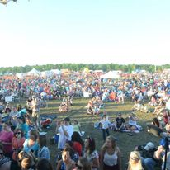

Non-Aeronautical Event Example Submission
(Vidalia Onion Festival)
Additional Info in Submittal
Letter of Agreement between Onion Festival and Airport Sponsor
Fair Market Value Compensation – to be used for airport operations and maintenance
Safety Plan for operations during event

Slide 12
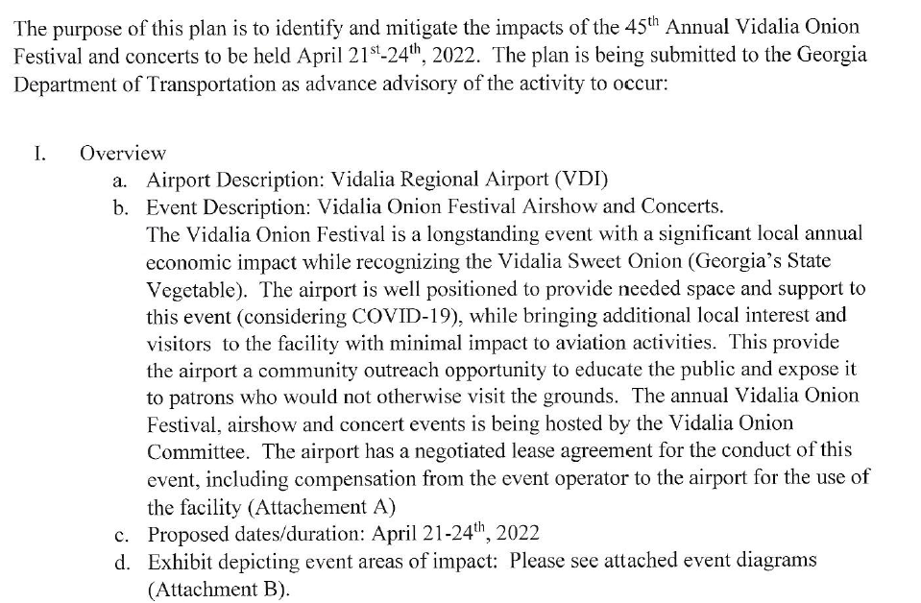
Non-Aeronautical Event Example Submission
(Vidalia Onion Festival)
Event Description

Slide 13
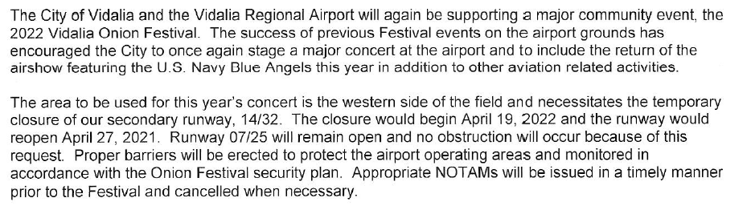
Non-Aeronautical Event Example Submission
(Vidalia Onion Festival)
Affected Areas
Issue Appropriate NOTAMs
Includes areas impacted
Duration of closure
Status of Airport operations during the event
Includes proposed use of airport surface(s)

Slide 14
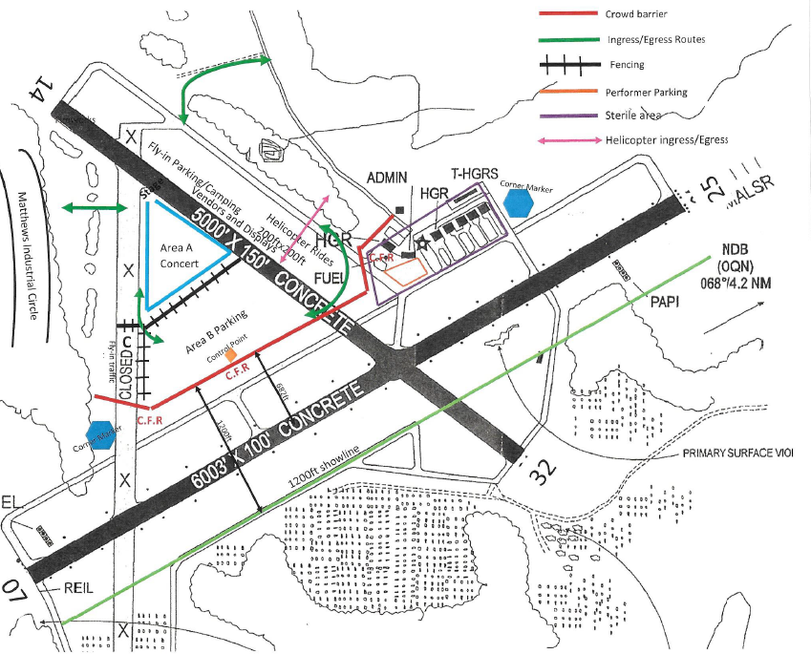
Non-Aeronautical Event Example Submission
(Vidalia Onion Festival)
Event Sketch
Sketch Shows:
Parking areas related to the airports movement areas
Barriers for crowds and protection of movement areas
Entrance and exit routes for event attendees

Slide 15
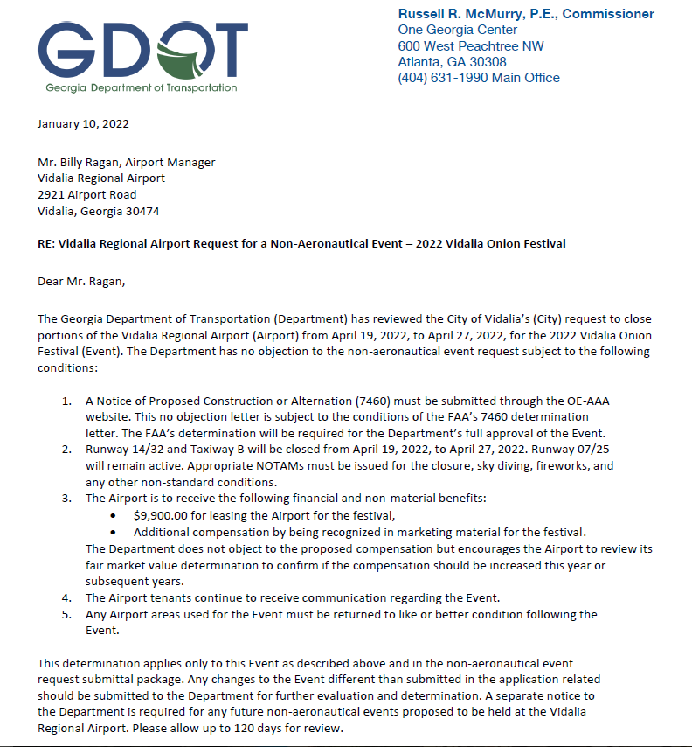
GDOT No Objection Letter
Letter Contains:
1. Notice of Proposed Construction or Alternation (7460) must be submitted through the OE-AAA website.
2. Description of Closures with specific dates and times.
3. Appropriate NOTAMs must be issued for the closures, safety issues, and non-standard conditions.
4. Airport is to receive FMV
5. Airport tenants receive communication regarding the Event.
6. Airport areas used for the Event must be returned to like or better condition following the Event.
7. Any changes to the Event different than submitted in the application should be submitted to the Department for further evaluation

Slide 16
Common Questions/Issues
Include Fair Market Value Compensation
  Compensation should go back to the airport
  Additional information may be requested on how rates were determined
Include tenant communication plan for event
Include impacts to airport movement areas
  No event should impact active safety areas or object free areas
  No event traffic should traverse any active safety or critical areas
  Drawings should show barricades to contain event activities within enclosed area and prevent aircraft operations from entering closed areas
Consider Event Insurance to cover the Airport’s Liability
Safety Plan Essential and Airport Staff should Monitor the Plan During the Event

Slide 17
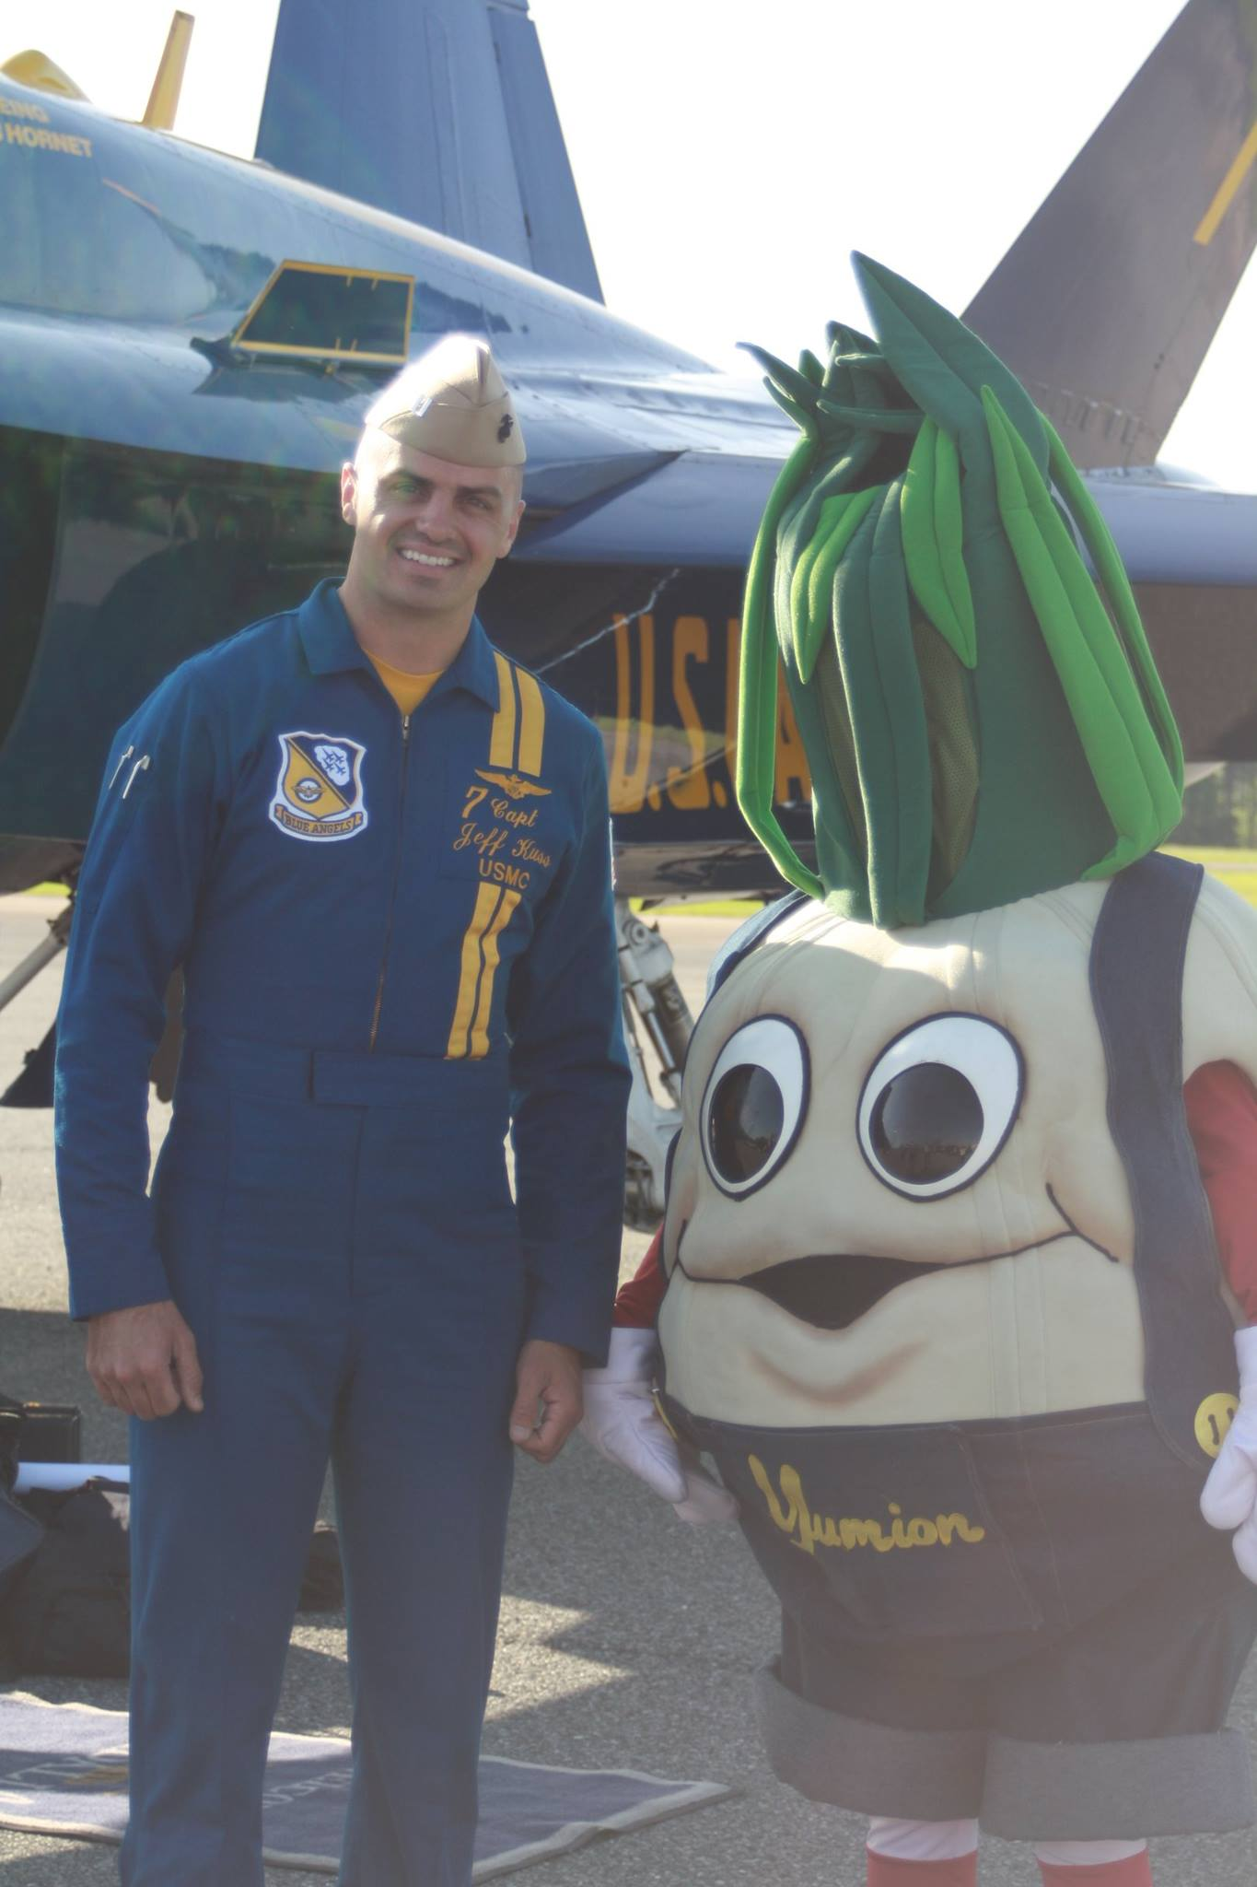
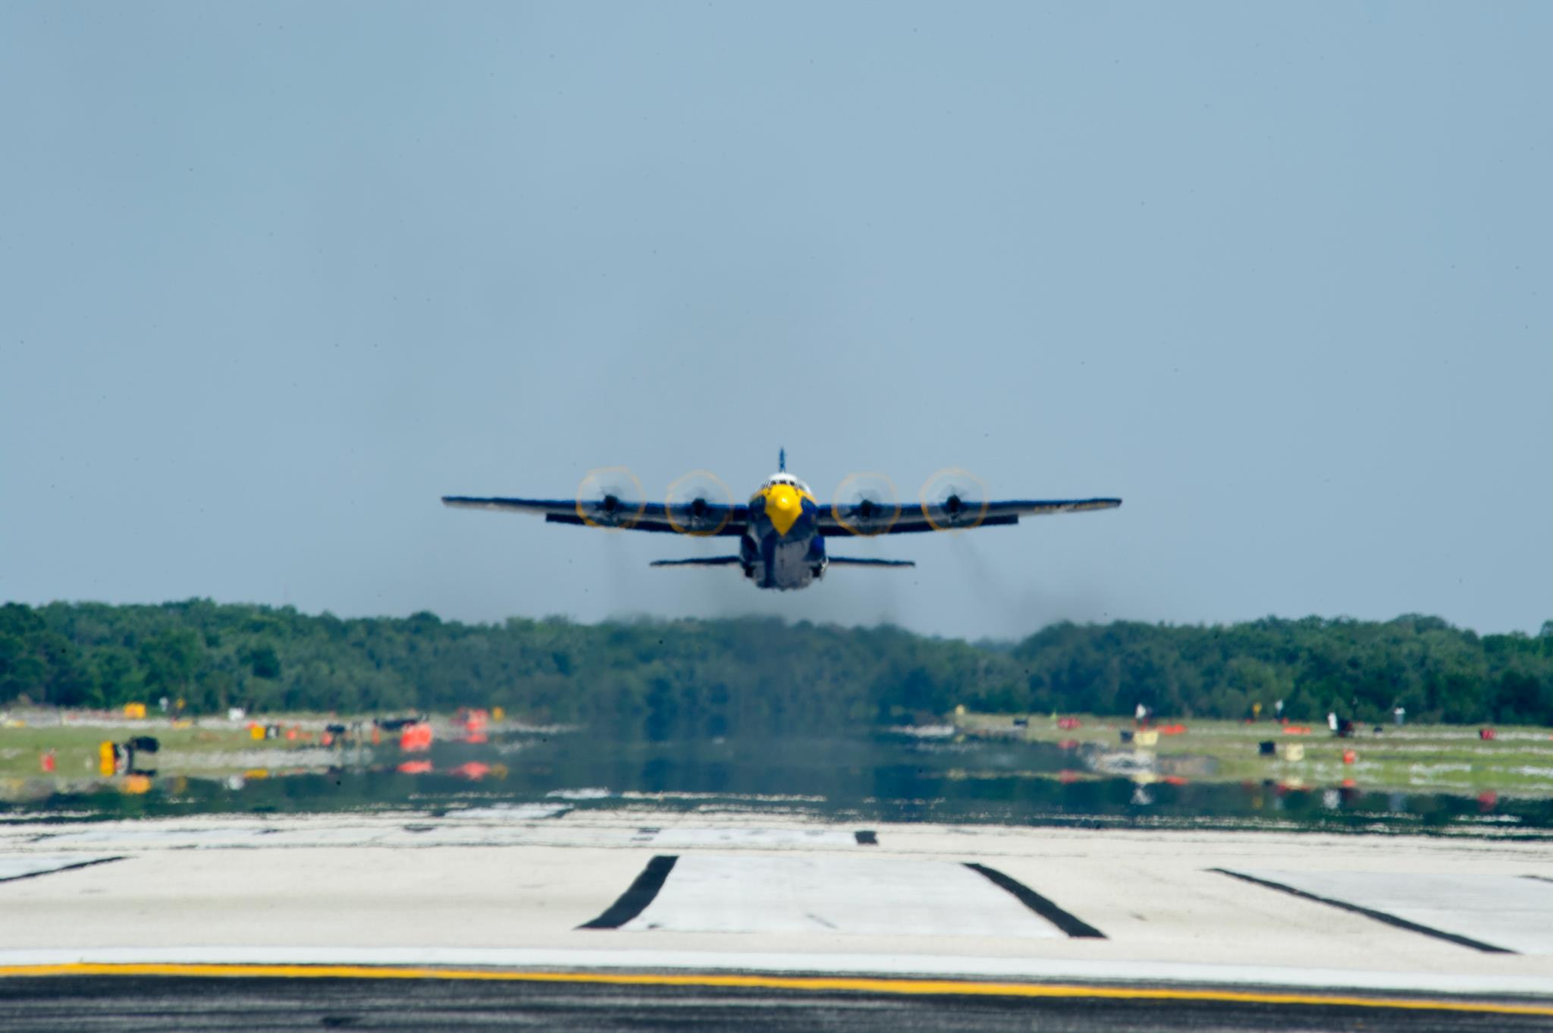
Questions?
Any Questions for:
Steve Brian, sbrian@dot.ga.gov
Terra Winslett, twinslett@flygcairports.com
Billy Ragan, bragan@vidaliaga.gov

