Slide 1

Emergency Preparation and Response at a General Aviation Airport

Slide 2
Aircraft Incidents and Accidents
Be prepared before an incident or accident occurs.
Talk to local Police/Sheriff and Fire Department about how they will respond to an incident or accident.
  How will they access the airport?
  Is there a staging area for them to wait?
  How long will it take them to get to the airport?
  What do they think their jobs are once they arrive, and what would you like them to do?

Slide 3

Airport Preparations
Talk to other airport managers and to the tenants on your airport.
  Ask what their response plans are and copy the good stuff.
  Discuss sharing resources.

Slide 4

Airport Operations Preparations
Have an accident kit
  Paper and pencil – pre-printed form is better
  Rain poncho or raincoat
  Bottle of water
  Make sure you bring your cell phone and a car charger
  List of contact phone numbers
  Fire extinguisher and First Aid Kit
  Handheld Radio and car charger

Slide 5
After you call 911
During the incident participants should follow the National Incident Management System (NIMS).
  The fire department is in charge until the fire is out and people are safe.
  If there is reason to believe a crime has been committed police/FBI/ATF/etc. would take over.
  After everyone else has finished the airport operator is then in charge of the scene.

Slide 6
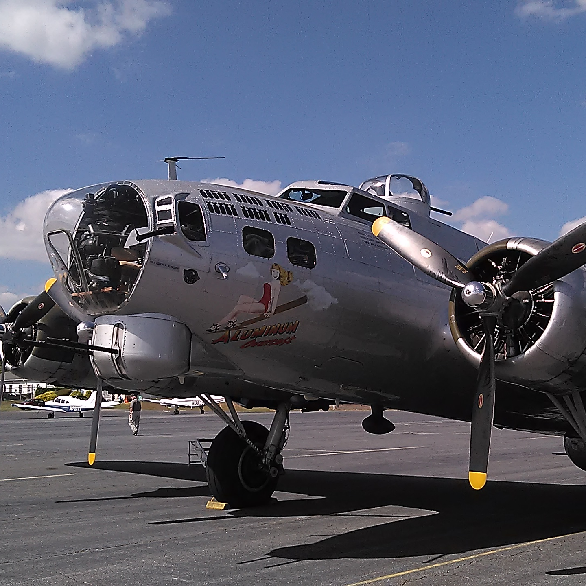
Media
Follow your jurisdiction’s procedures.
They will get pictures and video
If possible and safe, allow them onto the airport to build good will

Slide 7

Regulatory Requirements
49 CFR Part 830 – Notification and Reporting of Aircraft Accidents or Incidents and Overdue Aircraft, and Preservation of Aircraft Wreckage, Mail, Cargo, and Records
It is aircraft operator’s responsibility to comply

Slide 8
Regulatory Requirements
NTSB can be notified at 844-373-9922 or 202-314-6290
FAA FSDO Regional Operations Center (ROC) can be notified at 404-305-5180
Once notification is made the investigator on-duty will make contact and determine if they want to further investigate, or if they are willing to release the aircraft.
Issue any NOTAMs that are required.

Slide 9
Disabled Aircraft Removal
It is the aircraft owner’s responsibility to remove a disabled aircraft from your runway(s) or taxiway(s).
On airport mechanics and FBOs can usually help an owner remove a disabled aircraft.
  There are various devices, dollies, etc., that are designed for disabled aircraft, aircraft with flat tires, etc.
If a local company is not available or does not have the equipment or expertise – Atlanta Air Recovery in Griffin GA, can provide all types of recovery service
  800-237-8831 – Normal Business Hours
  770-584-3422 – After Hours Contact

Slide 10

Aircraft Wreckage Removal
  If FAA/NTSB wants to impound the wreckage, they will arrange for the collection.
  If FAA/NTSB releases the wreckage to the owner, the same services for disabled aircraft can be used for the wreckage.
  Pavement Damage – soft spots, metal melted into asphalt, binder burns away leaving rocks.
Notes:
.

Slide 11
Inclement Weather & Natural Disasters
Prior planning is the key.
Work with your Risk Manager/insurance agent to determine proper insurance limits.
Work with other airports to:
  Provide temporary safe aircraft parking (e.g., fly to an inland airport if a hurricane is coming to your area).
  Pool resources – lights, wire, closure markings, sharing staff to help with clean-up, etc.

Slide 12
Inclement Weather & Natural Disasters
Coordinate with public works for roadways.
Talk with power providers to determine your restoration priority.
If possible, look into back-up power and discuss this with your tenants.
Notes:
.

Slide 13
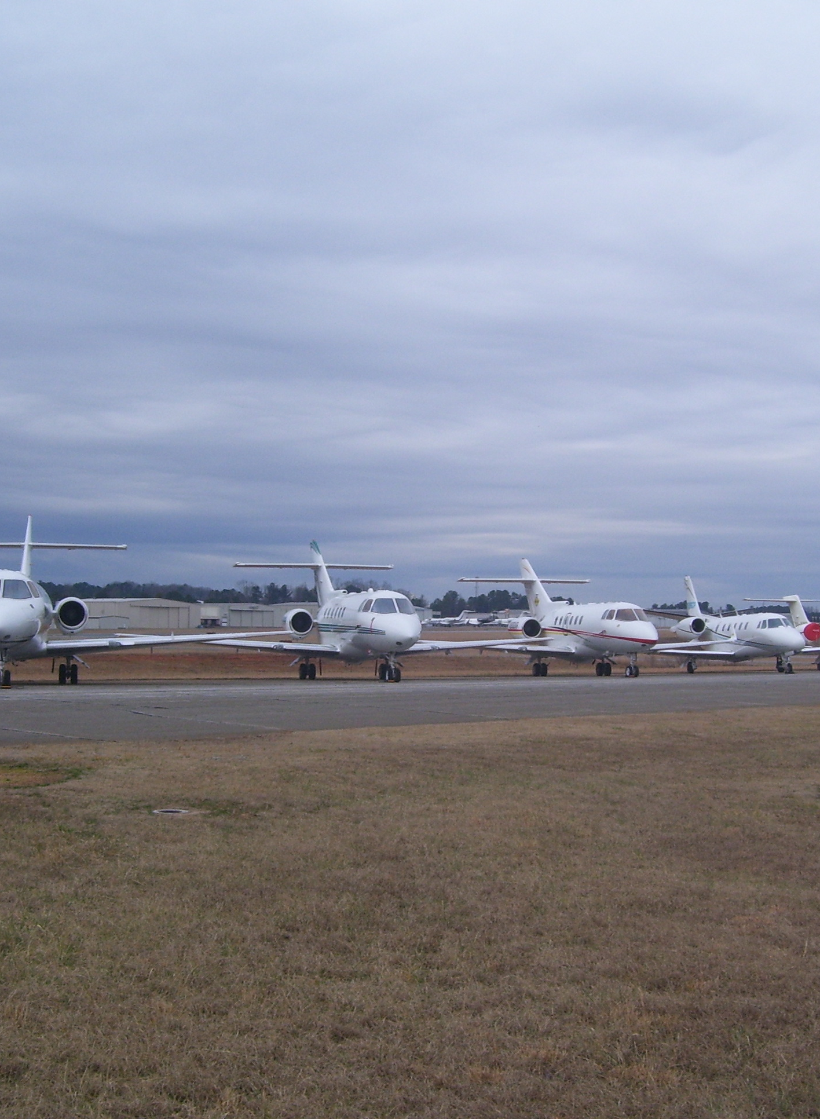
During the Event
Provide field condition reports to aviation programs
Make sure you issue NOTAMs as appropriate

Slide 14

Thank you!
Contact Information:
• Matthew Smith
• Office: (770) 822-5196
• Cell: (770) 722-8127
• matthew.smith@gwinnettcounty.com

