Slide 1
2022 Georgia Airports Association Conference

Slide 2
ADO Update
Staffing Updates
Project Highlights
Recap of FY22 Programs
FY23 Programs
Hot Topics/Reminders
Questions

Slide 3
Atlanta ADO Staff
Notes:
Phillip will be taking NRA’s over for Barrett
Still have openings for 1 planner and 1 engineer

Slide 4
FAA Funding Programs
Airport Improvement Program
Passenger Facility Charge Program
Supplemental Funding
Bipartisan Infrastructure Law (BIL)
Airport Infrastructure Grants (AIG)
Airport Terminal Program (ATP)
Tower Program (FCT)
COVID Relief Programs (CARES/CRRSA/ARPA)

Slide 5
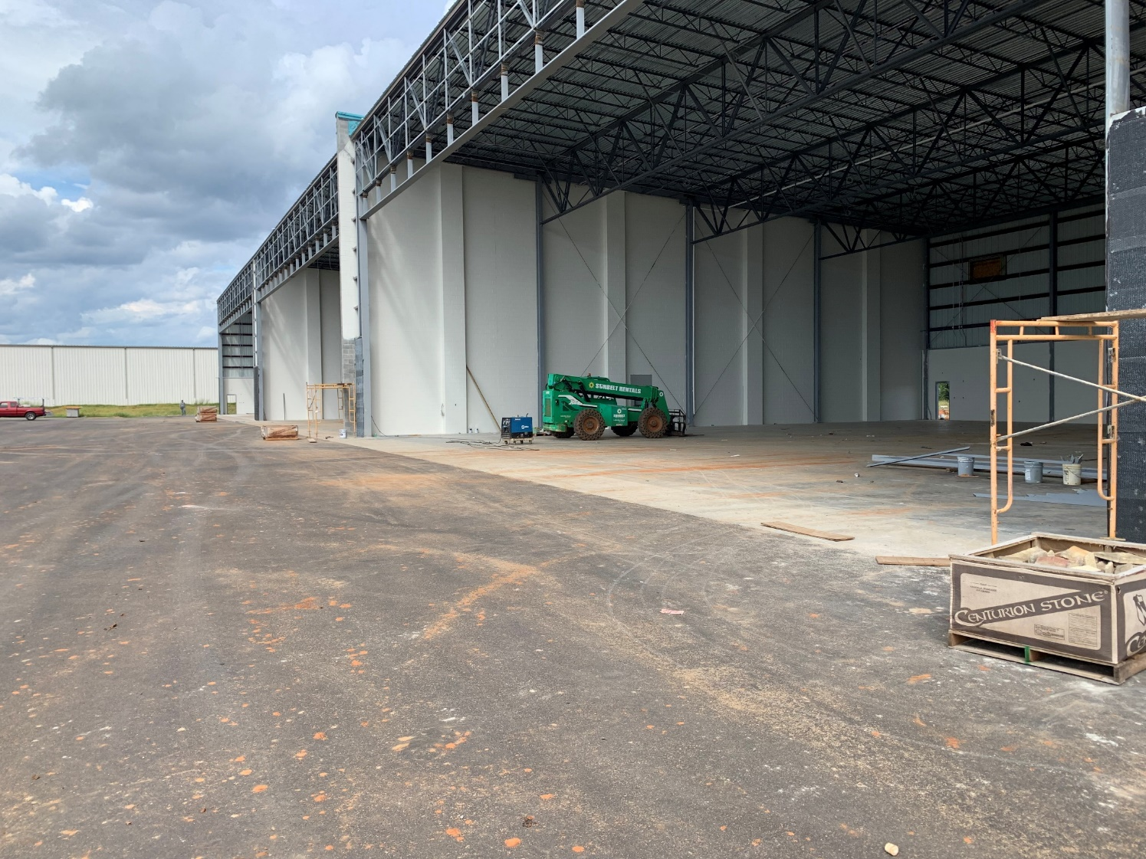
AIP Project Highlights
Albany
New GA Terminal and Hangars
Notes:
Separate into slides

Slide 6
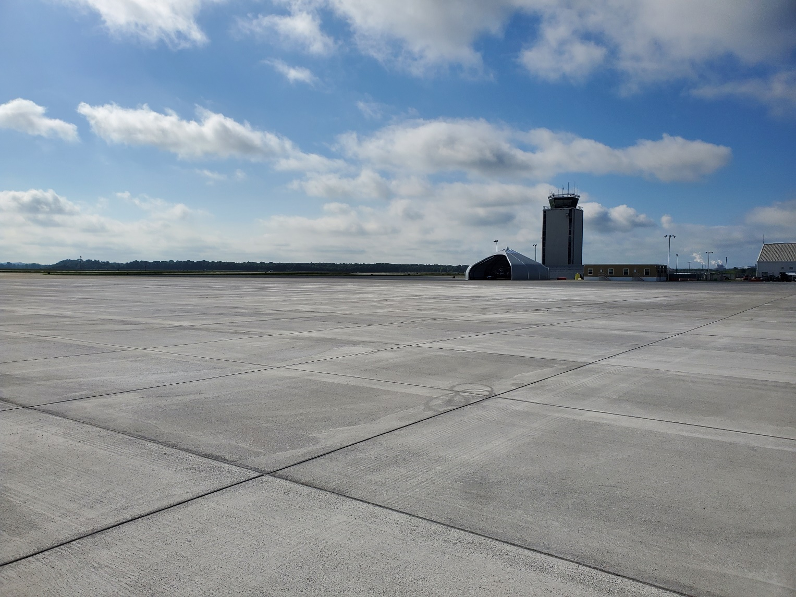
AIP Project Highlights
Augusta
Apron Reconstruction
Notes:
Separate into slides

Slide 7
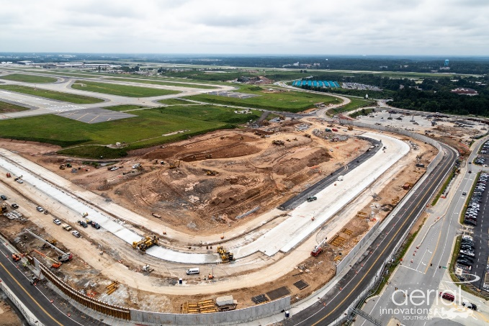
AIP Project Highlights
Atlanta
Runway 9L End Around Taxiway
Notes:
Separate into slides

Slide 8
AIP Project Highlights
Brunswick
Compass Calibration Pad
Notes:
Separate into slides

Slide 9
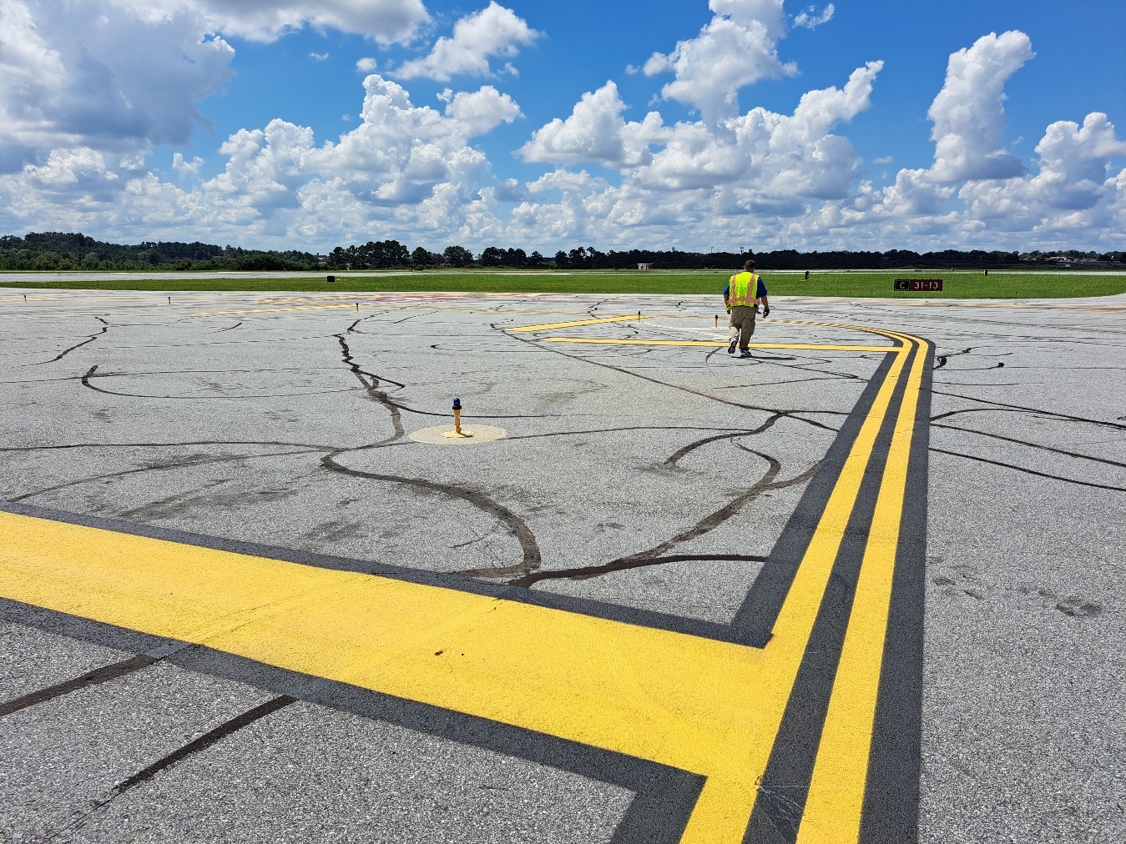
AIP Project Highlights
Columbus
TWY A/C/D RIM mitigation and remarking
Notes:
Separate into slides

Slide 10
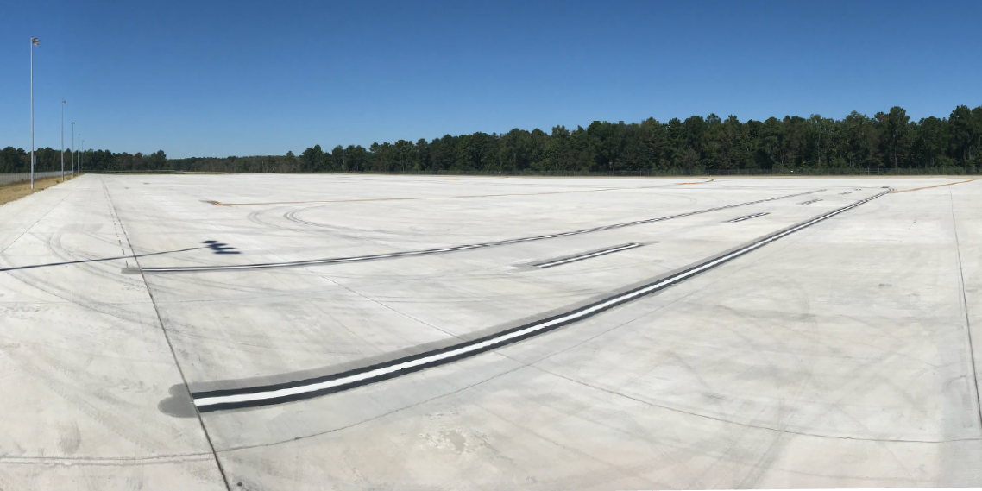
AIP Project Highlights
Savannah
New Air Cargo Apron
Notes:
Separate into slides

Slide 11
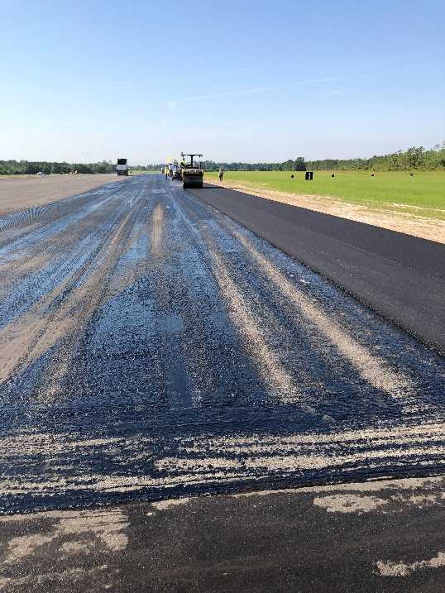
AIP Project Highlights
Valdosta
Runway Rehabilitation
Notes:
Separate into slides

Slide 12
ATL-ADO 2022 Financial Program
October 1, 2021 – September 30, 2022
ATL-ADO Total Program (148 Grants)
$656 Million
(Georgia, South Carolina, Puerto Rico, Virgin Islands)
Georgia Commercial Airports: $426,228,341
General Aviation Airports: $34,682,988
Georgia Discretionary: $36,667,769
General Aviation Discretionary: $18,049,838
Georgia Total = $460 Million*
*Includes COVID Grants

Slide 13
Georgia FY2022 AIP Discretionary/Supplemental
Atlanta-Hartsfield Jackson Intl (TW Shoulders Rehab) $18,537,059
Vidalia Regional (Runway 7/25 Rehab) $1,531,512
Decatur County (Apron Rehab) $1,468,488
Athens/Ben Epps (ARFF Equipment) $ 23,250
DeKalb-Peachtree (Runway 34 RSA) $2,334,484
Cartersville (Runway 19 RSA) $3,829,856
Lee Gilmer Memorial (Runway 15/23 Rehab) $1,750,000
Baldwin County Regional (Runway 10/28 Rehab) $1,599,972
Jackson County (Runway 17/35 Rehab) $3,099,212
Heart of Georgia Regional (Runway 2/20 Rehab) $2,413,064
Notes:
Add supplemental note

Slide 14
ATL-ADO 2022 Georgia Grants by Area
Georgia Total = $70 Million
*Excludes COVID Grants

Slide 15
Notes:
61% of All Grants were for Rehabilitation or Reconstruction of Existing Pavement
90% of Georgia Discretionary Grants

Slide 16
Bipartisan Infrastructure Law
Airport Infrastructure Grants
FY22 Georgia Allocations: $123,255,026
$2,069,324 in allocations issued (9 Projects)
Anticipate FY23 Funds being available Nov 1
Coordinate AIG grant request through GDOT
Request must be based on bids
ATL ADO requesting stand alone AIG applications by January 31st
Airport Terminal Program
FY22 ATP – Atlanta – Concourse D - $40,000,000
FY23 NOFO – Apps due by 5 PM Oct 24th

Slide 17
FY 2023 AIP Program
December 2021 – CIPs
July 2022 – FY23 AIP Program Established
August 2022 -FY23 project letters sent
Pre-grant meeting in first quarter to establish schedules for FY23 Projects
Application Deadlines
Design/Planning only – Requested by February 28th
Construction - Applications for Entitlement only projects, due to ADO by early April 2023 (FR)
Discretionary – Application deadline

Slide 18
FY24-28 AIP Program
CIP Call Letter Issued September 2022 (Dec. 3 submittal)
Realistic funding plan for all phases
Complete Pre-Application (SF-424) for FY24 project requests
Sponsor Checklist
Reminder – State Apportionment and Discretionary funds are ineligible for 3 years following a revenue-producing project.
Use FAA CIP Template
New requirement for GDOT to submit comprehensive CIP to FAA
July 2023 – Selection of Projects & Disc. Program (Environ. due by April 30)
We Continue to Encourage Prior-year Design and Fiscal Year gap between design and construction for discretionary projects.

Slide 19
5 Year Capital Improvement Plan (CIP)
Ensure CIP includes all potential project request (ATP, AIG, AIP)
Ensure CIP has $750,000 in AIP construction to protect airport non-primary entitlement funds
Tighten up planning on future years
Stick to the plan (CIP) when requesting discretionary funding
FAA seeking to solidify outer years
Better planning increases our ability to help you

Slide 20
Reminders
NPIAS Report occurs every two years
FY23-27 NPIAS published September 30th
Largest development categories are: Reconstruct $22 B (35%); Terminal $17 B (27%); Standards $12 B (20%); Capacity $4 B (7%).
General Aviation – threshold for Unclassified identification is dependent upon data entered in BasedAircraft.com.
Unclassified airports are ineligible to receive Non Primary Entitlement funding
Consultant Selection – Reference A/C 150 5100-14E
Cost + % (of sub consultant price) is not allowed.
Sole advertisement for Planning (Master Plan)
Specific projects listed in advertisement
Realistic CIPs
Project Coordination early in design
Pavement design
Design Standards review (don’t rely solely on ALP)
Non-standard items

Slide 21
Airspace
NRA (On-airport)
Reminder: GA airport NRA cases need to be coordinate through GDOT first regardless of fund source. FAA will not review cases until GDOT concurrence is received
OE (Off-airport)
- The FAA cannot prevent the construction of structures near an airport. The airport environment can only be protected through such means as local zoning ordinances, acquisitions of property in fee title or aviation easements, letters of agreements, or other means.

Slide 22
Thank You!
Questions?
Atlanta
Airports
District
Office

