Slide 1
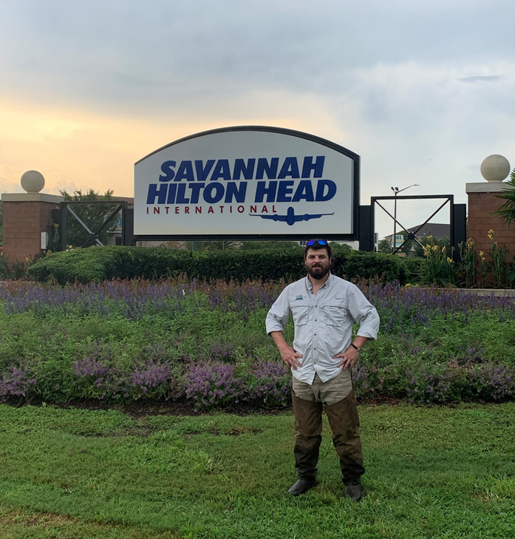

Georgia Aviation Association Conference
Wildlife Hazards at AirportsAviation
Ethan Burke
USDA- Wildlife Biologist
james.e.burke@usda.gov
912-414-1350

Slide 2
What is USDA Wildlife Services?
United States Department of Agriculture (USDA), Animal and Plant Health Inspection Service (APHIS), Wildlife Services (WS)
Our Mission:
protect agriculture, natural resources, private property, and human health and safety
Solving human/wildlife conflicts through the HERL method.

Slide 3
What USDA Wildlife Services Does at Airports?
Completes surveys throughout a specified time frame
Uses Survey Data to make land management recommendations
Indirect Control
Direct Control
Reports any Wildlife Strikes
Helps in writing BASH plans and Wildlife Hazard Management Plans
Helps in implementing BASH and Wildlife Hazard Management Plans

Slide 4
Why are wildlife strikes an increasing problem for aviation?
Increasing populations
Urban Adaptation
Increasing air traffic
Multi-engine jet aircraft
Increased liability

Slide 5
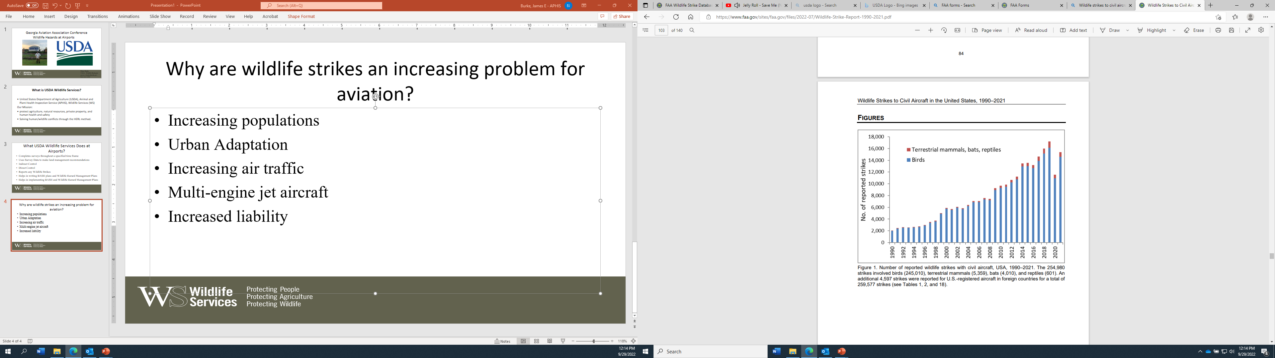

Slide 6
Hazardous species- What you need to know for your airport:
What are your hazardous species? (direct / indirect hazards)
When are they at your airport? (seasonally / daytime / night-time)
Why are they at your airport? (natural / man-made habitats and onsite / offsite features)
The idea is to start thinking like a Wildlife Biologist. You need to turn your home airfield into a biological desert in order to prevent wildlife strikes.
Notes:
6. Hazardous species need to know basis:
What are your hazardous species? (direct / indirect hazards)
When are they at your airport? (seasonally / daytime / nighttime)
Why are they at your airport? (natural / man-made habitats and onsite / offsite features)

Slide 7
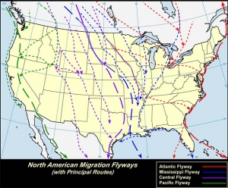
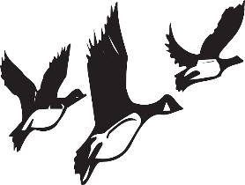
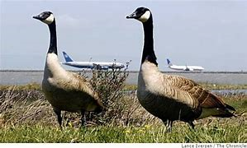
The Importance of Strike Reporting
IF THE AIRPORT DOESN’T KNOW YOU STRUCK IT, HOW CAN THEY KNOW HOW TO MANAGE IT?
Wildlife Strike Reports are important to figuring out:
Seasonal Patterns of Wildlife
Wildlife Hazards on and around the airfield
Attractants on the Airfield
By looking at wildlife strikes, airport operations and airport wildlife biologists can create increasingly successful wildlife hazard management practices to create a safer flying environment, for pilots and wildlife.

Slide 8
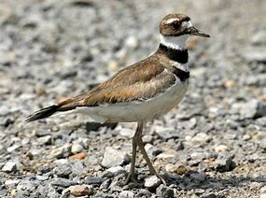
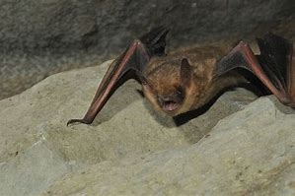
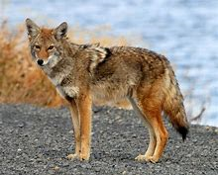
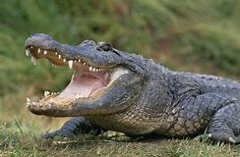
Types of Wildlife to Report if Involved in a Strike:
REPORT:
  ALL BIRDS
  ALL BATS
  TERRESTRIAL MAMMALS
      LARGER THAN 2.2 LBS (1 kg) (i.e. all rabbits, muskrats, foxes, armadillos, dogs, coyotes, deer, etc. but not mice, voles, rats, chipmunks, etc.)
  Reptiles larger than 2.2 lbs (1 kg)

Slide 9
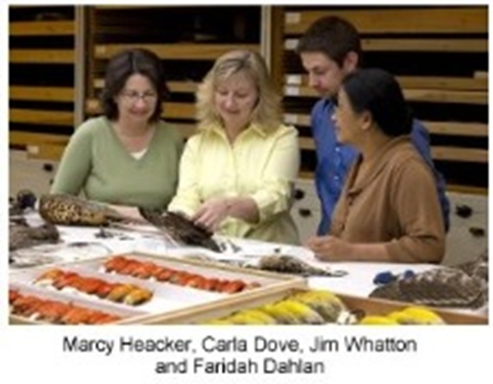
What if I don’t know what kind of wildlife was struck?
Smithsonian Institution, Feather Identification Lab
Not only may your local airport biologist be able to assist you, the Smithsonian Institution has a Feather Identification Lab, where animals can be identified using their collection as reference.
The Smithsonian Institution's Feather Identification Laboratory is able to identify a bird species from its remains. Depending on the condition of the remains, birds can be identified based on physical characteristics, feather fragments, and/or DNA analysis
Smithsonian Institution, Feather Identification Lab
E-600, MRC 116
PO BOX 37012
Washington, DC 20013-7012

Slide 10
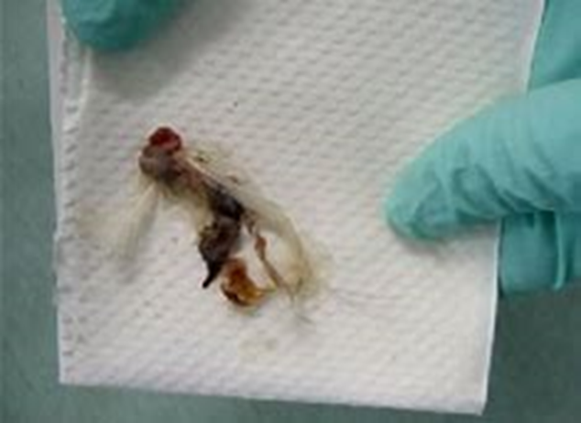
What should a wildlife strike kit include.
Loose leaf paper or FAA form 5200-7 to take down pertinent information
Sharpie
Cotton swabs
Cotton makeup pads
Alcohol wipes
Latex gloves
Ziplock bags
Simply collect what tissue, blood, and/or feathers (snarge) you can, fill out the pertinent information from the strike. Fill out the online FAA 5200-7. Send to the Smithsonian Feather ID lab with the snarge and the printed-out strike report form FAA 5200-7.

Slide 11
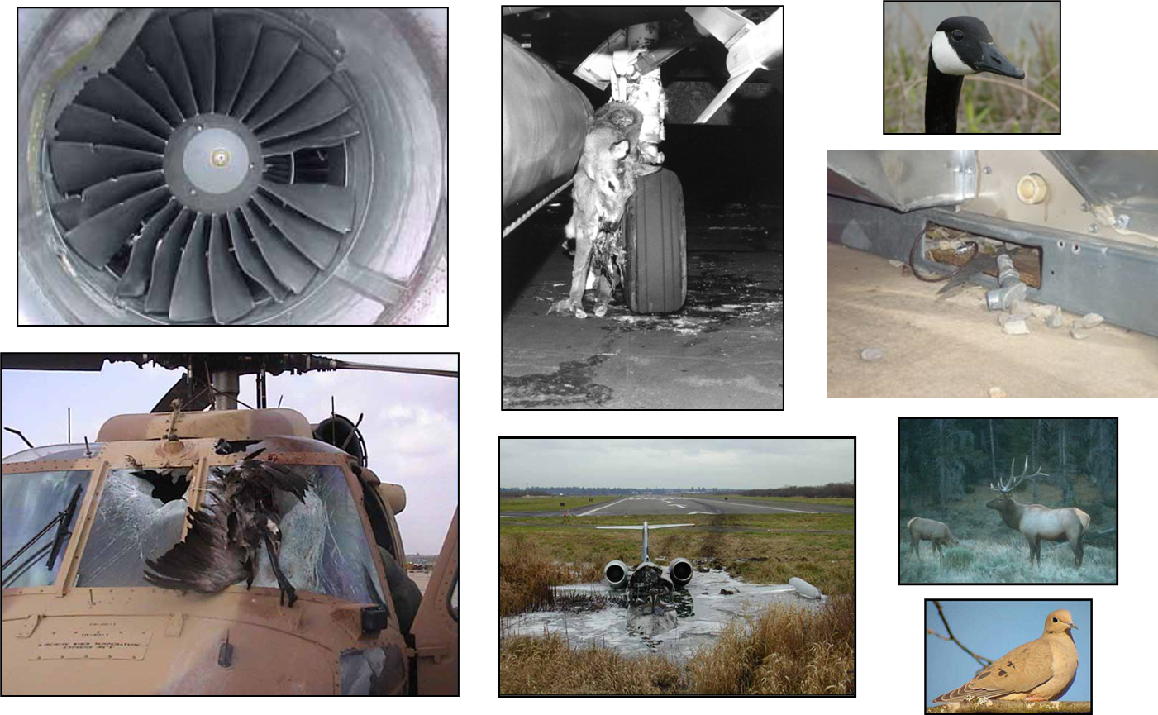
Direct Hazards

Slide 12
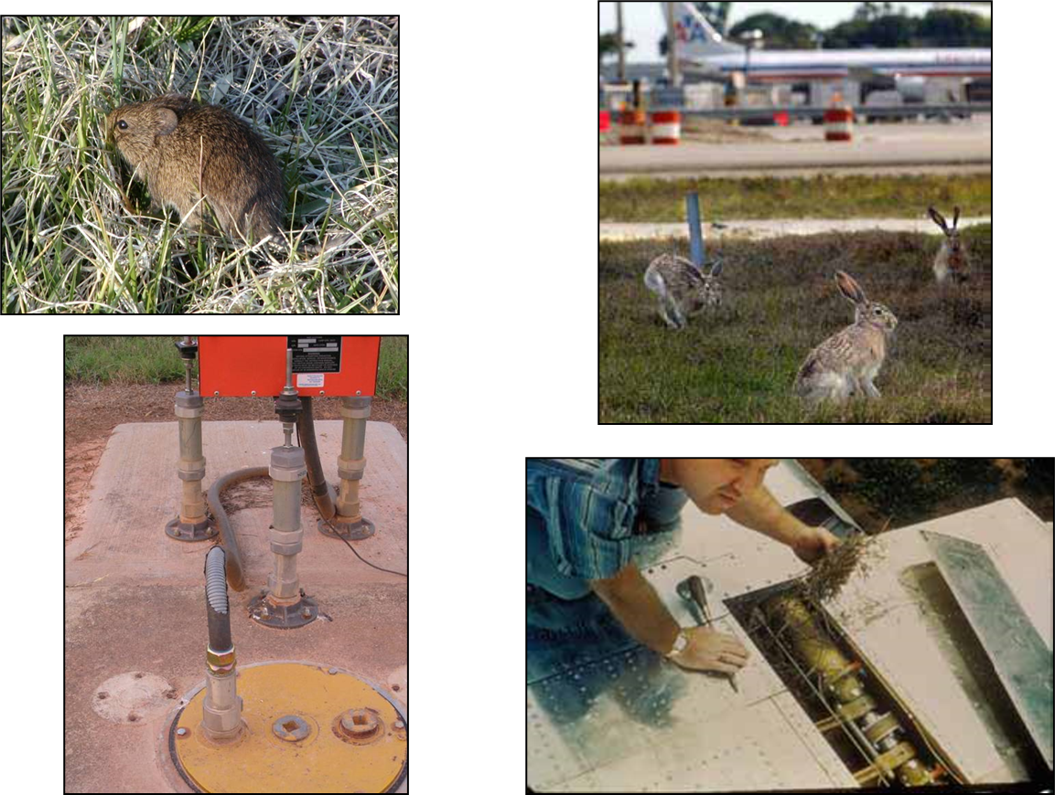
Indirect Hazards

Slide 13
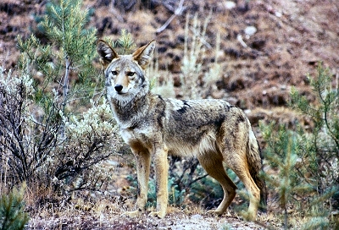
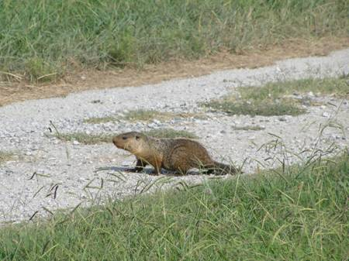
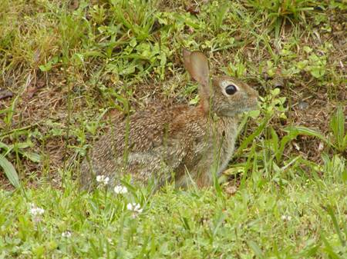
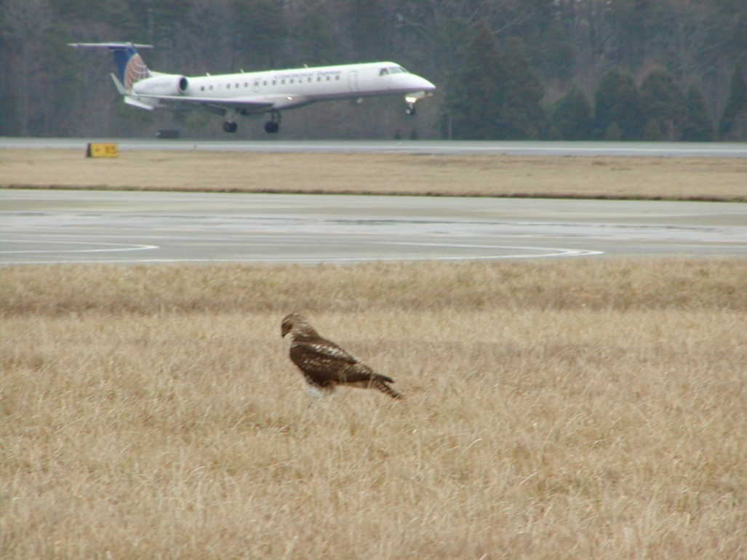
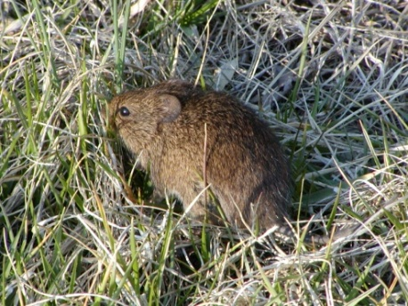
Predator / Prey Relationships
Determine a relationship of why a species is here……What is the attractant ? What is their food source ?
Notes:
12. Predator / prey attractants (rodents, insects, earthworms can attract hazardous bird species)

Slide 14
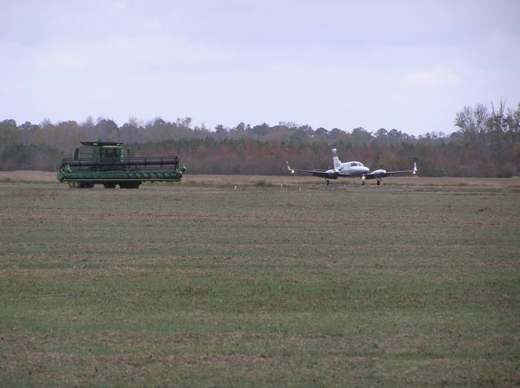
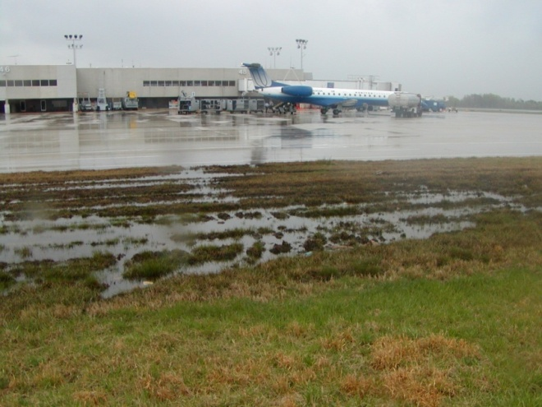
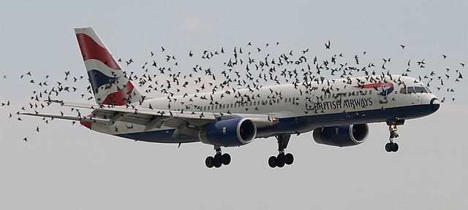
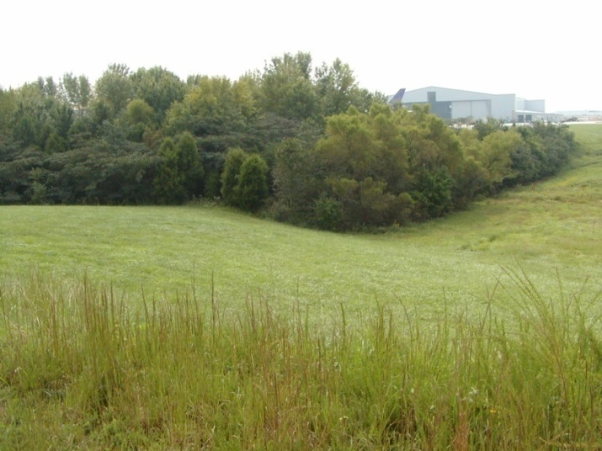
Wildlife Use of Airports
Food
Water
Cover
Travel Corridor
Notes:
8. Wildlife use of airports: food, water, cover, travel corridor

Slide 15
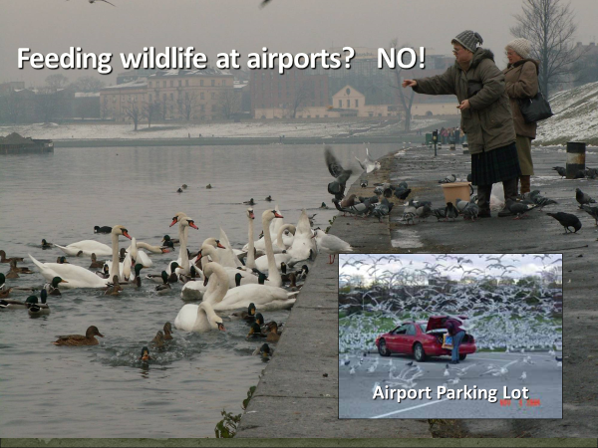

Slide 16
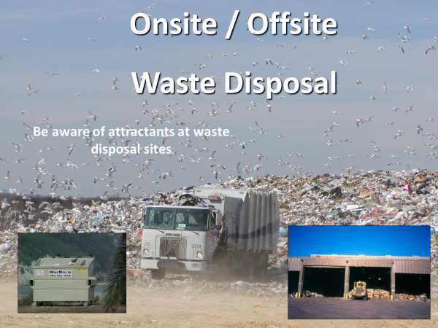

Slide 17
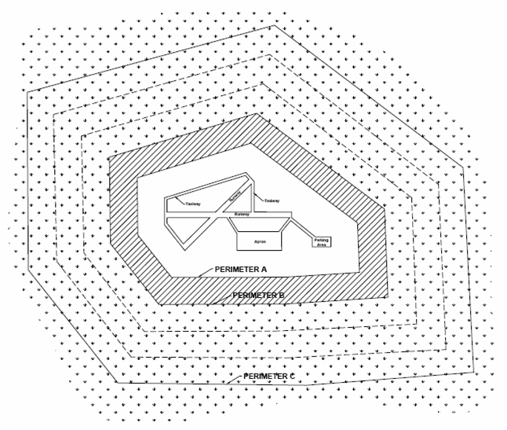
Wildlife Hazard Separation Distances
Separation distances from which hazardous wildlife attractants should be avoided, eliminated or mitigated.
Perimeter A: airports with piston powered aircraft, hazardous wildlife attractants must be 5,000 feet from AOA
Perimeter B: airports with turbine-powered aircraft, hazardous wildlife attractants must be 10,000 feet from AOA
Perimeter C: 5 mile range to protect departure, approach and circling aircraft
Notes:
16. Wildlife hazard separation distances

Slide 18
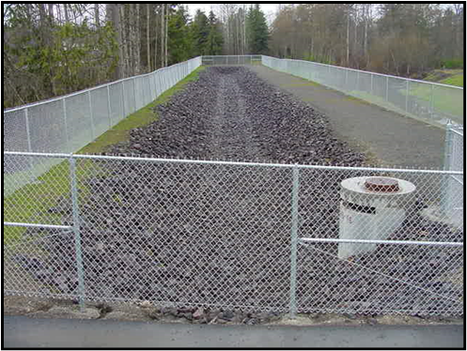
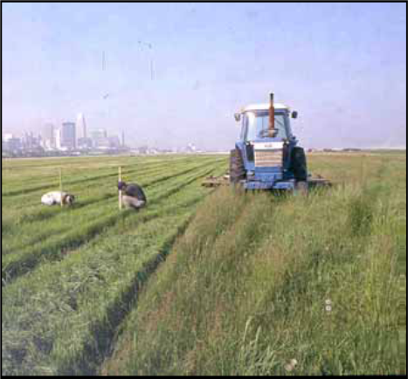
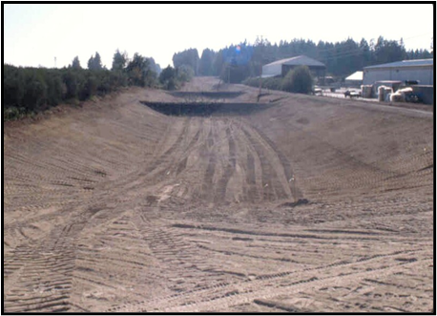
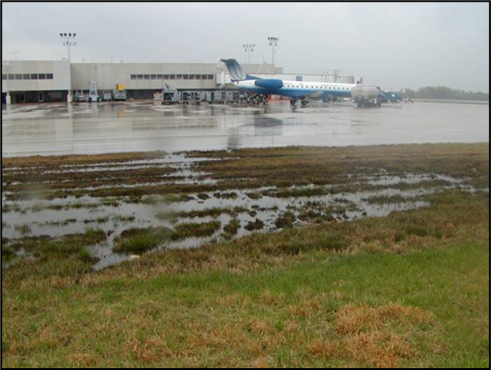
Damage Prevention and Control Methods
HERL
Habitat modification
Exclusion
Repellents
Lethal control

Slide 19
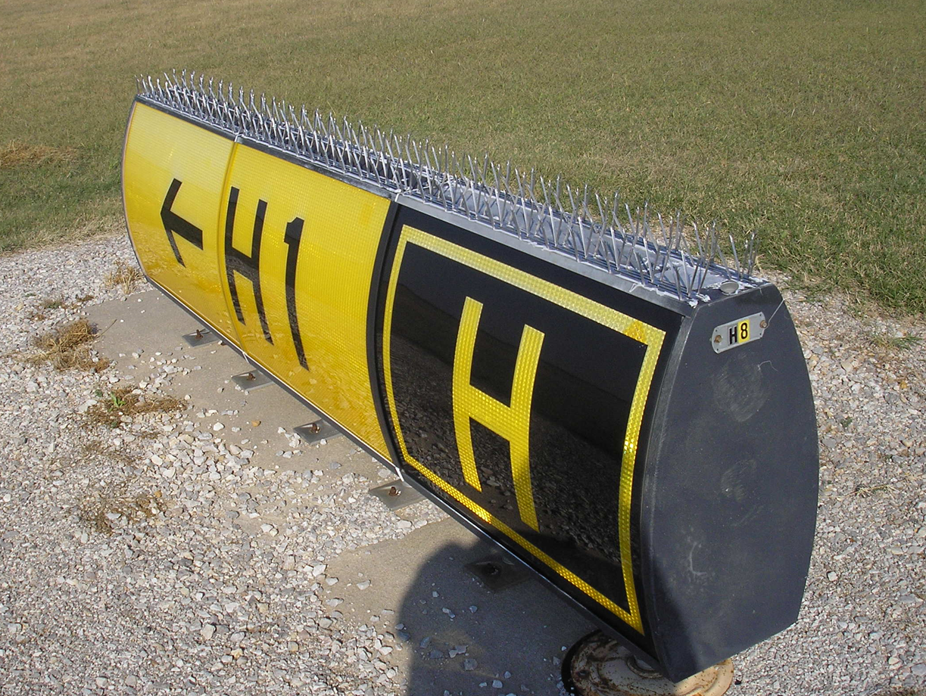
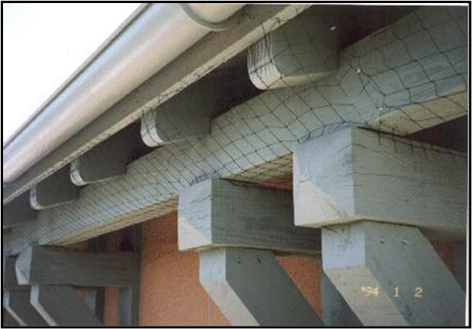
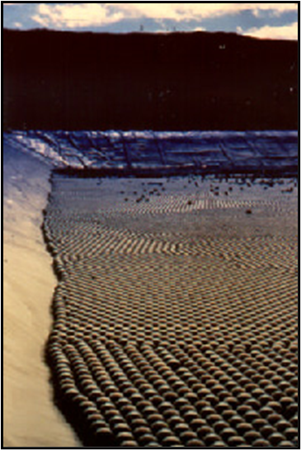
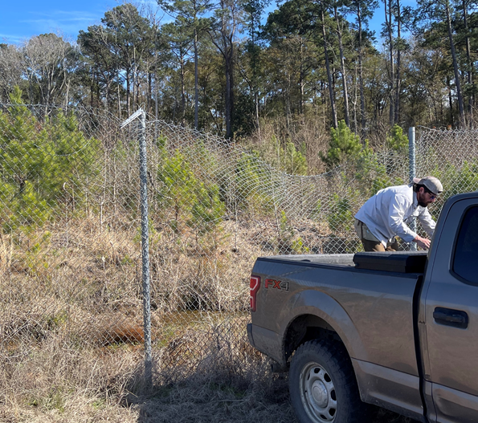
Damage Prevention and Control Methods
HERL
Habitat modification
Exclusion
Repellents
Lethal control

Slide 20
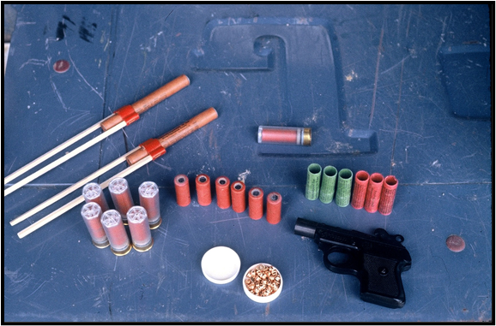
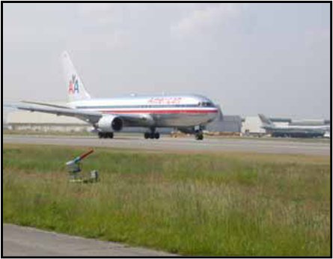
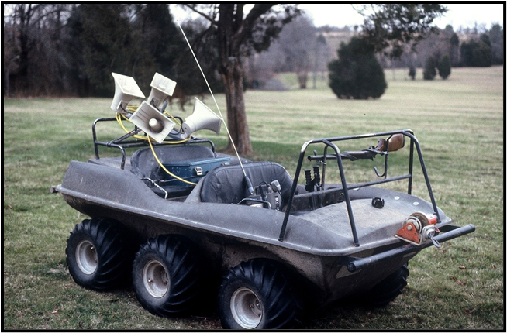
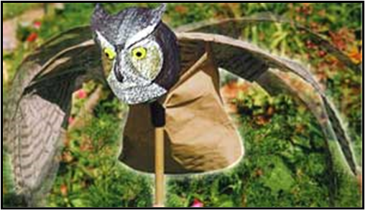
Damage Prevention and Control Methods
HERL
Habitat modification
Exclusion
Repellents
Lethal control

Slide 21
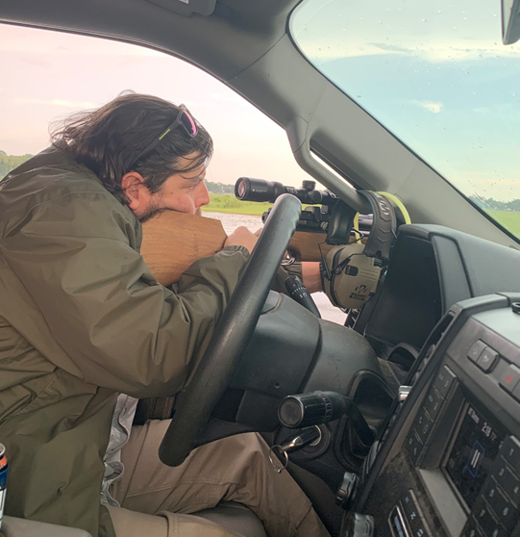
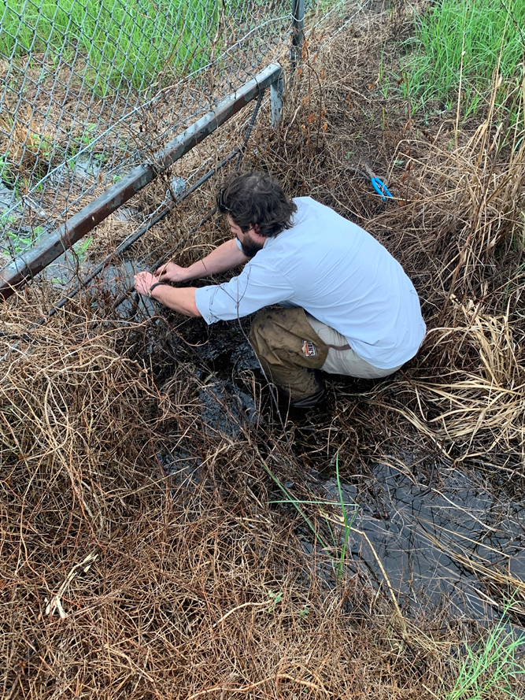
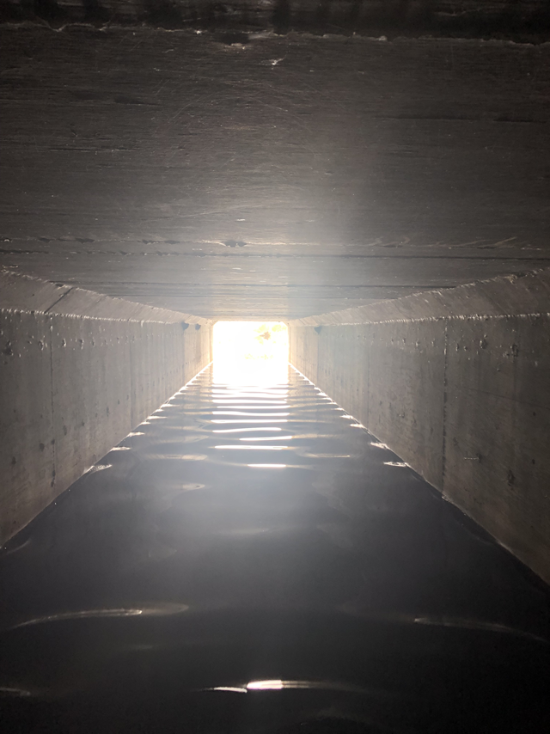
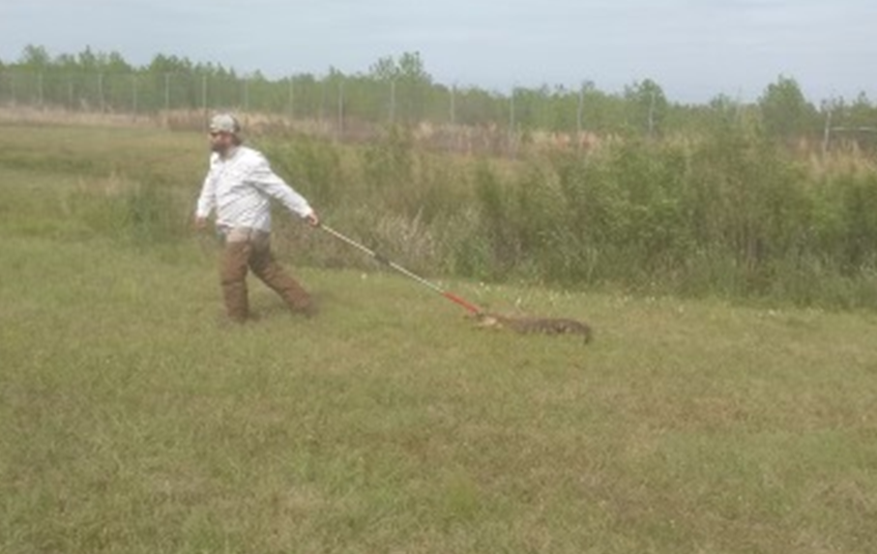
Damage Prevention and Control Methods
HERL
Habitat modification
Exclusion
Repellents
Lethal control

Slide 22
What you can do.
Utilize the HERL method.
Acquire a Form 37 from USDA Wildlife Services.
Apply for a USFWS Migratory Bird Depredation Permit.
Acquire a GA DNR White-tailed deer depredation Permit.
Use Lethal/Non-lethal depredation techniques.

Slide 23
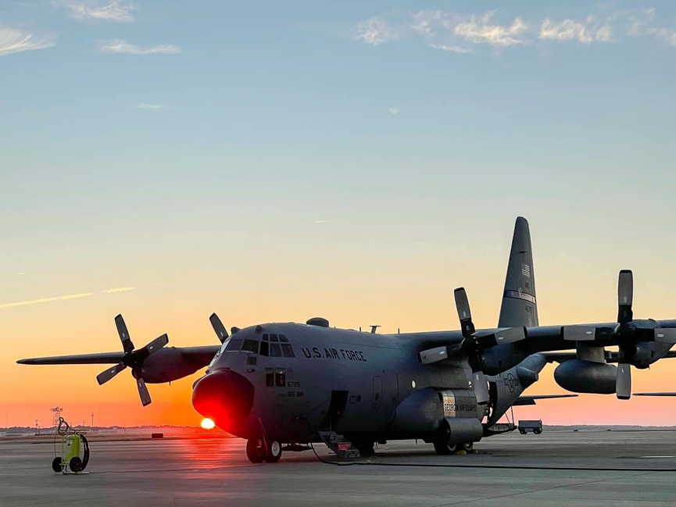
cQuestions/Comments?
Ethan Burke
USDA- Wildlife Biologist
james.e.burke@usda.gov
912-414-1350

