Slide 1
Wildlife Control Permits for Airports
David Mixon
WRD Game Management
Department of Natural Resources

Slide 2
Permits
Primarily deer
GADNR does not provide removal services
Enables airport to take care of own nuisance issues
Do not issue permits for migratory birds

Slide 3
Protocol
Under authority of § 27-2-31(2), the department is authorized to issue wildlife control permits for the control of white-tailed deer on airport property for purposes of public safety.
Airport authorities should submit a letter requesting a Nuisance Wildlife Control Permit, including a map of the boundaries of the airport and a list of up to three employees of the airport authority to serve as agents under the permit.
Regional supervisors should issue a letter authorizing the removal of deer with the following standard conditions.
Authorization letters will be effective for the following one (1) calendar year, and should state an expiration date in the letter.

Slide 4
Standard Conditions
Permittee and his/her agents must have a copy of the letter of authorization in their possession when deer removals are being conducted. Only those individuals listed in the letter of authorization may conduct removal activities. Such individuals must be employees of the airport authority.
Deer are to be lethally removed with the use of firearms.
Any firearm legal for deer hunting as listed in the current hunting regulations may be used. The use of vehicles and lights, and shooting hours are not restricted. The removal of deer is not authorized during May, June, and July (except by approval of Game Management Section regional supervisor).
Permittee must maintain complete records of all deer removed, number and sex. These records must be kept by permittee and be available for inspection by DNR upon request. Upon expiration of this permit, a summary of the number and sex of deer removed must be mailed to the address on the letter of authorization.

Slide 5
Standard conditions (cont.)
5. Deer carcasses must be transmitted to a family (household) with income below the federal poverty level; to disabled or senior citizens; or transmitted to a civic group, public agency, or charitable group for distribution to families with income below the federal poverty level or disabled or senior citizens or given to a local correctional facility. Spoiled deer must be disposed of using standard sanitary procedures.
6. This permit shall expire at midnight December 31st of the current calendar year.
7. In no event shall attempts to locate or shoot deer from a public road be authorized.
8. Violation of any terms and conditions of this permit shall invalidate said permit, and deer killed under authority of said permit may be considered taken in violation of §27-2-31.
9. Control activities are limited to within the boundaries of the airport as designated on the attached map.

Slide 6
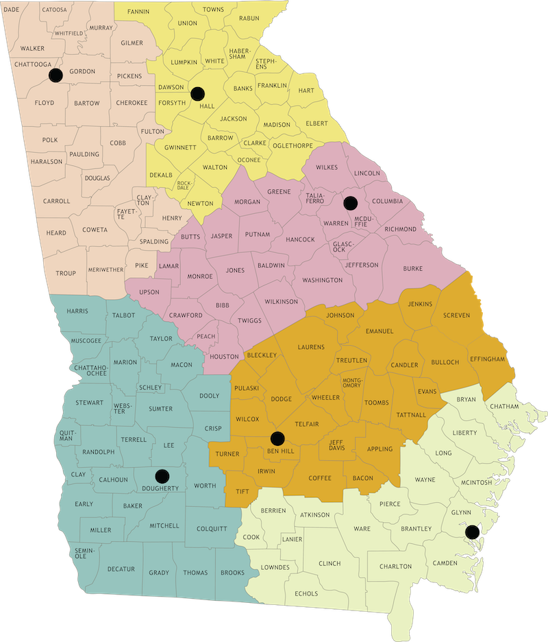
Region Contacts
Region 2 770-535-5700 2150 Dawsonville Highway Gainesville, GA 30501
Region 1 706-295-6041 2650 Floyd Springs Road Armuchee, GA 30105
Region 3 706-595-4222 142 Bob Kirk Road NW Thomson, GA 30824
Region 4 229-426-5267 1773-A Bowens Mill HWY Fitzgerald, GA 31750
Region 5 229-430-4254 2024 Newton Road Albany, GA 31701
Region 6 912-262-3173 1 Conservation Way Brunswick, GA 31520

Slide 7
Questions?
www.georgiawildlife.com
Department of Natural Resources

