Slide 1
Planning A Community Event at Your Airport
You’ve invited the general public to the airport…
What do you do now?

Slide 2
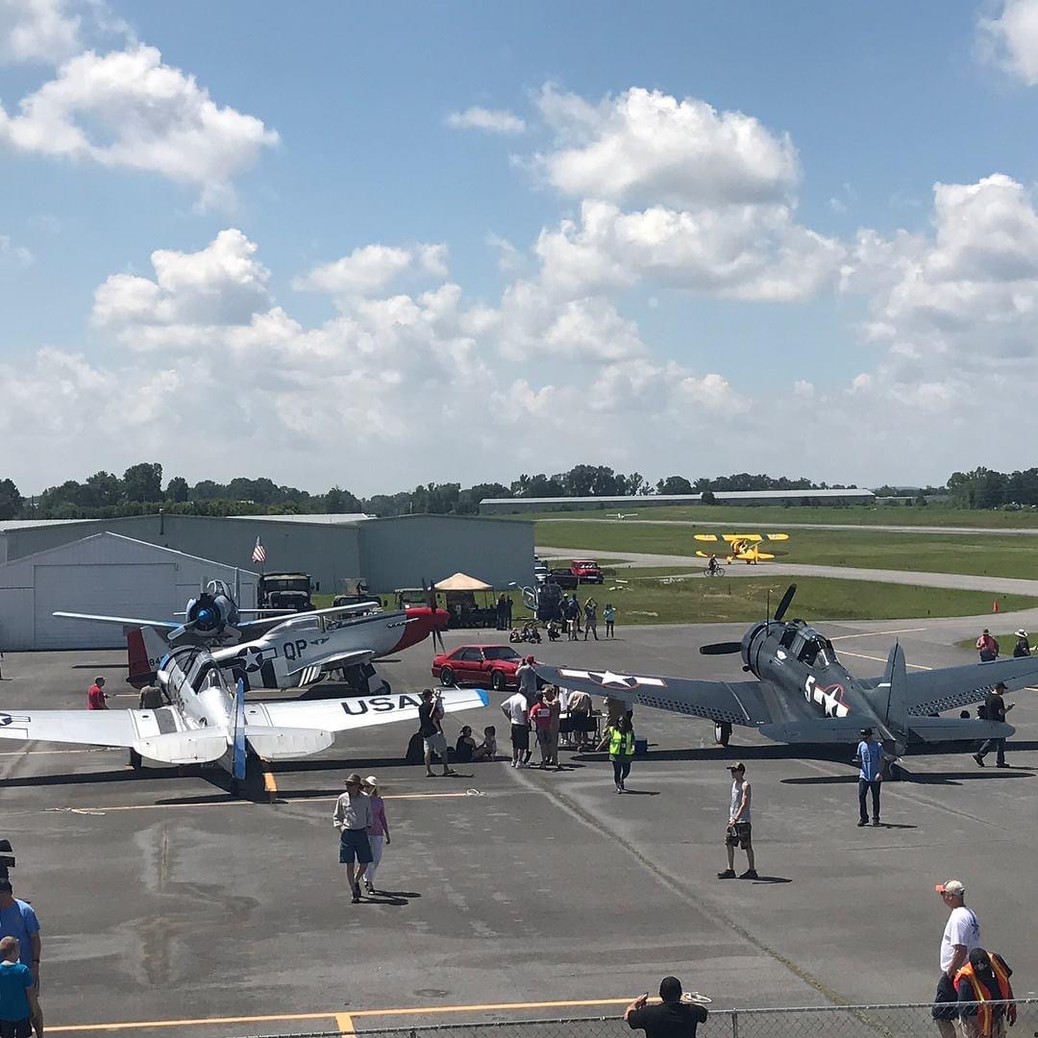
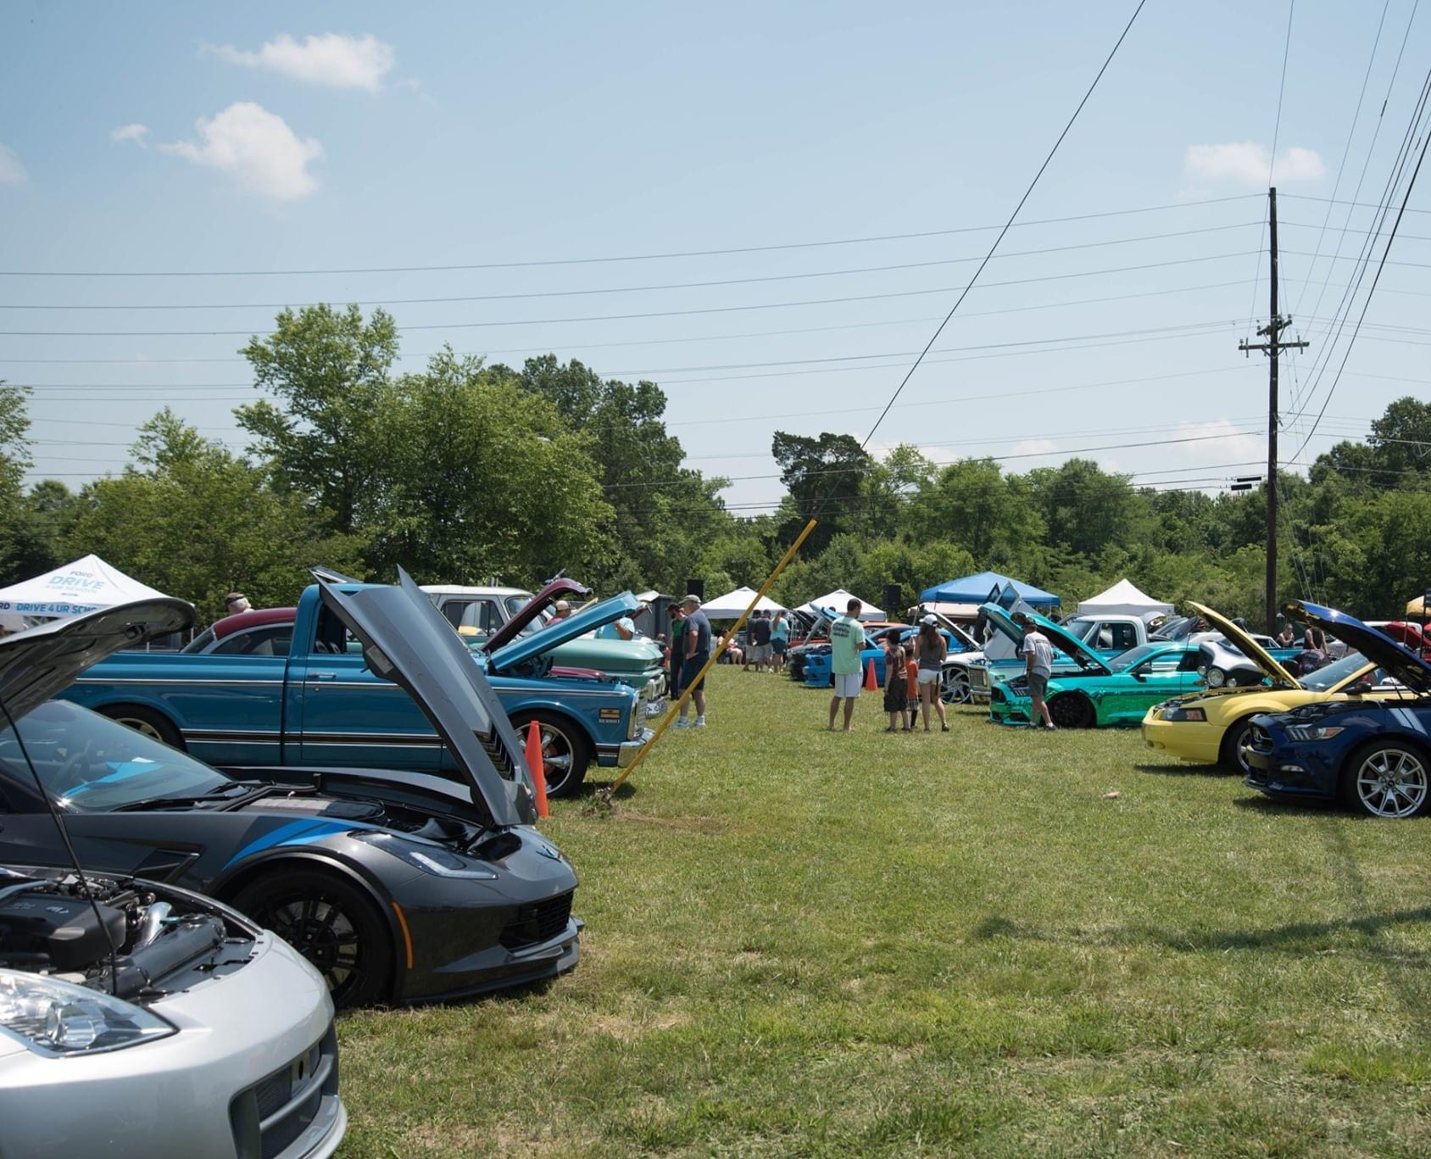
So, do you think you are ready for this?

Slide 3
What are we going to talk about today?
The team at CZL (Tom B. David Airport - Calhoun, GA) has been planning and operating community events at the airport for over 20 years now.
CZL typically hosts two major events a year, that are enjoyed by our aviation friends, tenants and the general public.
We would like to share some of our thoughts and experience on airport event planning with you.
We will also share the detailed event planning checklist we have developed.
We hope this will give you a jump start on hosting your own event.

Slide 4
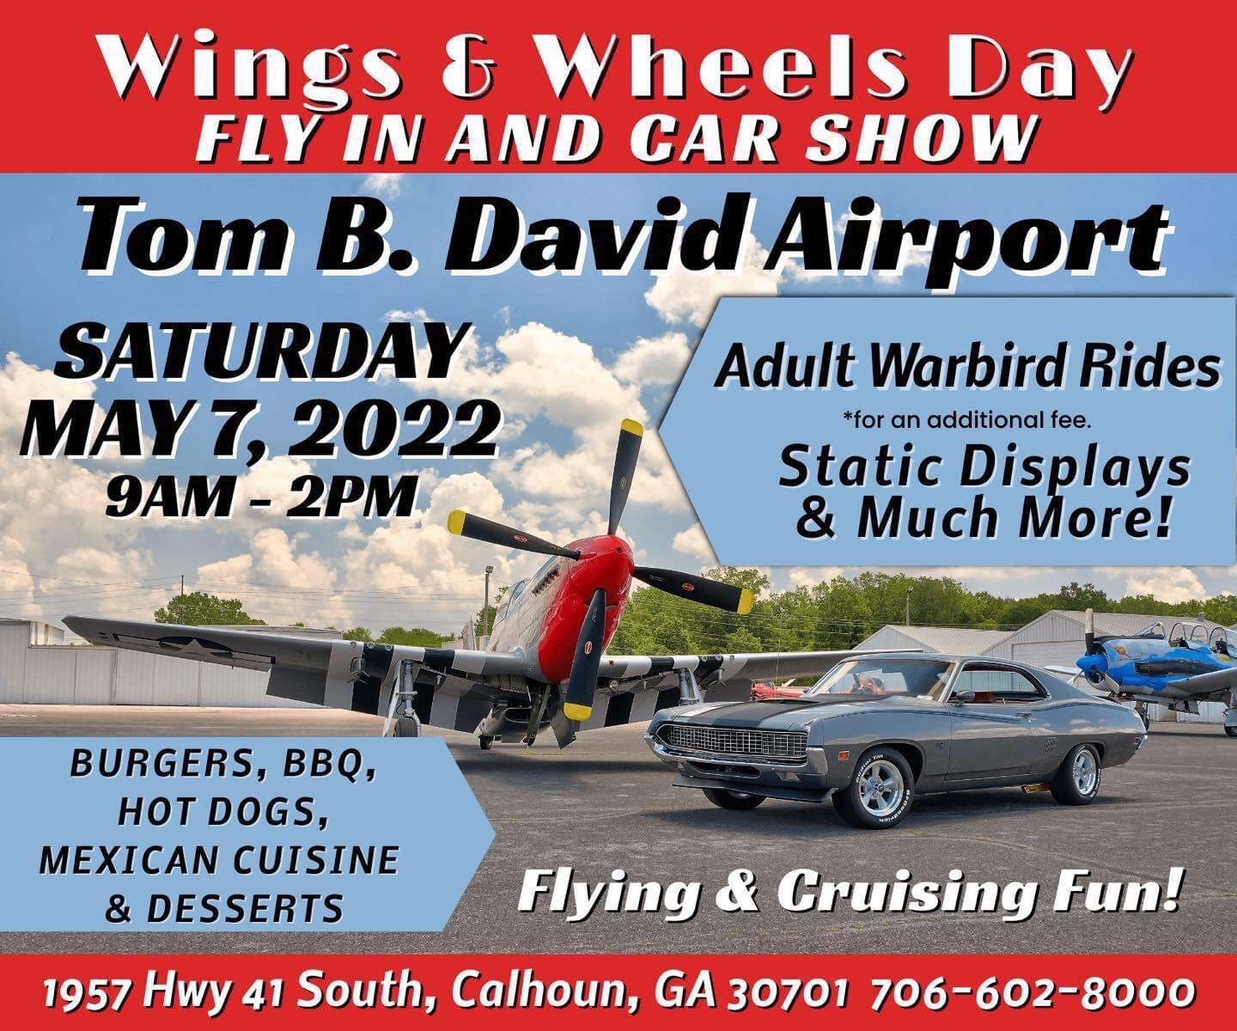
Early Planning: what type of event will it be?
Advertised, general-public event
Fly-in
Carshow
Open House / Good Neighbor Day
Charity / benefit event
Pilot’s fly-in
Competition

Slide 5
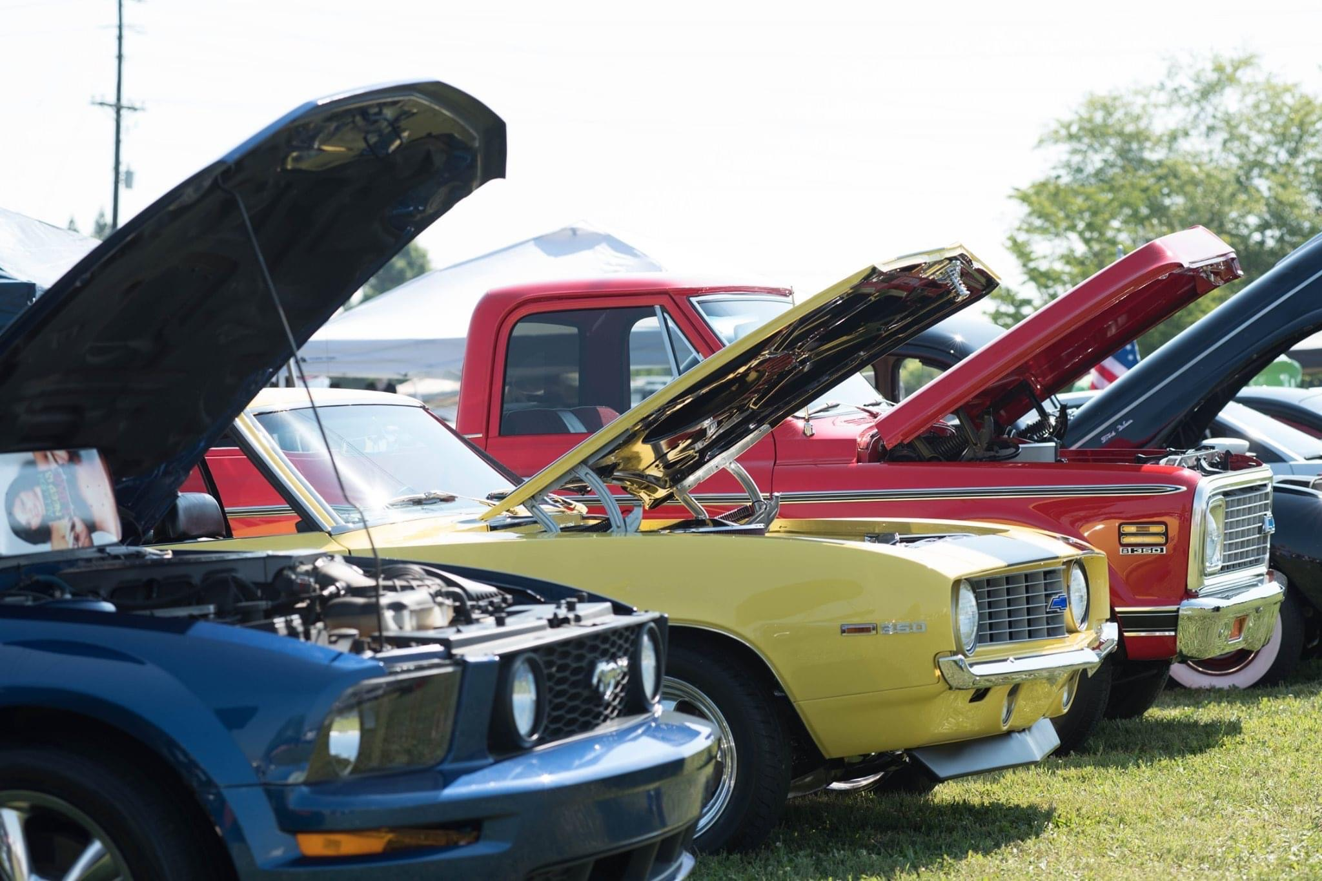
Setting a Date
Seasonal weather considerations
Research for conflicting events
Social flight
Facebook Groups
Other events within 100 miles

Slide 6
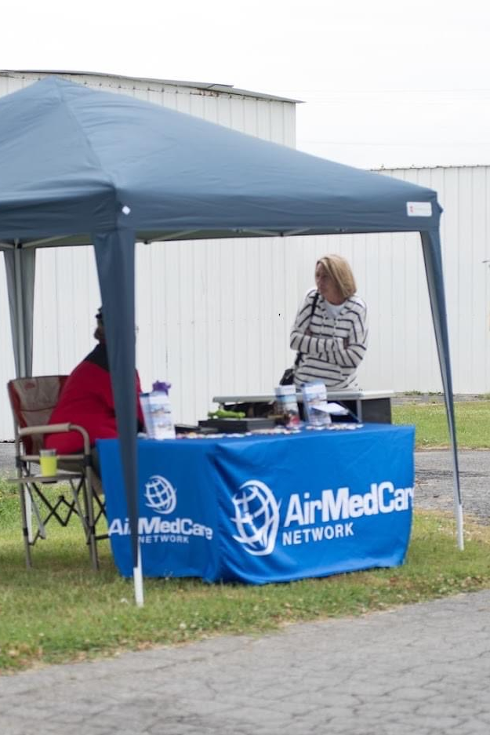
Sponsors?
Public events can get expensive quickly. Local businesses are great sponsors!
Sponsorship money can help cover the costs of:
Advertising
Volunteer meals
Prizes for competitions
Sanitation services (trash cans, dumpsters, etc.)
Temporary restroom rental
Signs and banners
Table and chair rental

Slide 7
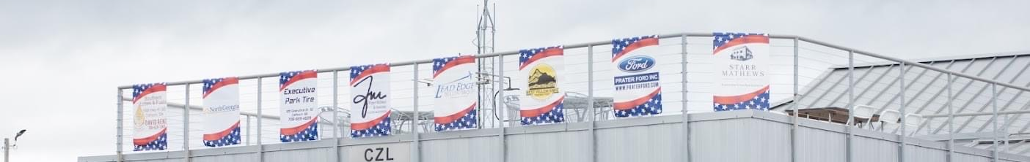
Securing Sponsors
Consider setting up sponsorship tiers.
Contact local businesses or vendors you have worked with in the past.
Involve the local chamber of commerce and visitors bureau.
Send an email then follow up with phone call or visit in person.
This event will be a great day for your community! You should be proud to present it as such. Don’t be nervous or afraid to ask.

Slide 8
Examples of Sponsorship Tiers:
Platinum: $2,500+ | Corporate name included in the event name; prominent corporate banner at event entrance; booth and/or banner located in vendor area; logo on event t-shirt and all media advertising; both scenic helicopter and open cockpit biplane rides.
Gold Level: $1,000+ | Prominent corporate banner at event entrance; booth and/or banner located in vendor area; logo on event t-shirt and all media advertising; scenic ride in your choice of helicopter or open cockpit biplane.
Silver Level: $500+ | Booth and/or banner located in vendor area; logo on event t-shirt and all media advertising; scenic helicopter ride.
Bronze Level: $250+ | Logo on event t-shirt and all media advertising

Slide 9
Tom B. David Airport
1957 Hwy 41 SW
Calhoun, GA 30701
706-602-8000 Phone
706-602-8001 Fax
2022 Calhoun Wings & Wheels Day
Air Show/Car Show, May 7, 2022 | 9am-2pm
Sponsorship Form
Company Name: ________________________________________________________
Contact Person: ________________________________________________________
Company Address: ______________________________________________________
Contact Phone #: _______________________________________________________
Contact Email: _________________________________________________________
Sponsorship Amount: $______________ Payable to Tom B. David Airport
Platinum: $2500+ Corporate name included in the event name; prominent corporate banner at event entrance; booth and/or banner located in vendor area; logo on all media advertising; both scenic helicopter and open cockpit biplane rides.
Gold Level: $1000+ Prominent corporate banner at event entrance; booth and/or banner located in vendor area; logo on all media advertising; scenic ride in your choice of helicopter or open cockpit biplane.
Silver Level: $500 + Booth and/or banner located in vendor area; logo on all media advertising; scenic helicopter ride.
Bronze Level: $250+ Logo on all media advertising
PLEASE EMAIL THIS FORM AND INCLUDE A HIGH RESOLUTION COPY OF YOUR COMPANY LOGO (.pdf or .psd format, with each color on separate layers) ON OR BEFORE April 15, 2022
TO: janet@calhounairport.com
PLEASE MAIL PAYMENT OR BRING TO AIRPORT BY April 15, 2022 TO:
Tom B. David Airport
1957 Hwy 41 South
Calhoun, GA 30701
Thank you for your support!!

Slide 10
Volunteers: you can NEVER have too many!
Begin soliciting for volunteers at least 1 month prior to the event date.
Send a direct appeal to all your airport tenants/friends via email.
Use any other social media groups you have a presence on also.
Follow up weekly until the final week before the event.
Send out reminders the day before the event setup/work day and the day before the actual event date.
Provide free meals, snacks and drinks for your volunteers.

Slide 11
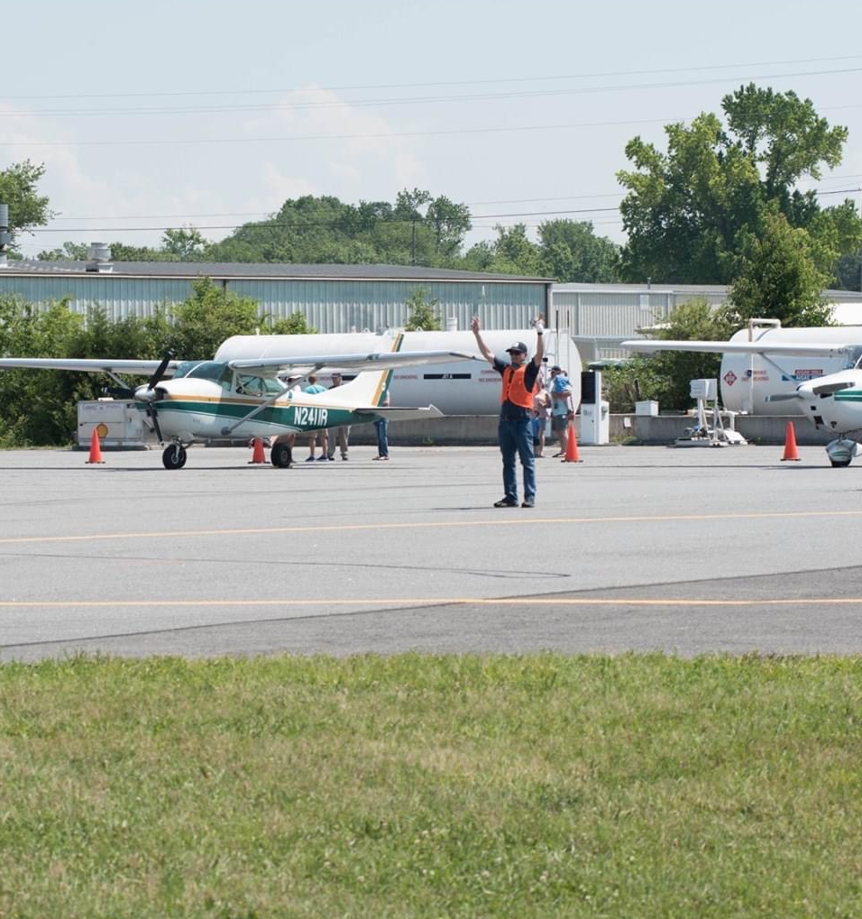
Volunteer Positions
Air boss
Auto parking chairman
Aircraft parking chairman
Competition chairman
Aircraft parking volunteers
Auto parking volunteers
Competition volunteers
Fuel attendants
Event set up
Event tear town and cleanup

Slide 12
Tom B. David Airport
Calhoun-Gordon County Airport Authority
1957 Hwy 41 SW
Calhoun, GA 30701
706-602-8000 Phone
706-602-8001 Fax
Hello CZL friends,
It’s Fly in and Car Show time again!
Mohawk Presents Wings and Wheels Day
Saturday May 7th will be Wings and Wheels Day Fly-In and Car Show.
We will be having all of our usual Fly – In activities and fun.
Additionally: The Museum of Flight, The Commemorative Air Force, Tiger Flight and many others will be joining us with Warbird and military equipment displays and demonstrations.
We have multiple food trucks and vendors booked to provide a variety of lunch and treats for everyone.
We are planning for this to be our largest and best event ever at CZl.
To make it happen we need YOUR HELP!
We are asking for all the volunteer help we can get. We need all the help we can get for setup on Friday the 6th and the event on Saturday the 7th.
Whether you can volunteer for either day for a few minutes or all day it will be needed and greatly appreciated.
Also, please help us to increase the number of display aircraft and attractions for the local kids and parents to enjoy by getting your aircraft out of the hangar and on display.
As an incentive: we will offer a 50 cent per gallon fuel discount to anyone who has their aircraft on display on Saturday.
We hope you all will join us in showing the local people the best of aviation.
Thanks in advance for the help.
Calhoun Airport Staff

Slide 13
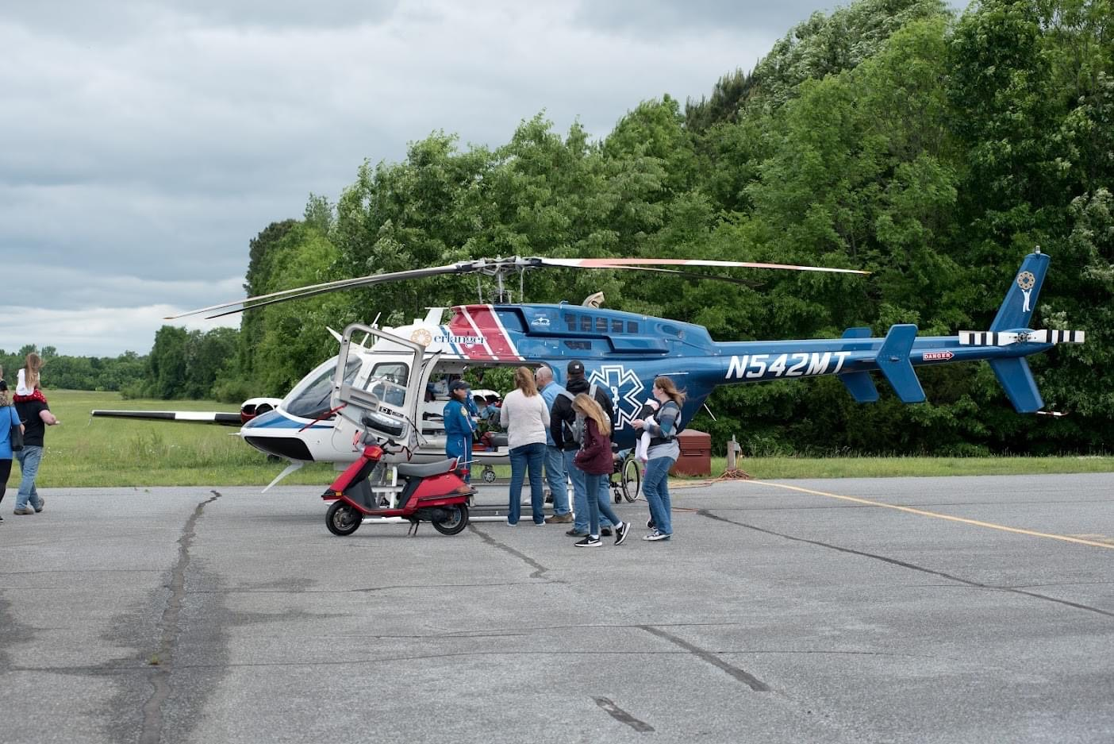

Slide 14
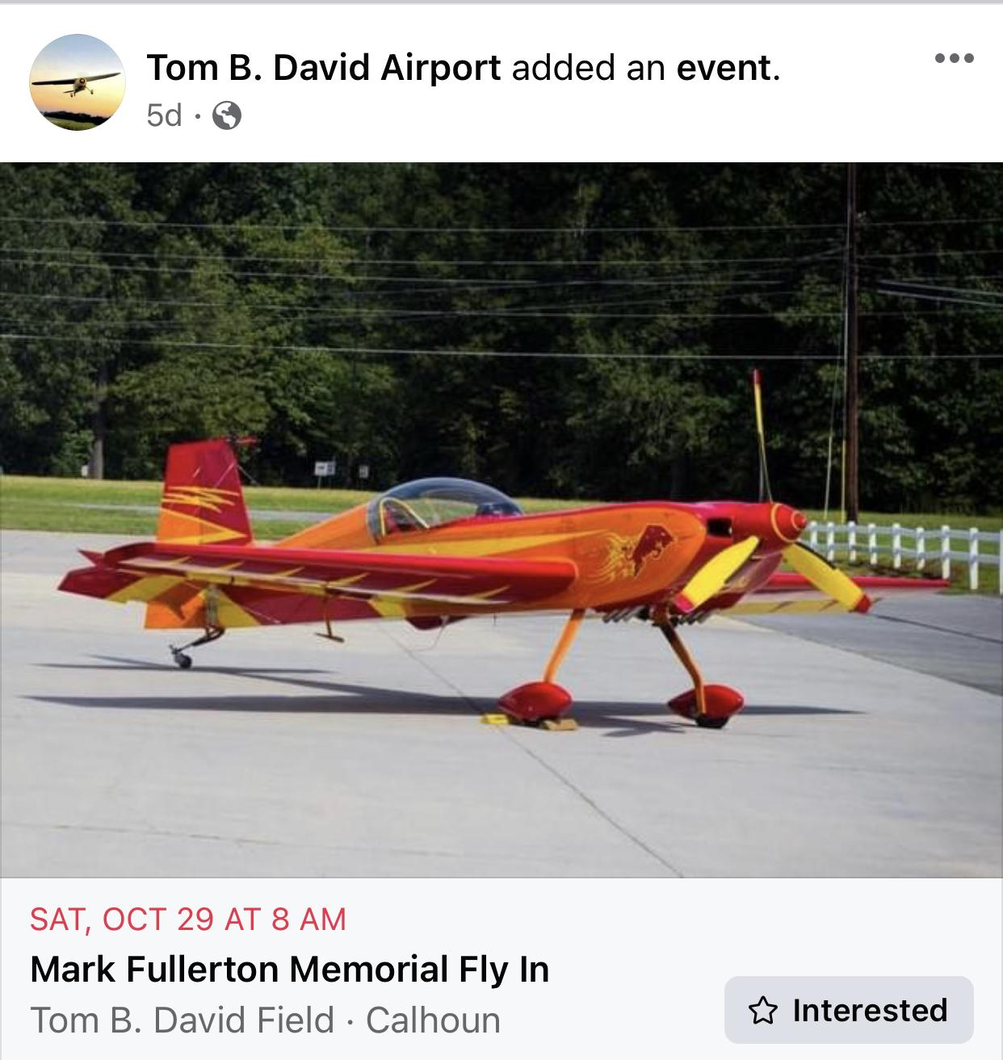
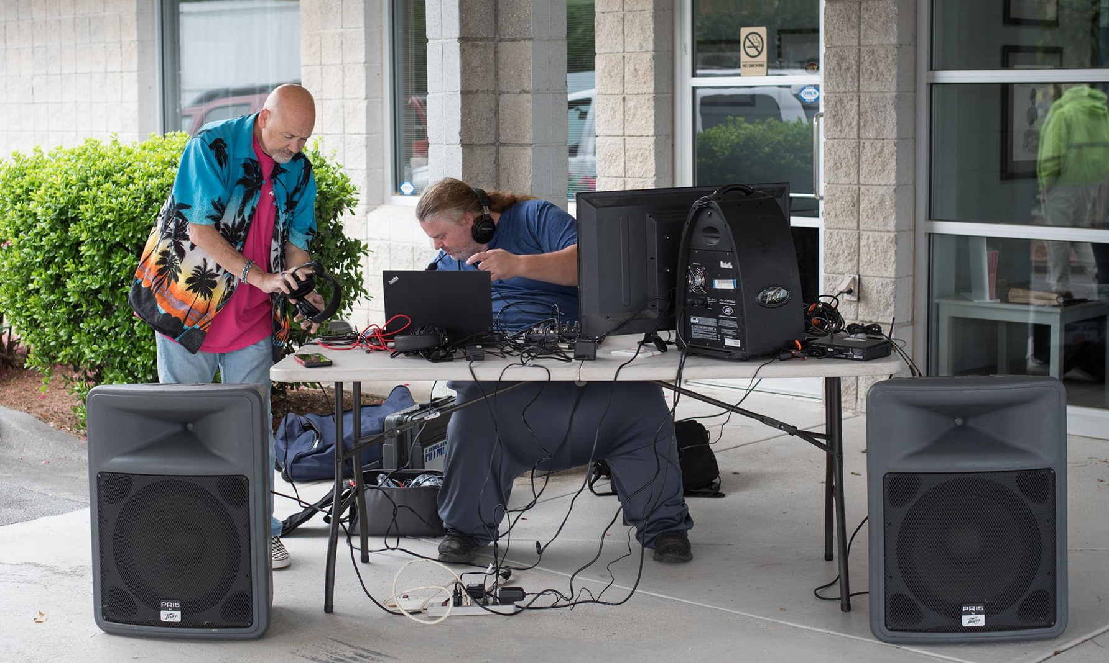
Getting the Word Out
Social flight
Social media
  Facebook events and groups
  Boost a post or post an ad
Tenant and friends email list
Direct mail flyers to area airports
Flyers to local schools
Local chamber of commerce
Local radio and newspaper outlets

Slide 15


Slide 16
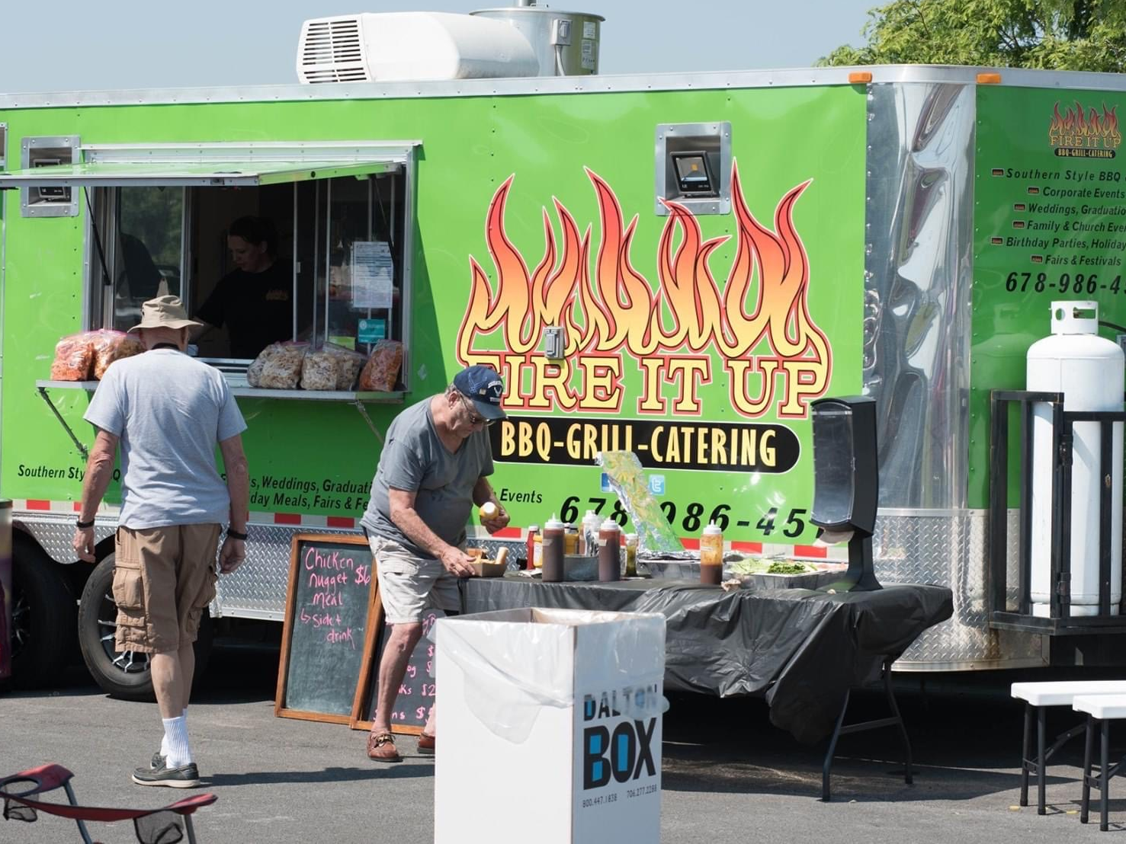
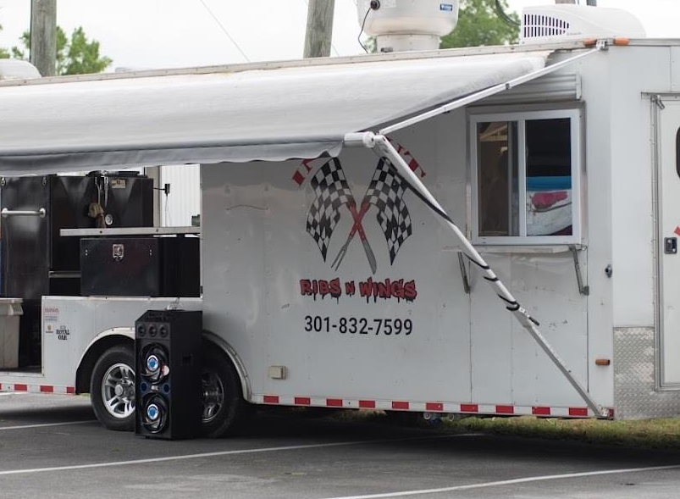
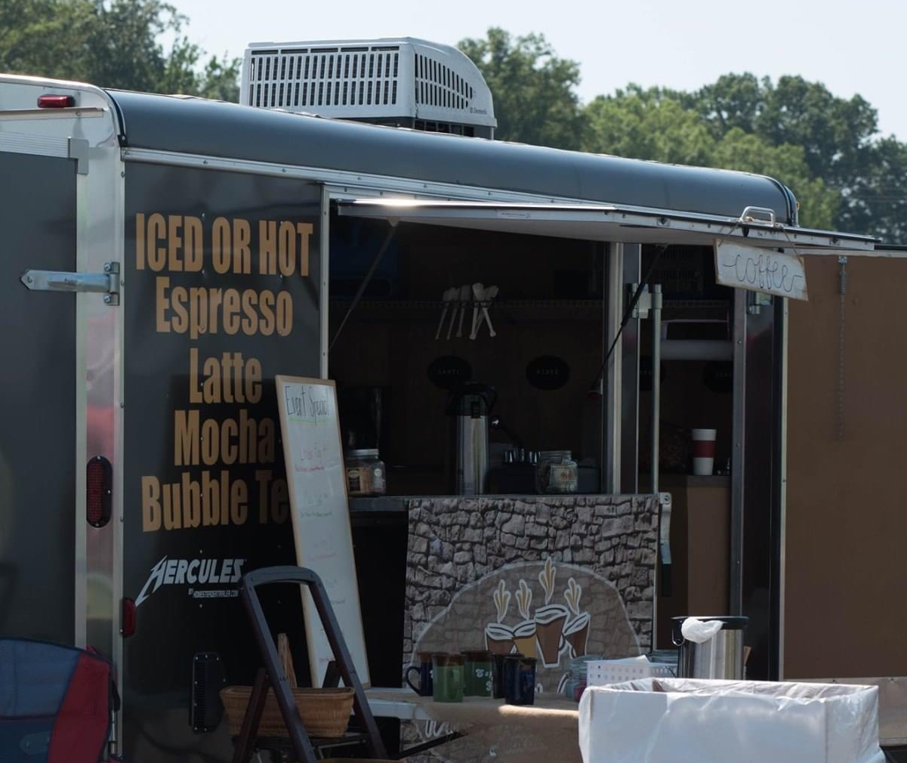
Food: Yes, you’re going to need to feed them.
Need several options: main courses, desserts, drinks, snacks, etc.
Consider setting up a central “food court” area
Option: charge for vendors to participate

Slide 17
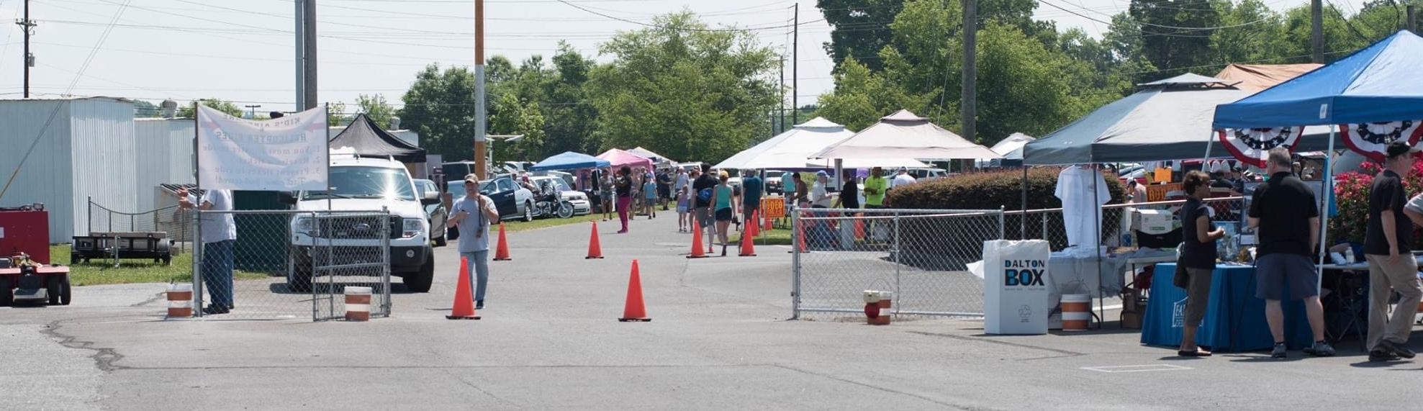
Vendors & Sponsors Display Area
Set up display area for your sponsors and area for other vendors
Local car and powersports dealers, etc.
Separate, dedicated area just for flight schools

Slide 18
Commemorative/Promotional T-Shirts
Pre-order
Design/color considerations
Display/sales tent during event
Sales personnel
Cash box with change
Card reader

Slide 19
Automobile Parking
Auto parking chairman
Numerous volunteers (teenagers?)
Option: charge for parking/event admission
Money pouches and change for attendants
Parking area well marked with cones/barricades
Handicap parking area
Plenty of signs pointing to various/multiple lots
Reserved area for volunteers/official vehicles
Reflective vests for all volunteers

Slide 20
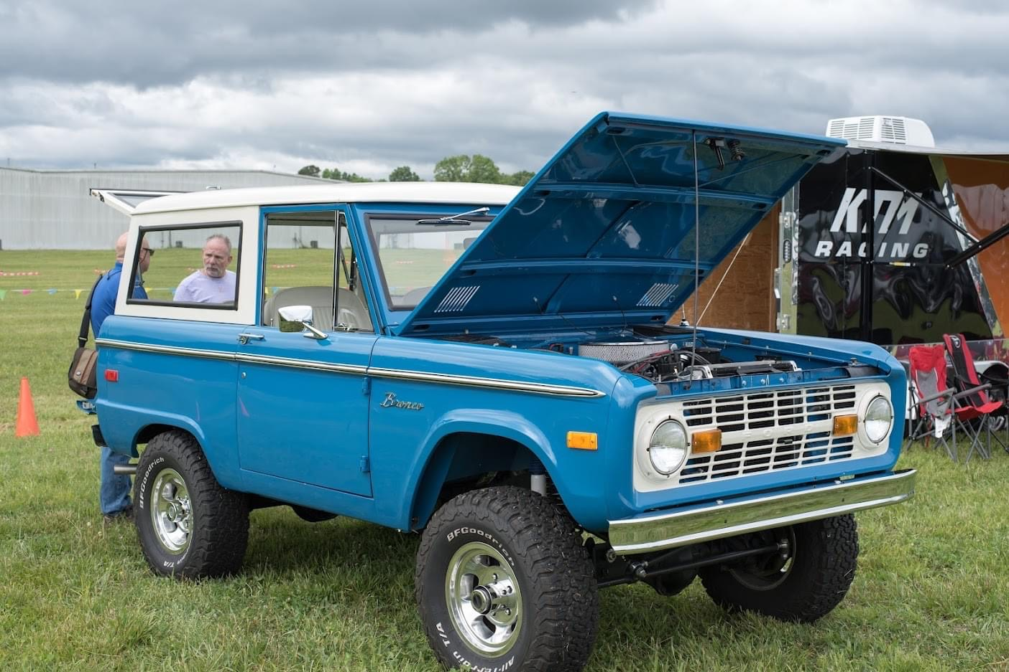

Slide 21
Aircraft Parking
Air boss - super important!
Parking area chairmen, one for each area: North, South, etc.
Plenty of volunteers, preferably pilots or experienced CAP Cadets
Aviation radios tuned to event ground frequency for all volunteers
Establish a ground frequency for the event, and indicate with large, legible signs at taxiway exits. Airboss will advise arriving aircraft to switch to ground frequency.
Option: separate aircraft by type (warbirds, general, taildraggers, etc.)
Reflective vests for all volunteers

Slide 22
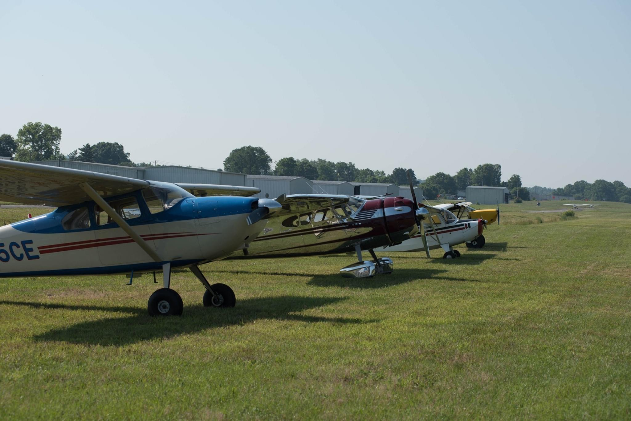

Slide 23
Aircraft Fueling
Plenty of fuel on hand for event – order early
Consider advertised fuel discount for event
Extra fuel service personnel during event
Fuel attendant at self-serve facility – speeds up process
Use cones to segregate fuel service area from aircraft parking area
Set up one way access area for self service fuel area using cones
Prevent traffic jam/chaos near fuel pumps

Slide 24
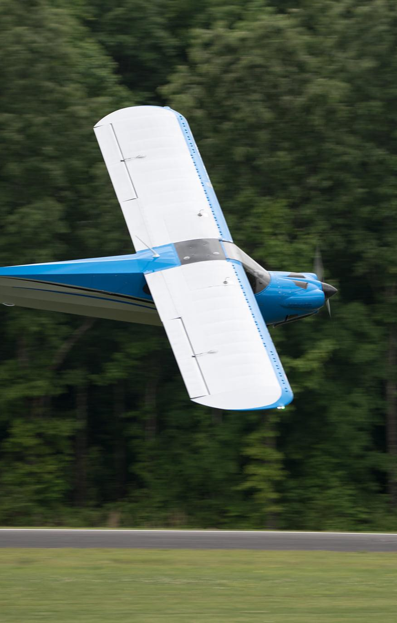
Competitions and Demonstrations
Options: S.T.O.L. Demo, Flour Bombing, Spot Landing
Participant registration information and fees
Hold detailed pilots meeting prior to start of competition
Competition/demonstration chairman - super important!
Seek out someone with experience in this
Lots of volunteers needed for these events

Slide 25
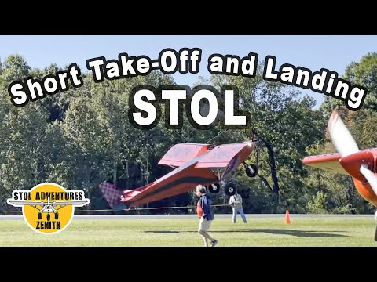

Slide 26
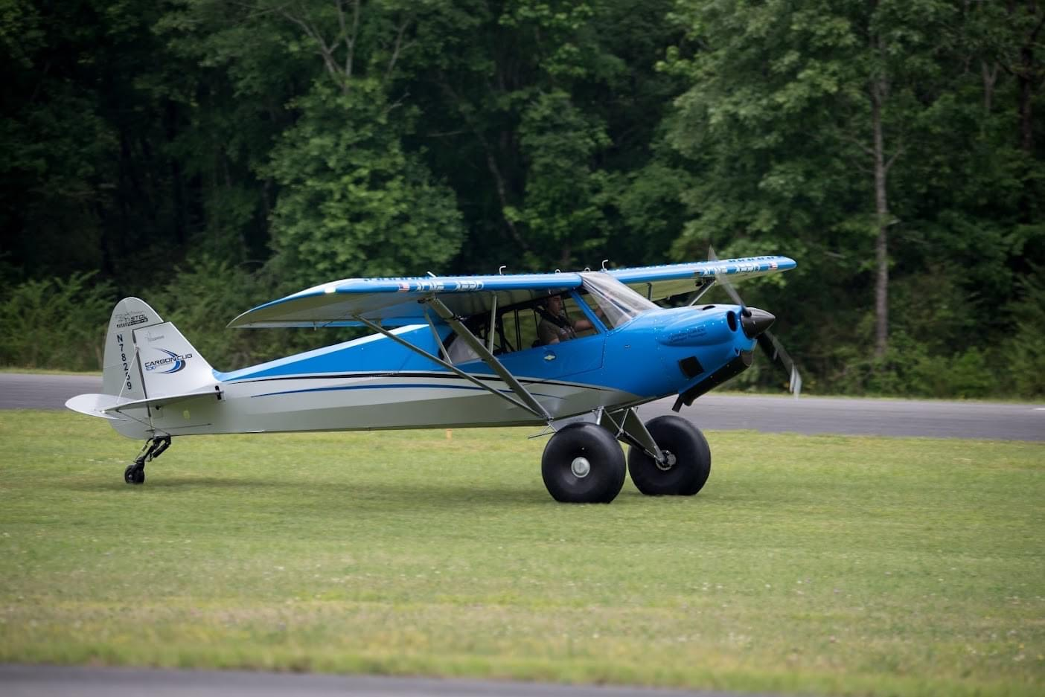
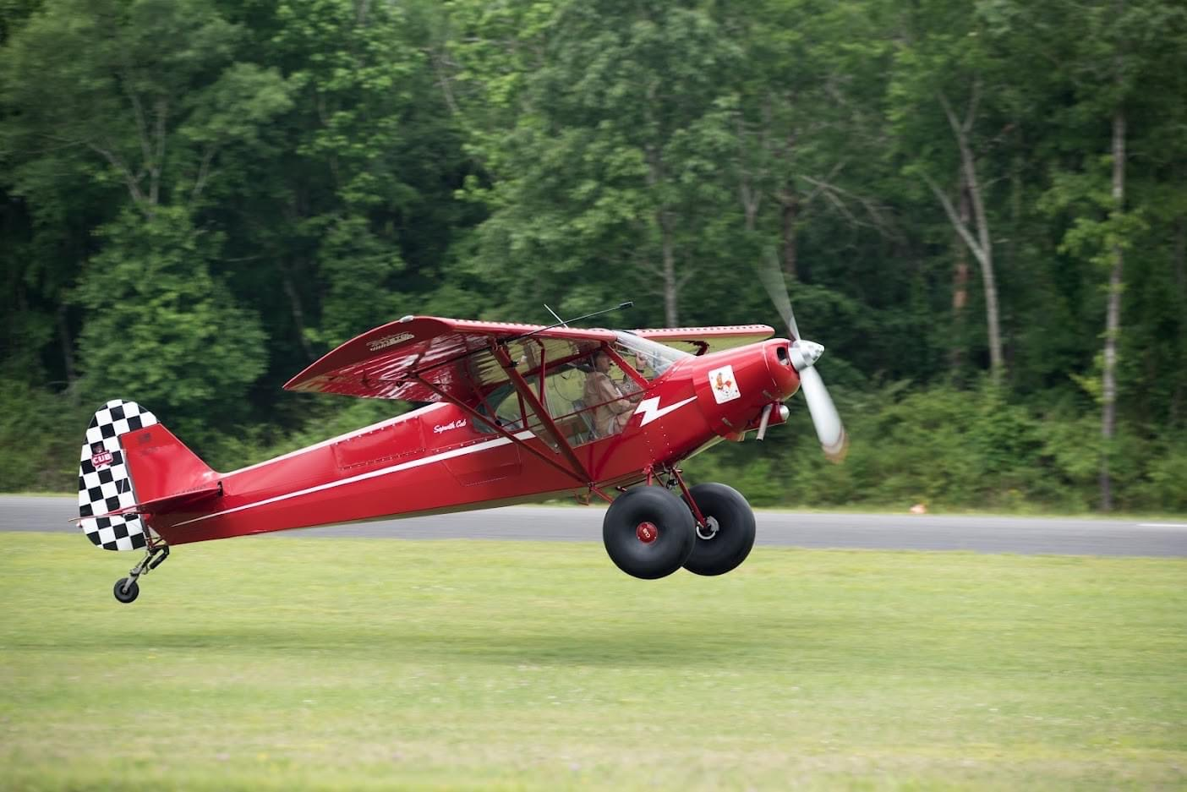
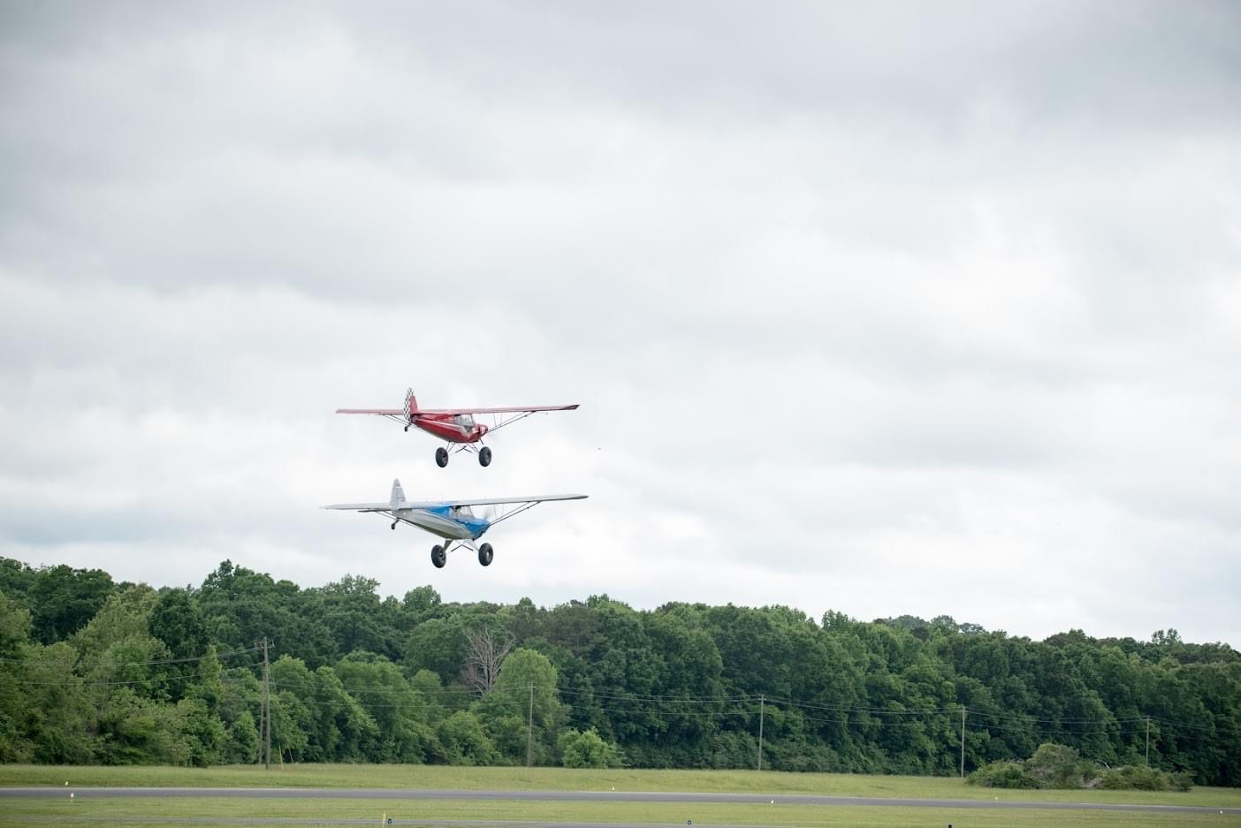
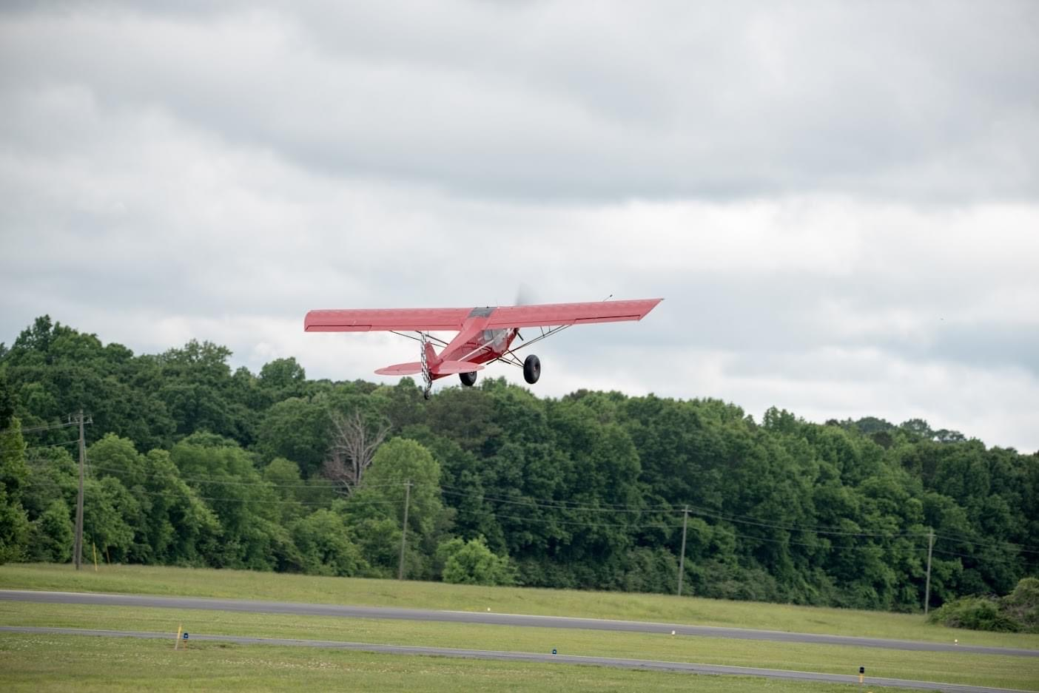

Slide 27
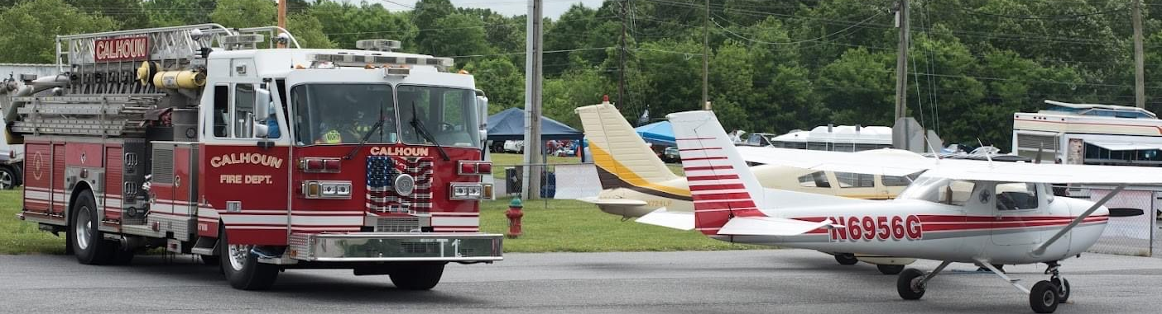
Emergency Service Personnel
Have emergency personnel stationed on the field during event
Fire, EMS and police
Provide free meals, snacks and drinks for service personnel

Slide 28
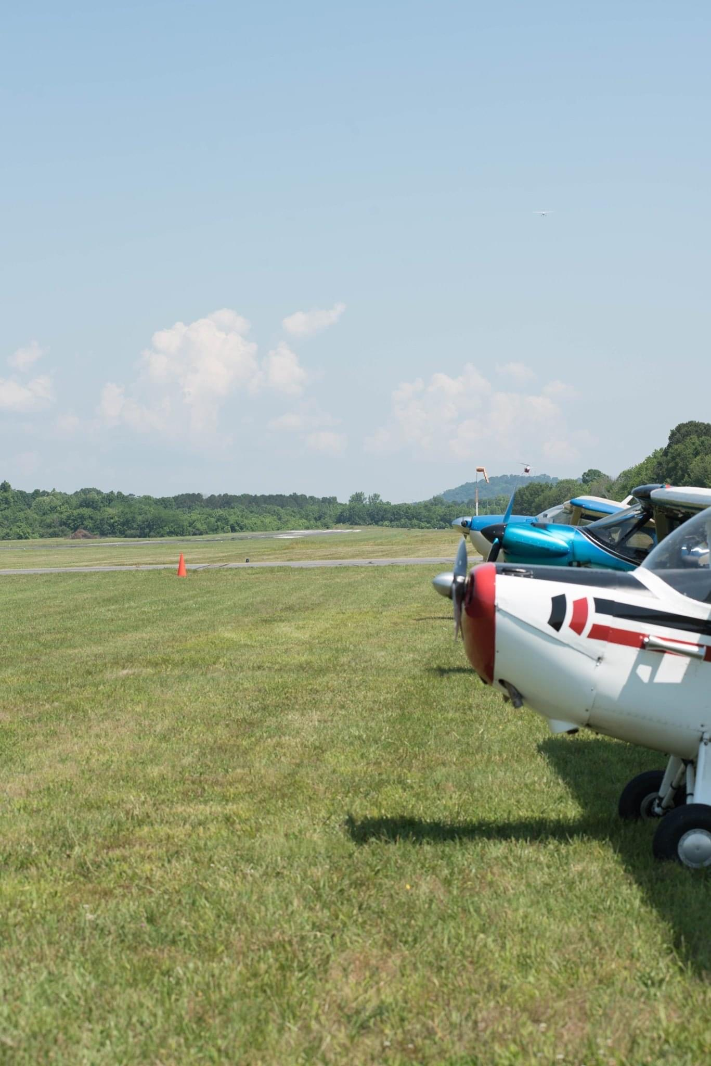
Photography and Videography
Have dedicated photographers and videographers for the event
Invite the local newspaper and television stations to cover the event
Arrange an aircraft ride for the media
Photos/videos will be great for social media, community relations and future advertising

Slide 29
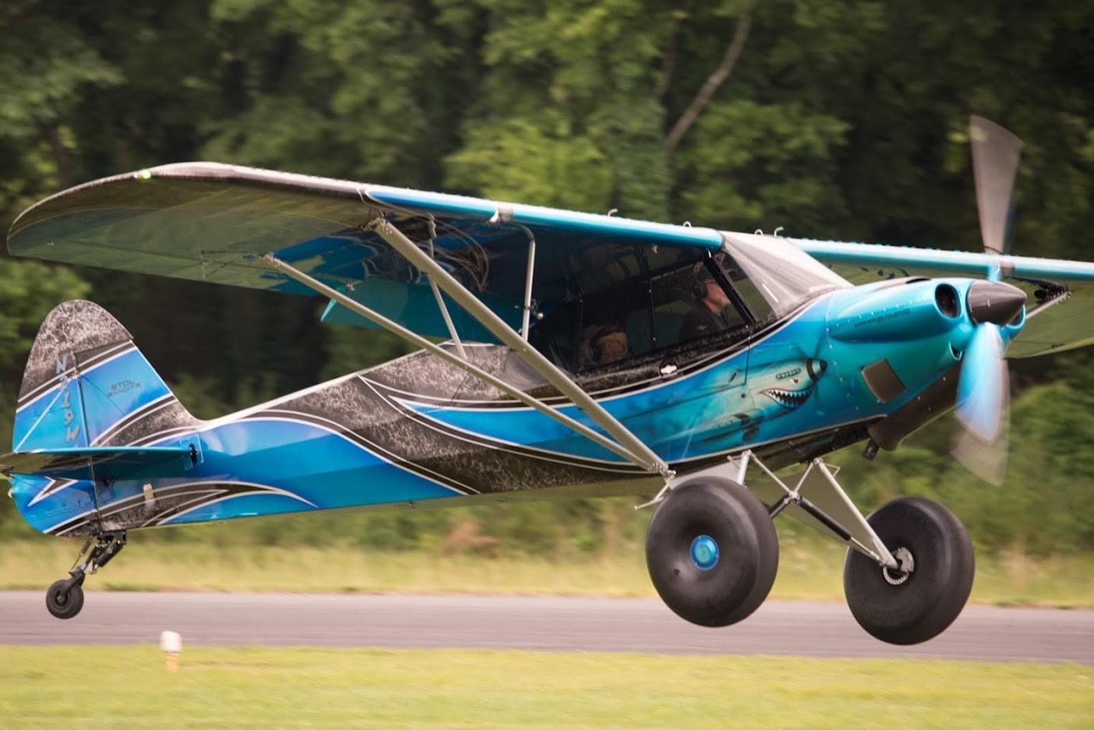
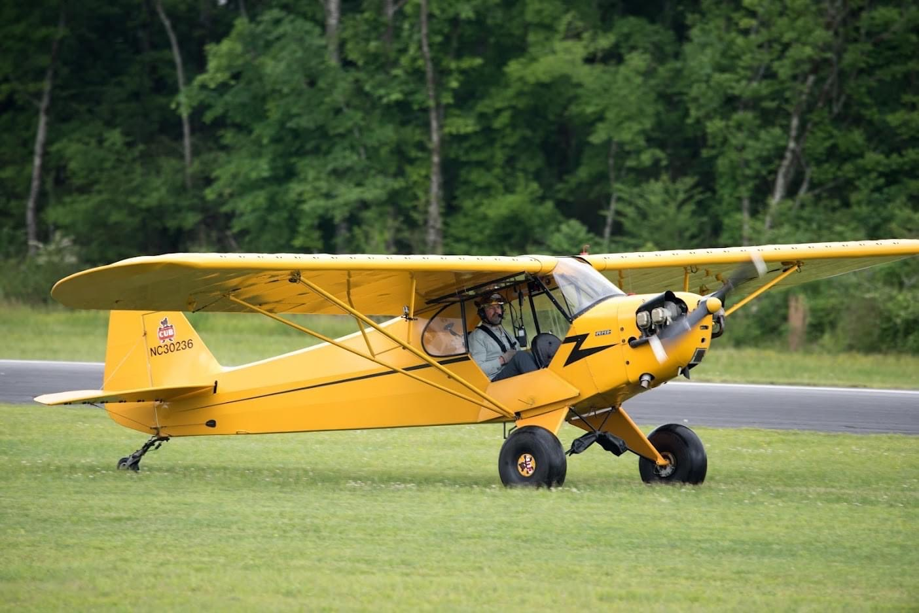
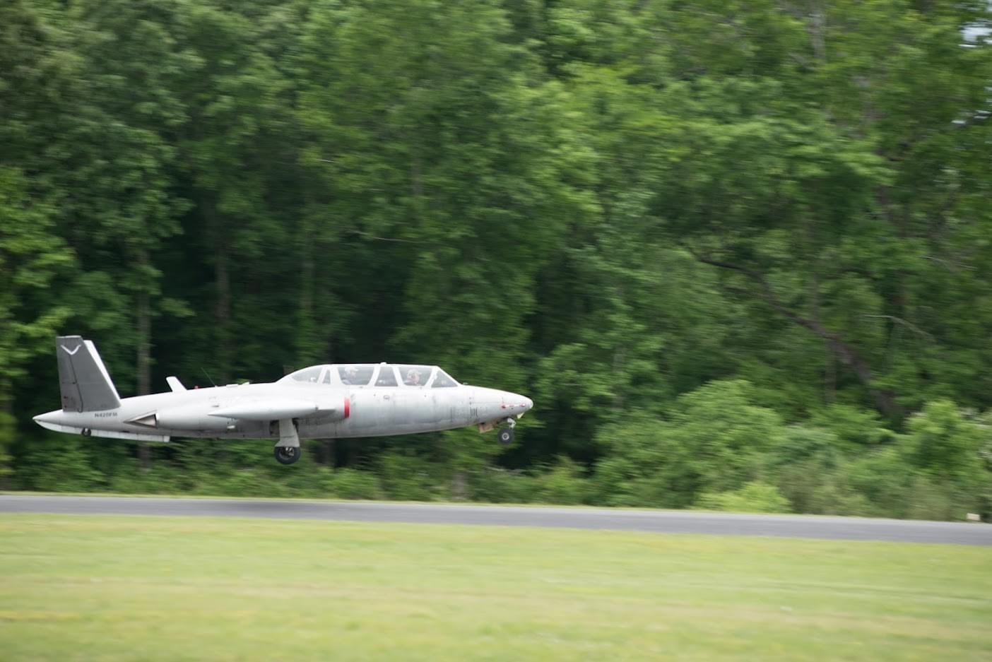

Slide 30
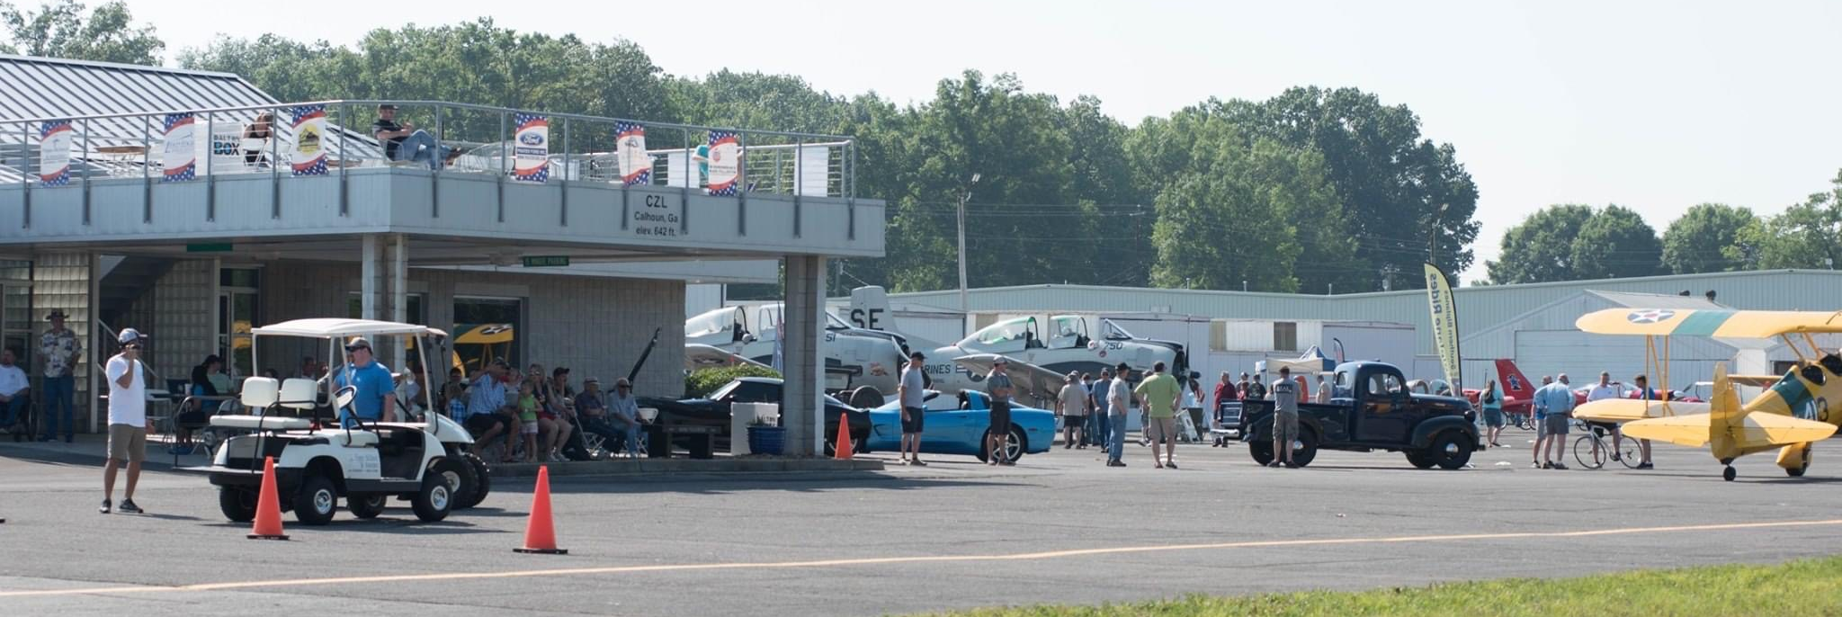
Event Insurance Coverage
Contact your airport insurance professional regarding what additional coverage they may recommend or require for the event.

Slide 31
Pre-Event Planning Checklist (start 3 months out)
Event defined
Date selected
Advertising in place
Sponsors secured
Volunteers secured
T-shirts ordered
Signs and banners ordered
Food vendors secured
Emergency personnel invited
Sponsor vendor area defined
Food court area defined
Aircraft and auto parking plans
Aviation mechanic invited
Plenty of fuel on hand
Tables and chairs secured
Media/photographers invited

Slide 32
General Event, Facility, Supply Checklist
Grass mowed, trimmed and manicured
Shrubs/hedges trimmed - beds mulched
Aircraft tug standing by
Dumpsters emptied and additional dumpster brought in for event.
Temporary trash receptacles
Signs/banners in place
Plenty of communication/aviation radios
Auto parking area signs and cones in place
Aircraft fueling area/lane defined with cones
Temporary toilets in place
Plenty of tables and chairs set up
Food vendor court area well defined
Sponsor/vendor area well defined
Plenty of reflective safety vests for volunteers
Plenty of aircraft chocks ready to go
Plenty of cold, bottled water for volunteers and emergency personnel

Slide 33
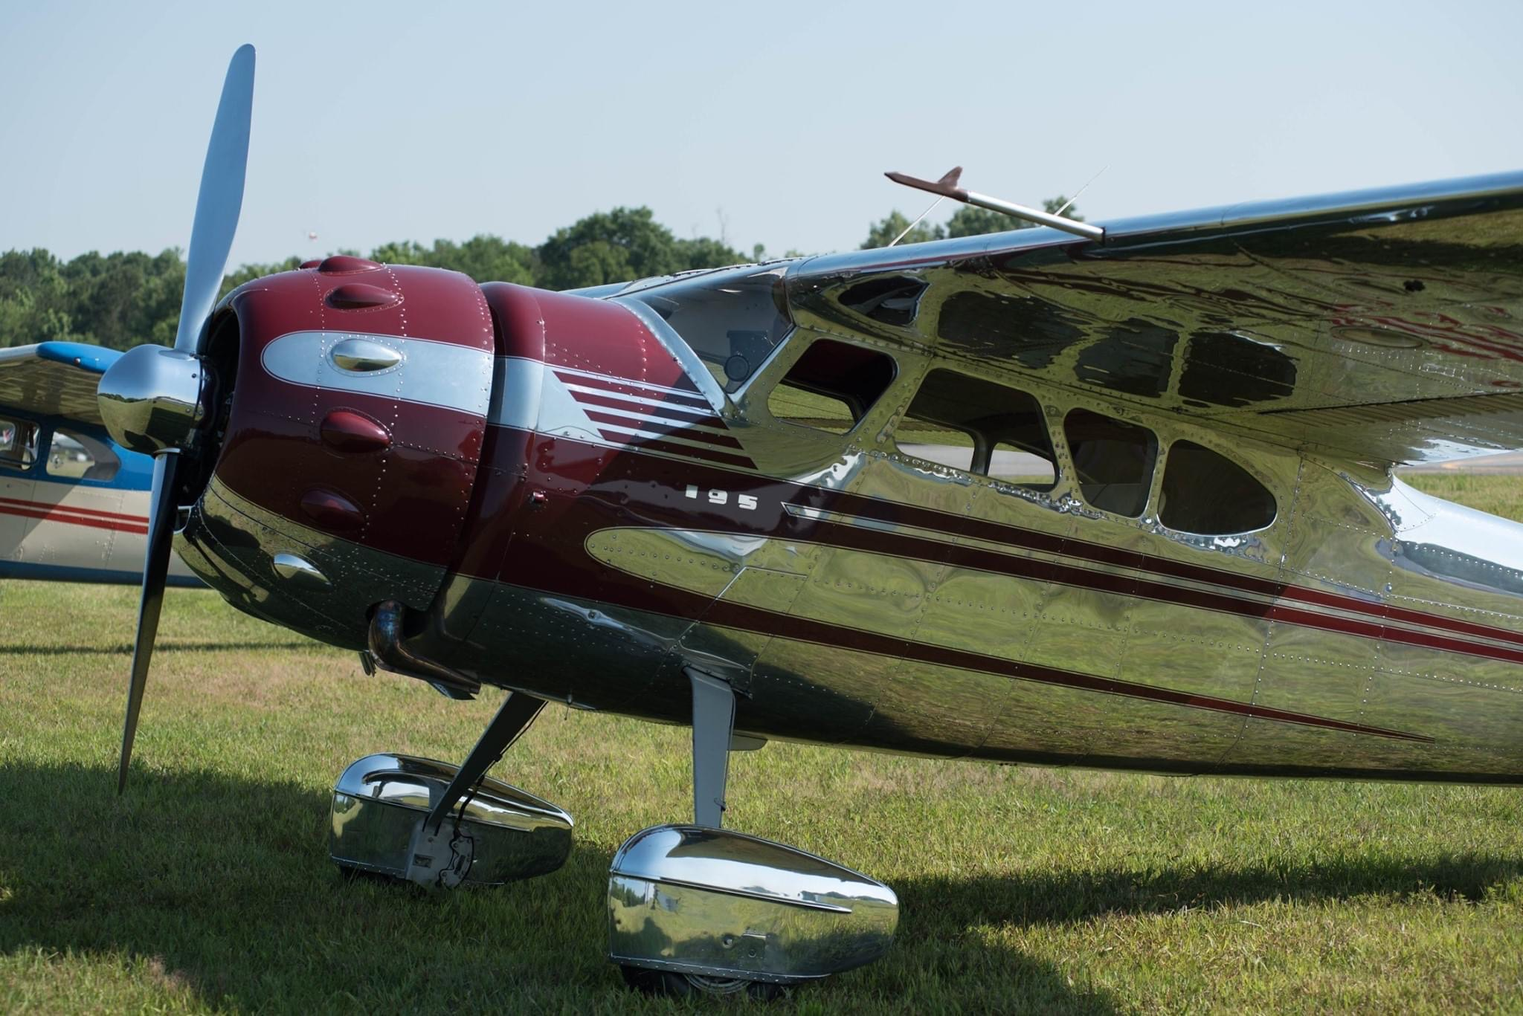

Slide 34
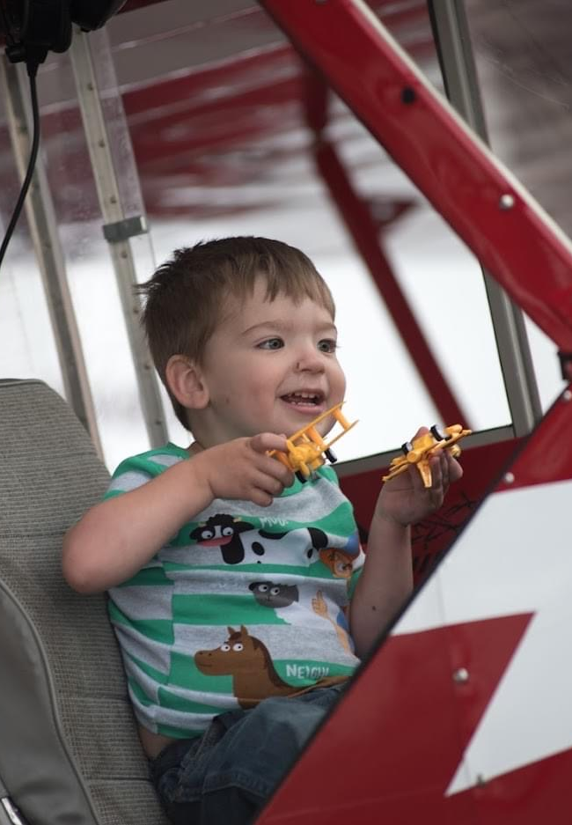
Final Points
Hosting a community event at the airport is a lot of fun and a great way to improve community relations.
If I can figure out how to host a successful airport event, anyone can!
Scan the QR code below for a copy of this slideshow and the checklists:

Slide 35
