Slide 1
Welcome to SkyDrive
U.S. Market Presentation
BizDev Team 7/2022

Slide 2
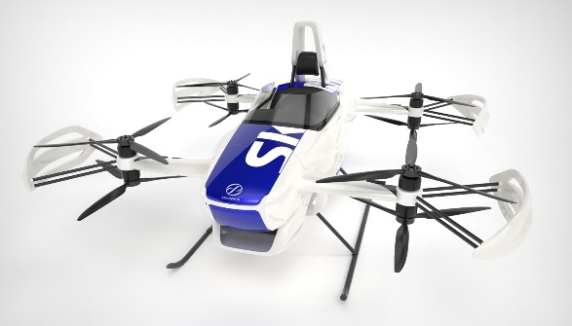
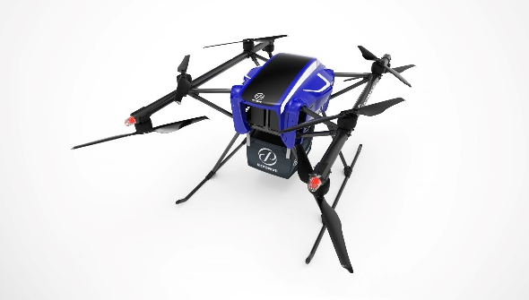
Overview of Business Structuring
Corporate Overview
Business Divisions
URBAN AIR MOBILITY
CARGO DRONES
ESTABLISHED
LOCATIONS
EMPLOYEES
FUNDRAISNG
JULY 2018
6
100+
$38 Million
3 R&D Bases
3 Offices
Significant increase in 2021
Raised so far, and on track for the next round

Slide 3
Overview of Business Structuring
Corporate Profile
Corporate Name :
Founder & CEO :
Founded :
Headquarters :
Locations:
Business :
Employees :
SkyDrive Corporation, Ltd.
Tomohiro Fukuzawa
2018
Tokyo, Japan
Toyota City, Aichi and Minamisouma City, Fukushima
Developer of eVTOL aircraft and Heavy-Lift Cargo Drones
120 (January,2022)

Slide 4
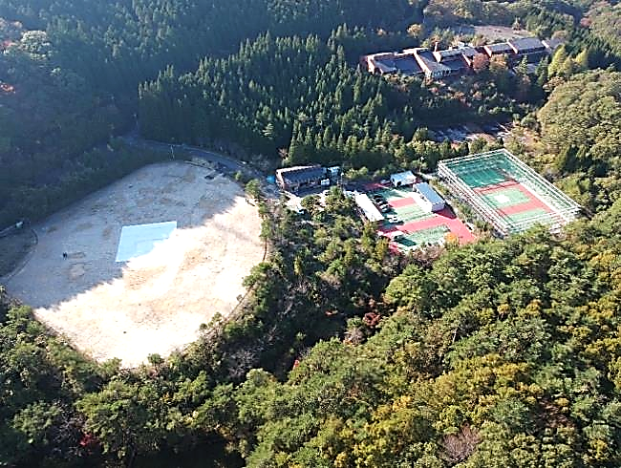
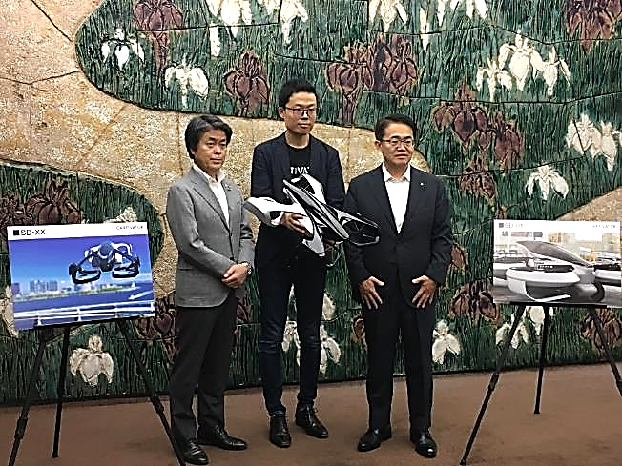
Business Development Advantages
Strategic Development Base
Notes:
SkyDrive has entered into a partnership agreement with Toyota City, where we have exclusive use of a vast 10,000 m2 test facility. The development and flight test facility are located on the same grounds which we see as a strategic advantage.
The photo on the left shows the development base in Toyota City.
The vast site where the development building and the flight test site are located is leased from the city of Toyota.
The site is surrounded by trees and is located deep in the mountains. A Google Map search shows an 8-hour walk to the nearest train station.
The site has no radio towers nearby and no cell phone service, which allows SkyDrive to conduct various flight tests without disturbing people outside of the company with noise and while also assuring safety.

Slide 5
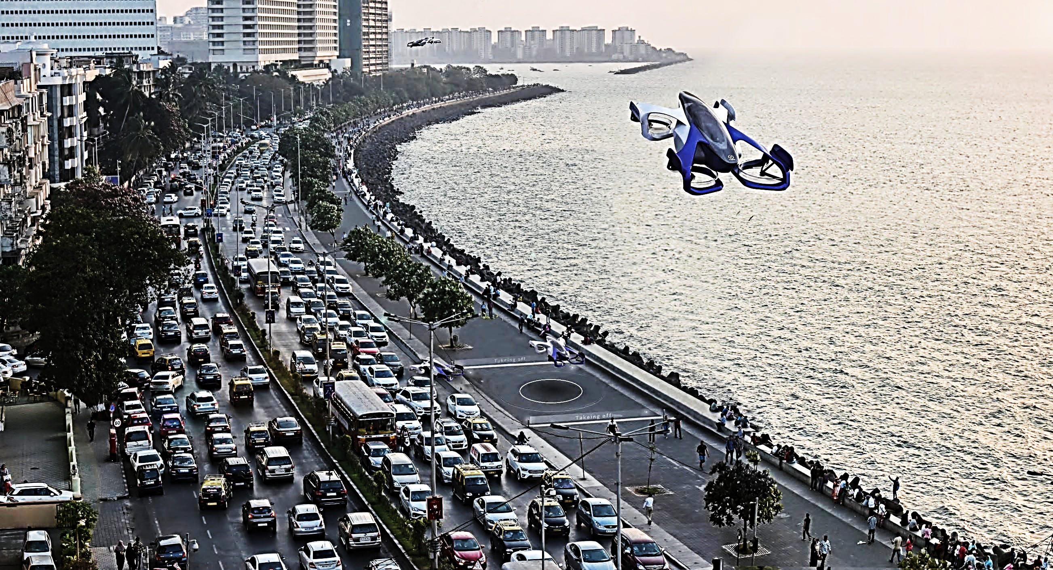
Our Long Term Vision
Our Vision
  We aim to lead in the creation of a society where personalized daily air travel is possible for anyone –
  Getting you to the places you want to go reliably and efficiently to maximize your time for the most important things in life.
  A life Beyond Drive
Notes:
SkyDrive has entered into a partnership agreement with Toyota City, where we have exclusive use of a vast 10,000 m2 test facility. The development and flight test facility are located on the same grounds which we see as a strategic advantage.
The photo on the left shows the development base in Toyota City.
The vast site where the development building and the flight test site are located is leased from the city of Toyota.
The site is surrounded by trees and is located deep in the mountains. A Google Map search shows an 8-hour walk to the nearest train station.
The site has no radio towers nearby and no cell phone service, which allows SkyDrive to conduct various flight tests without disturbing people outside of the company with noise and while also assuring safety.

Slide 6
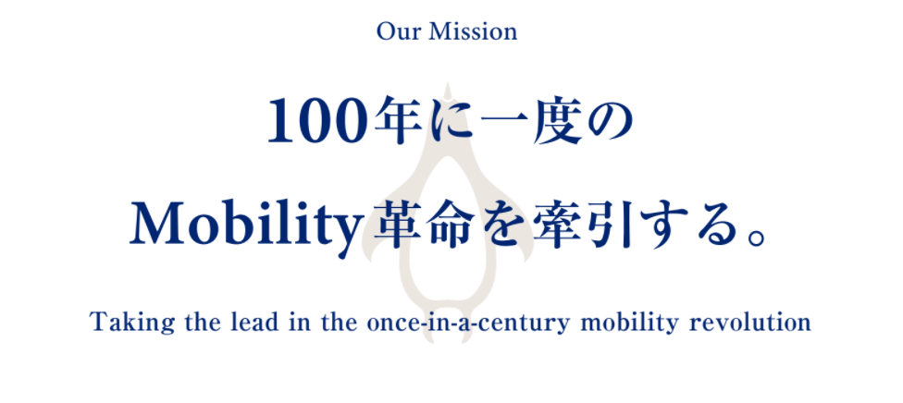
A Mobility Revolution
Our Mission
  It has been more than 100 years since automobiles and airplanes were put to practical use. We are now in the dawn of a once-in-a-century mobility revolution where we reach for the sky.
  While challenging conventional thinking and we aim to lead in that revolution through the development of innovative products and services designed to elevate human progress – Beyond Borders.
Notes:
SkyDrive has entered into a partnership agreement with Toyota City, where we have exclusive use of a vast 10,000 m2 test facility. The development and flight test facility are located on the same grounds which we see as a strategic advantage.
The photo on the left shows the development base in Toyota City.
The vast site where the development building and the flight test site are located is leased from the city of Toyota.
The site is surrounded by trees and is located deep in the mountains. A Google Map search shows an 8-hour walk to the nearest train station.
The site has no radio towers nearby and no cell phone service, which allows SkyDrive to conduct various flight tests without disturbing people outside of the company with noise and while also assuring safety.

Slide 7


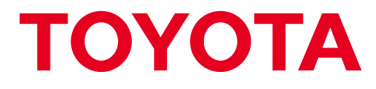






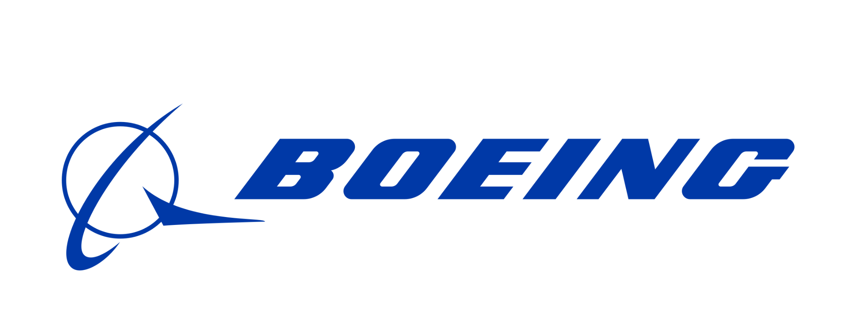





A Team of Industry Specialists From Diverse Backgrounds
Diverse Development Team
Automotive/Electronics
Industries
Aircraft/Drone
Industries
Business/Finance
Industries
Notes:
自動車・航空機・電池業界出身者を中心にチームを形成。
平均年齢が低い事をアピールするスタートアップもいるが、我々はベテランの知識、経験、人脈をフルレバレッジ
オールジャパンマニュファクチャリング的な要素に加えて、海外人材もどんどん増えており、凄いスピードで事業が進んでいる

Slide 8












Strategic Business Alliances from Private and Public Leaders
Key Ecosystem Partnerships
Public/Private Councils
Local Governments
Expanding Capital
and
Business Alliances
Cumulative Capital Raised
$38m (USD)
Bases on Yen Rate 7/12/22
Notes:
そして、空飛ぶクルマの世界を作っていくべく、日本中、各業界のトップランナーの企業様と、製造、運航、ポートなど、空飛ぶクルマの実現に必要な要素で連携させて頂いています。
起業後3年で、51億円の調達をし、現在も資本や事業面での提携は拡大中です

Slide 9
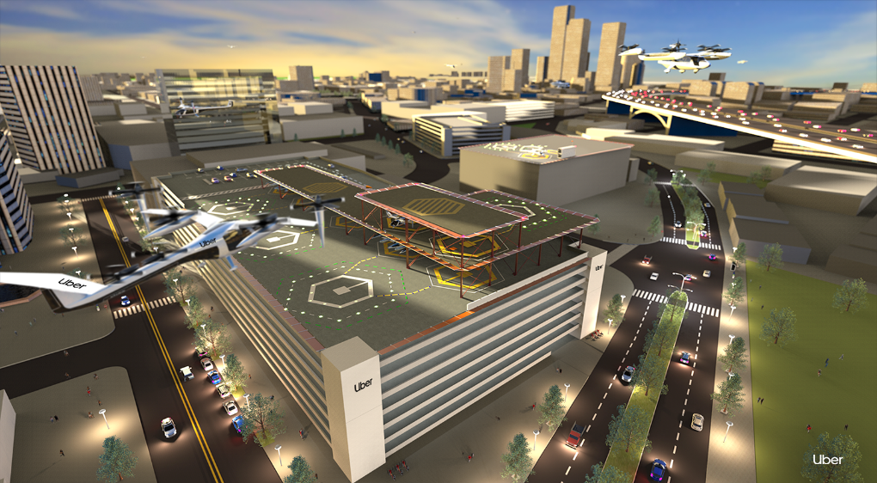
Social Issues SkyDrive Aims To Solve
Uber Elevate Project
引用：Uberホームページ
https://www.uber.com/ja-JP/newsroom/%E3%83%A1%E3%83%87%E3%82%A3%E3%82%A2%20%E3%82%A2%E3%82%BB%E3%83%83%E3%83%88/uber-elevate/
Notes:
Flying cars first made headlines around 2016 when Uber released a 98-page white paper.The whitepaper highlighted the challenges of road-based mobility, showing that "in cities like Los Angeles and Sydney, residents spend up to seven weeks each year commuting to work, two weeks of which are wasted in traffic jams and are unproductive.The company then showed that by establishing a means of air transportation that does not require roads, tracks, bridges, or other infrastructure, people can travel more efficiently and in less time, allowing them to spend more time with their families and do more productive work.This led to the development of flying cars by several companies around the world.Translated with www.DeepL.com/Translator (free version)

Slide 10








The Value We Bring To Our Customers
Our Value
New flight zones
Reduced operational costs and resource needs
Added option for private air travel
Autonomous flight reduces manpower costs
Emerging market opportunities
Convenient pinpointed mobility
Carbon neutral aircraft
Reduction in noise pollution
Notes:
Flying cars first made headlines around 2016 when Uber released a 98-page white paper.The whitepaper highlighted the challenges of road-based mobility, showing that "in cities like Los Angeles and Sydney, residents spend up to seven weeks each year commuting to work, two weeks of which are wasted in traffic jams and are unproductive.The company then showed that by establishing a means of air transportation that does not require roads, tracks, bridges, or other infrastructure, people can travel more efficiently and in less time, allowing them to spend more time with their families and do more productive work.This led to the development of flying cars by several companies around the world.Translated with www.DeepL.com/Translator (free version)

Slide 11
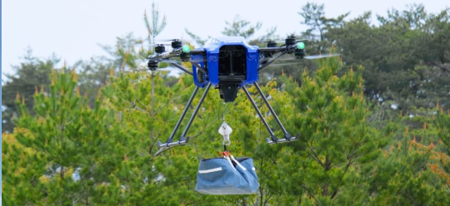
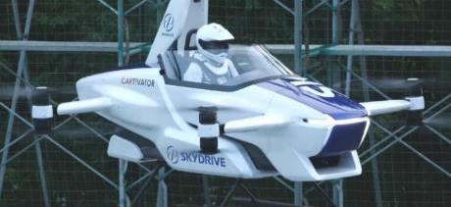
Our Latest Product Line
Product Line
Cargo Heavy Lift Drone – up to 66 lbs.
Key Design Benefits
Automated transport to challenging areas
Higher level of safety
Adaptable to be equipped with a hoist
SD-05 Compact eVTOL Aircraft
Key Design Benefits
Compact and cost-effective design
Autonomous control capability
Low manufacturing and operating costs
Notes:
Flying cars first made headlines around 2016 when Uber released a 98-page white paper.The whitepaper highlighted the challenges of road-based mobility, showing that "in cities like Los Angeles and Sydney, residents spend up to seven weeks each year commuting to work, two weeks of which are wasted in traffic jams and are unproductive.The company then showed that by establishing a means of air transportation that does not require roads, tracks, bridges, or other infrastructure, people can travel more efficiently and in less time, allowing them to spend more time with their families and do more productive work.This led to the development of flying cars by several companies around the world.Translated with www.DeepL.com/Translator (free version)

Slide 12
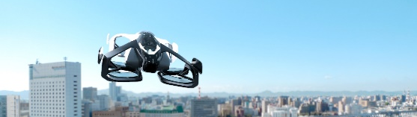

2.Why Flying Car?
Key Design Drivers
Compact Intra-City Mobility Focus
Compact （Size Under 10㎡・2Pax・Intra-City Design）
Minimum Port Requirements
By 2030, SkyDrive aims to develop nearly 100,000 port locations domestically in order to enable the sky as a new mode of
daily transportation.
Notes:
小型の空飛ぶクルマによって、日本では、ヘリコプターが使えるﾍﾘﾎﾟｰﾄ200弱から一気に10万いじょうに、日常的に空を移動できるようになります

Slide 13
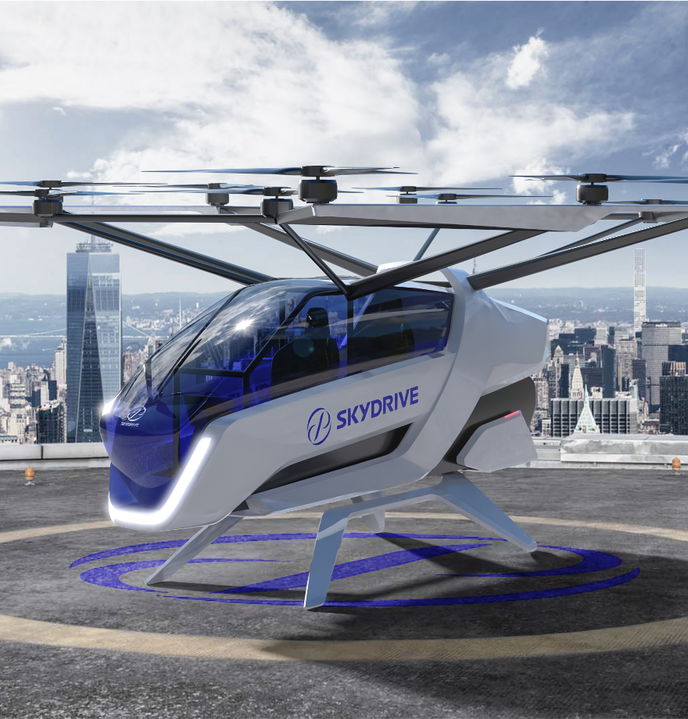
SD-05 FACT SHEET
Multi-copter type
Compact design
Lightweight technologies
→ Requiring minimal investments in infrastructure
Intra-city transportation
Capacity up to 2 people
Short cruising range
→ A new alternative to cars
Electrified & Certified
100% electric: Zero emission in operations
Airworthiness Certification Procedure
→ Safe and Environmentally friendly
Use cases
Personal transportation/travel
Sightseeing/entertainment
AirTaxi transportation
Emergency and critical cases
→ Enabling new possibilities..

Slide 14
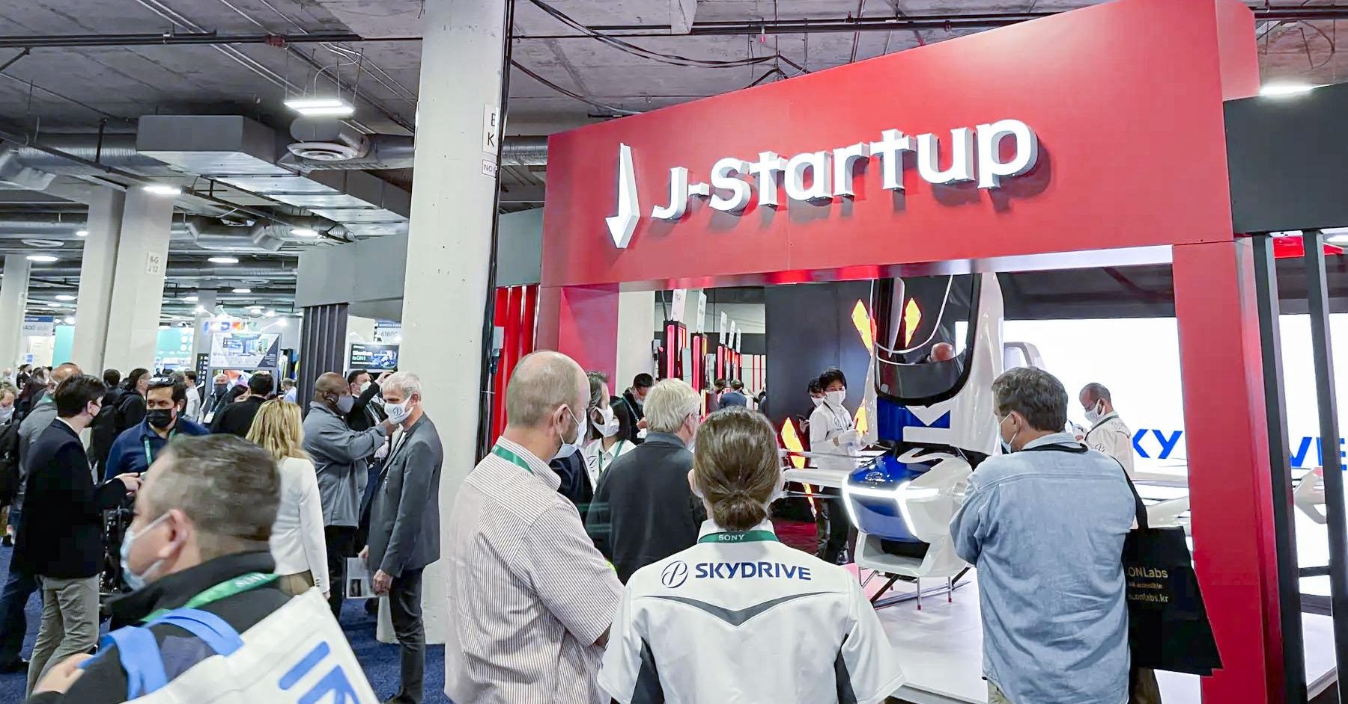
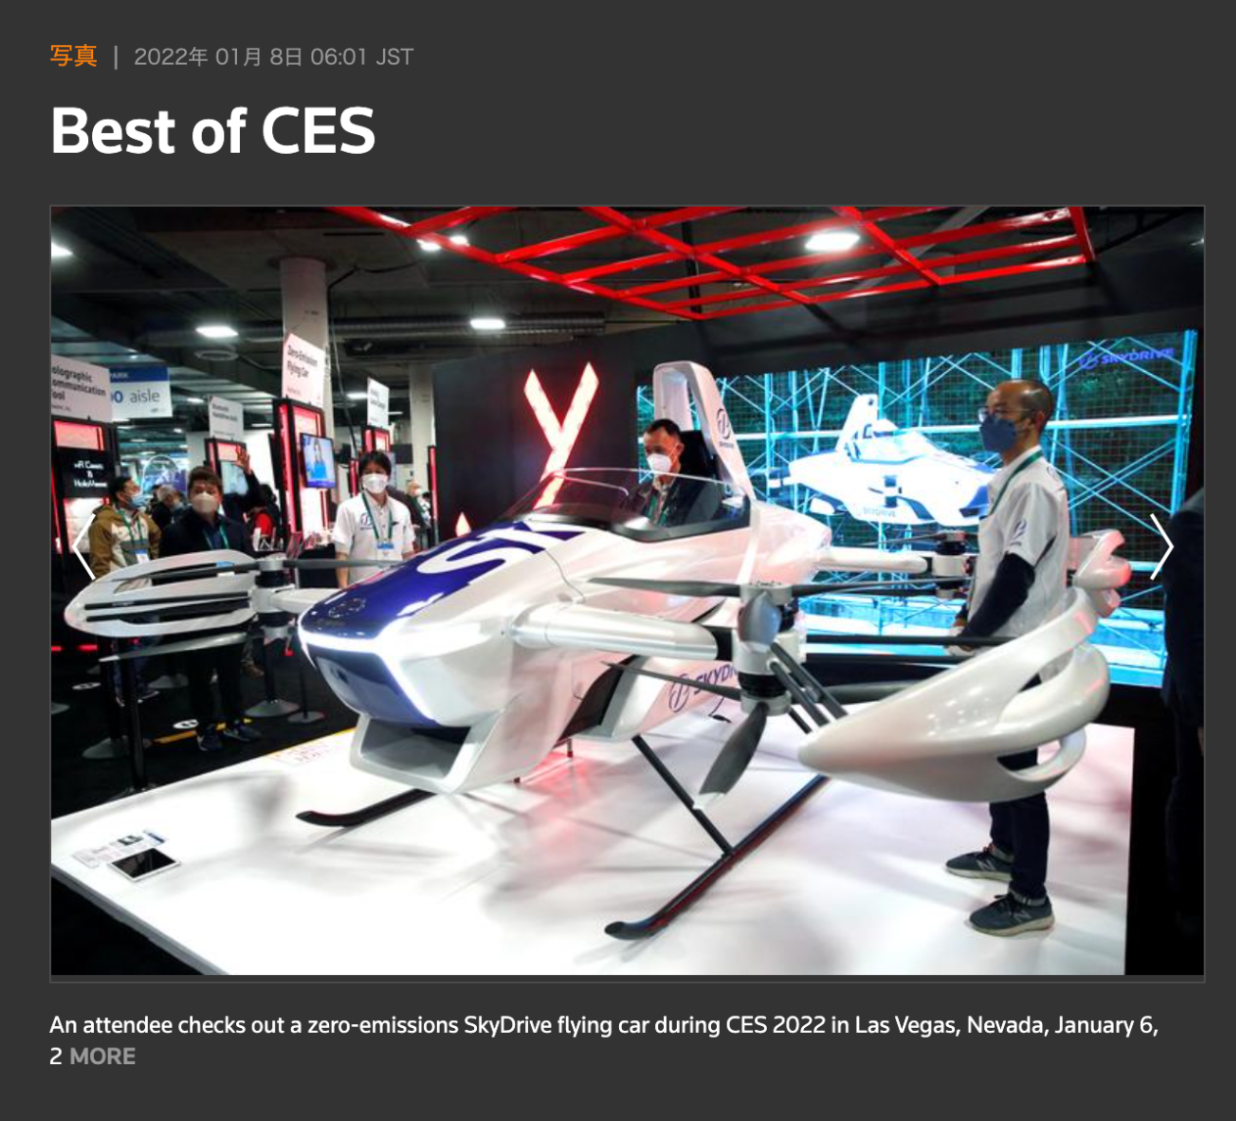

One of the Best of 30 at CES 2022
Notes:
そこから2年後、世界最大のテクノロジー展CESにて、BEST of CESに選ばれました。海外からの投資や人材獲得も増えています

Slide 15

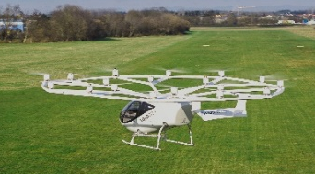

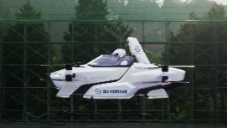
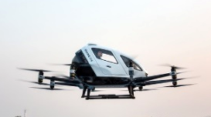

Our Market Position
Top 10 eVTOL Developers
Volocopter
7 (Full Size) Developers
Vertical
3 (Compact Size) Developers
Lilium
Archer
Beta
SkyDrive
Wisk Aero
Joby Aviation
EHang
Eve
SkyDrive aims to be one of the TOP 3
compact eVTOL developers globally.
Notes:
目指すは2025年。3年後のサービス開始です。
世界中300社が空飛ぶクルマを開発していますが、2025年前後にいち早く販売開始を目指しているのは、我々含め世界で10社。小型の空飛ぶクルマでは、僕らは世界トップ３です

Slide 16
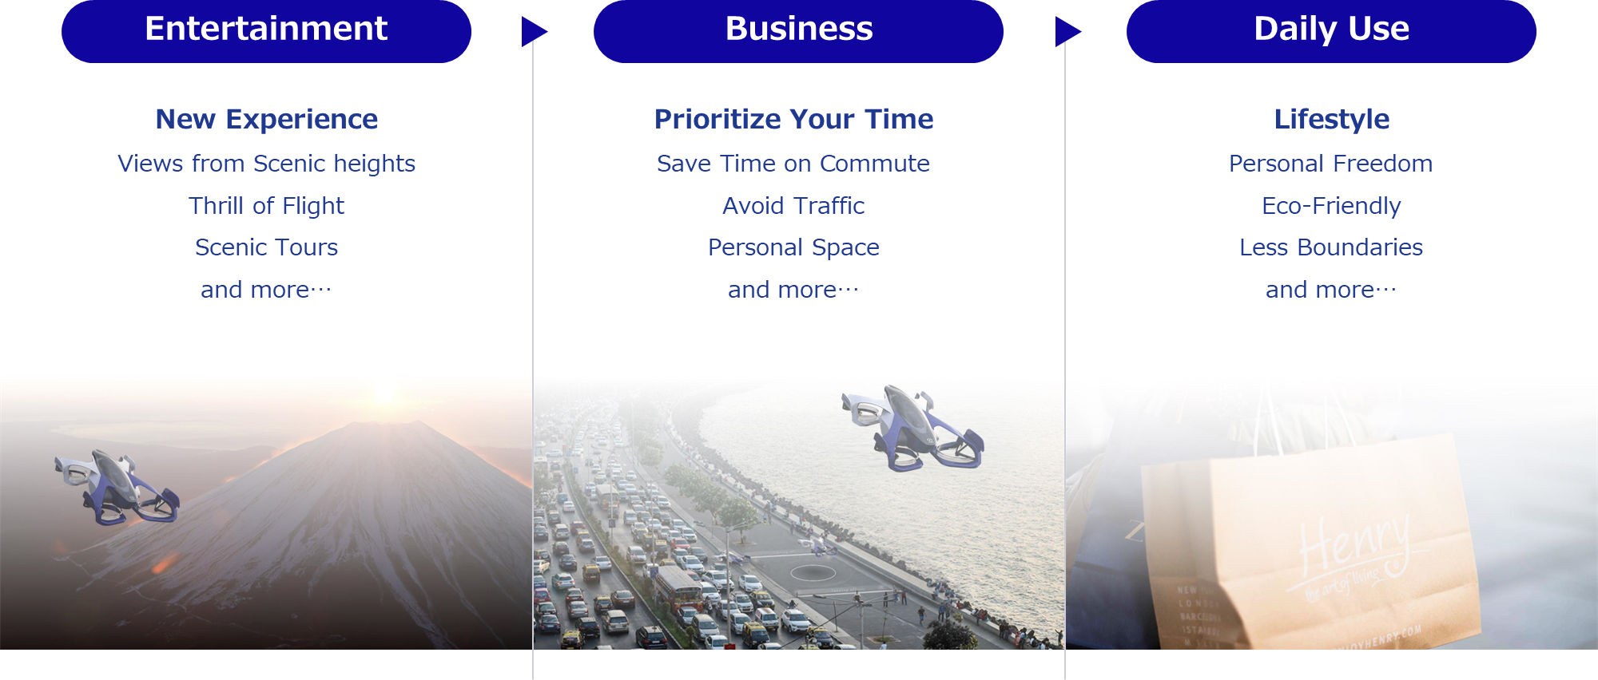
The Evolution of the eVTOL Industry
Enabling The Sky
Notes:
Aircraft will gradually evolve from entertainment to a means of transportation by increasing its cruising range and evolve into an everyday mobility vehicle by increasing the number of takeoff and landing sites.

Slide 17
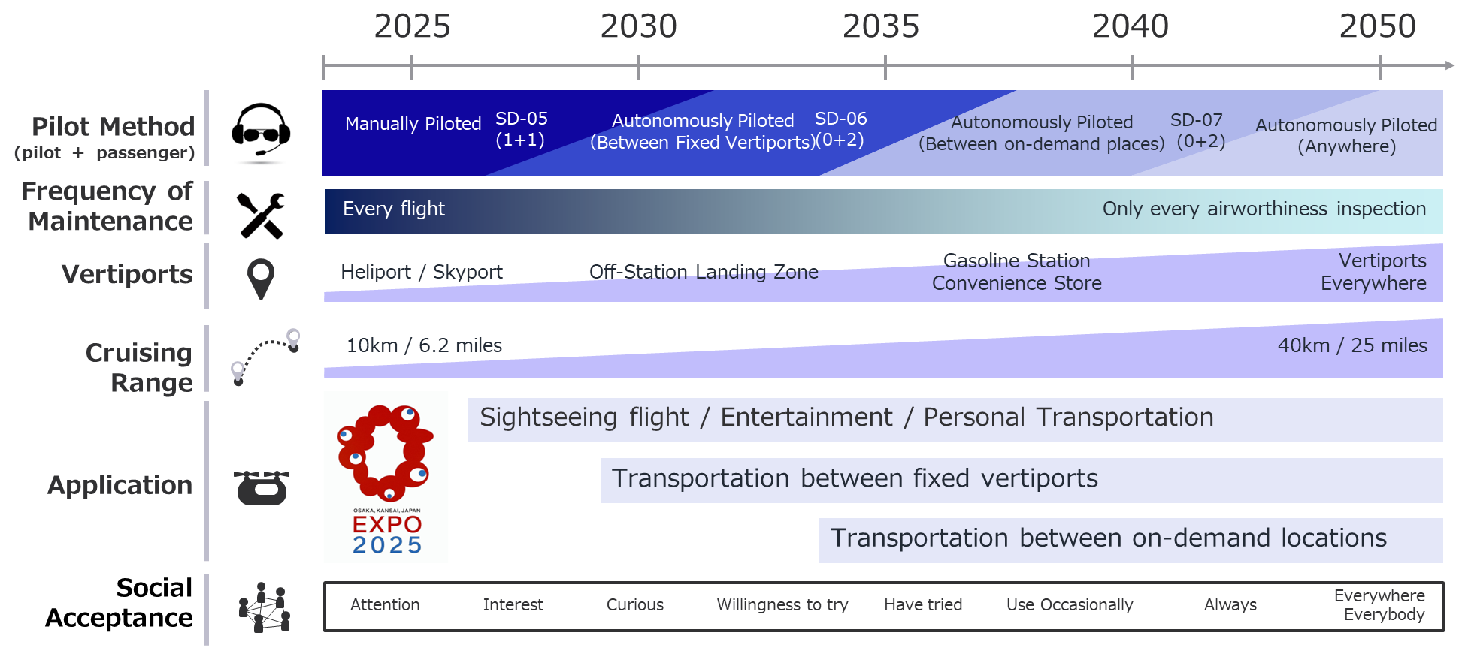
Our Product and Business Development Timeline
Business Evolution
Notes:
Aircraft will gradually evolve from entertainment to a means of transportation by increasing its cruising range and evolve into an everyday mobility vehicle by increasing the number of takeoff and landing sites.

Slide 18
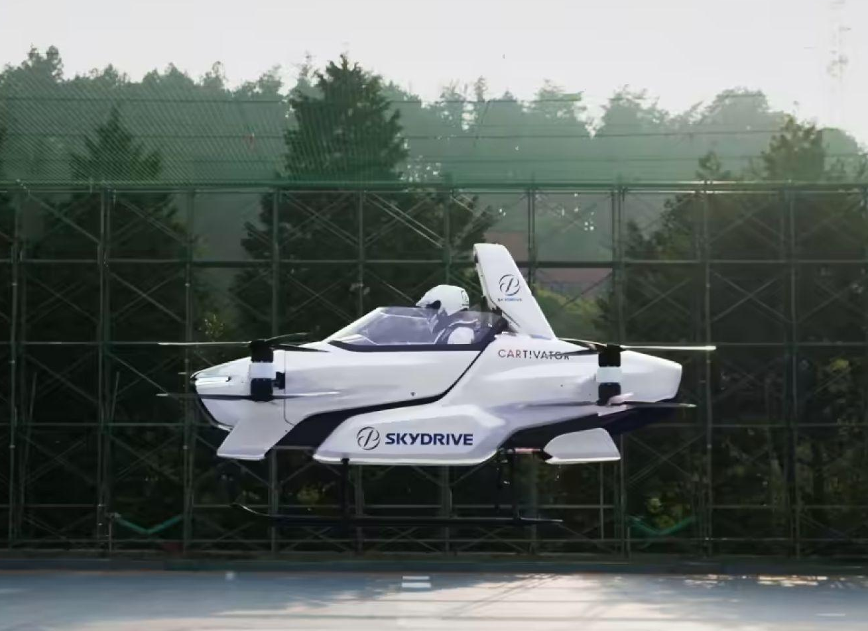
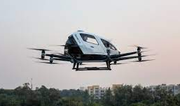
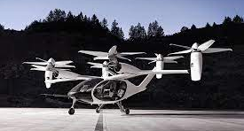
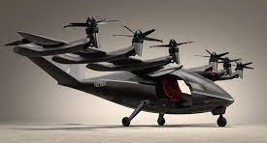
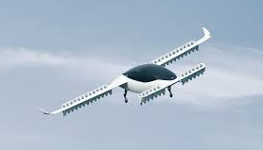
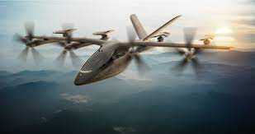
Our Market Development Goals
Global Market Size
$252 Bn.
250
200
150
100
SkyDrive
Target Market Size
$51 Bn.
50
$7 Bn.
Billion $
2022
2025
2030
2035
In unison with global market expansion
SkyDrive aims to begin sales in 2025
Notes:
そして、ここから市場が大きくなると共に、SkyDriveの機体が世界中を飛ぶ、そんな世界を作っていきます

Slide 19













Emerging Market Opportunities
Infrastructure Value Chain
Charging Station
Maker
Customers & Businesses
Electric
Provider
Ticket
Provider
Vertiport
Operator
Flight
Operator
UTM
Provider
Aircraft
OEM
5G Service
Provider
MRO
Provider
Support
Services
Flight Data
Provider
Flight Data
Provider
Government
Regulator
Insurance
Provider
Insurance
Provider
Notes:
Aircraft will gradually evolve from entertainment to a means of transportation by increasing its cruising range and evolve into an everyday mobility vehicle by increasing the number of takeoff and landing sites.

Slide 20
Thank You
Notes:
Flying cars first made headlines around 2016 when Uber released a 98-page white paper.The whitepaper highlighted the challenges of road-based mobility, showing that "in cities like Los Angeles and Sydney, residents spend up to seven weeks each year commuting to work, two weeks of which are wasted in traffic jams and are unproductive.The company then showed that by establishing a means of air transportation that does not require roads, tracks, bridges, or other infrastructure, people can travel more efficiently and in less time, allowing them to spend more time with their families and do more productive work.This led to the development of flying cars by several companies around the world.Translated with www.DeepL.com/Translator (free version)

