Slide 1
Advanced Air Mobility
Georgia Airports Association Conference 2022
October 13, 2022

Slide 2
Terms and Acronyms
AAM - Advanced Air Mobility
RAM - Regional Air Mobility
UAM - Urban Air Mobility
eVTOL - Electric Vertical Take-off and Landing
Vertiport - Facility supporting eVTOL operations
OEMs - Original Equipment Manufacturers

Slide 3
What is Advanced Air Mobility?
AAM
Advanced Air Mobility
Intra and Inter-City
UAM
Urban Air Mobility
Intra-City
ATL → Ameris Bank Amphitheater
RAM
Regional Air Mobility
Inter-City
Macon → Jekyll Island
An air transportation system utilizing electric vertical take-off and landing aircraft to move people, goods, or services in an urban or regional setting
AAM is possible due to advances in distributed electric propulsion, which have enabled electric vertical takeoff and landing (eVTOL) aircraft
Several eVTOL aircraft are on the path to FAA certification by the mid-2020s
Morgan-Stanley projects a $1 trillion AAM market by 2040, but:
Numerous hurdles to overcome, and skepticism is warranted
Lithium battery constraints
Pilot/mechanic shortage

Slide 4
Main Types of eVTOL Aircraft
Multicopter – looks and flies much like a helicopter, except with multiple rotors.
Lift and Cruise – uses rotors for vertical flight and transitions to propellers for horizontal flight.
Vectored Thrust – uses rotors or fans for both vertical and horizontal flight.

Slide 5
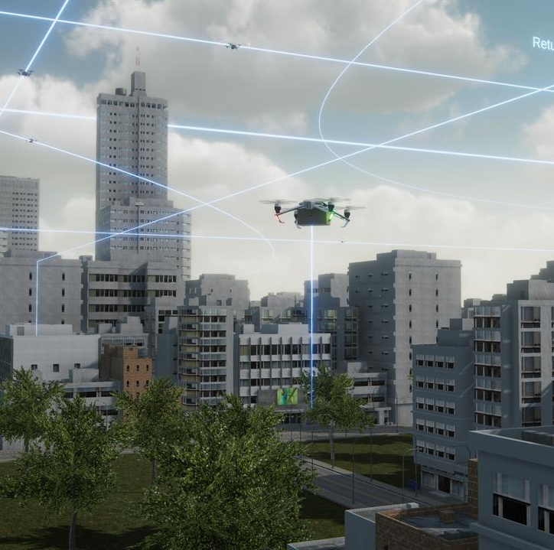
Progression of AAM
Advanced Air Mobility – Crawl, Walk, Run Progression
Pilot on Board
Autonomous
All Electric
Hybrid & Hydrogen
Visual Meteoroligal Conditions
Instrument Meteorological Conditions
Traditional Air Traffic Management
Uncrewed Aircraft Systems Traffic Management (UTM)
Low Tempo
Low Volume
High Tempo
High Volume

Slide 6
Progression of AAM
OEM | Platform | CONOP | EIS | Wingspan | MTOW lbs. | Passengers | Propulsion | Range | Gear | Key Alliances
Eve | LC | AT | 2026 | 36 feet | NA | 4 + pilot | E/B | 60 | S | Republic, Skywest
Lilium | VT | AT | 2025 | 46 feet | 7,000 | 6 + pilot | E/B | 155 | W | NetJets
Archer | VT | AT, C | 2024 | NA | 7,000 | 4 + pilot | E/B | 60 | W | United
Joby | VT | AT | 2024 | 35 feet | 4,800 | 4 + pilot | E/B | 150 | W | Toyota
BETA | LC | AT, C, EMS | 2024 | 50 feet | 7,000 | 5 + pilot | E/B | 250 | S or W | UPS, Amazon
Wisk | LC | AT | NA | 36 feet | NA | 4 + no pilot | E/B | 60 | W | Boeing
Supernal | VT | AT | 2028 | NA | NA | 4 + pilot | E/B | 60 | NA | Hyundai
CONOP: Concept of Operation
EIS: Entry into Service target
LC: Lift and Cruise, VT: Vectored Thrust, NA: Not Available
AT: Air Taxi, C: Cargo, EMS: Emergency Medical Service
E/B: Electric by Batteries;
S: Skid, W: Wheels
All values are approximate. Range is in miles.
Sources: OEM websites, eVTOL.news, AAM Reality Index.
Numerous OEMs are targeting the mid-2020s
Large focus on Air Taxi, but Air Cargo & EMS a likelier early use case

Slide 7
AAM Reality Index
OEM | ARI | Use Case | Vehicle Type | Operation | First Flight | EIS | Country
Joby Aviation | 8.7 | Air Taxi | Vectored Thrust | Piloted | 2018 | 2024 | USA
Volocopter | 8.4 | Air Taxi | Multicopter / Lift+Cruise | Piloted | 2021/2022 | 2024/2026 | Germany
Beta Technologies | 8.0 | Cargo, Air Taxi | Lift + Cruise | Piloted | 2020 | 2024 | USA
Eve | 7.7 | Air Taxi | Lift + Cruise | Piloted | 2022 | 2026 | Brazil
Lilium | 7.7 | Regional, Cargo, Biz Av | Vectored Thrust | Piloted | - | 2025 | Germany
Wisk | 7.5 | Air Taxi | Lift + Cruise | Autonomous | 2018 | - | USA
Archer | 7.4 | Air Taxi | Vectored Thrust | Piloted | 2021 | 2025 | USA
Elroy Air | 7.4 | Cargo | Lift + Cruise | Autonomous | 2022 | 2023 | USA
Kitty Hawk | 7.3 | Air Taxi | Vectored Thrust | Autonomous | 2018 | - | USA
Pipistrel (Textron) | 7.2 | Cargo | Lift + Cruise | Autonomous | 2022 | 2023 | USA
Vertical Aerospace | 7.2 | Air Taxi, Cargo, EMS | Vectored Thrust | Piloted | 2022 | 2025 | UK
Airbus | 7.0 | EMS, Tourism, Air Taxi | Multicopter | Piloted | 2023 | 2025 | France
Supernal | 7.0 | Air Taxi | Vectored Thrust | Piloted | 2023 | 2028 | South Korea
https://aamrealityindex.com/aam-reality-index

Slide 8
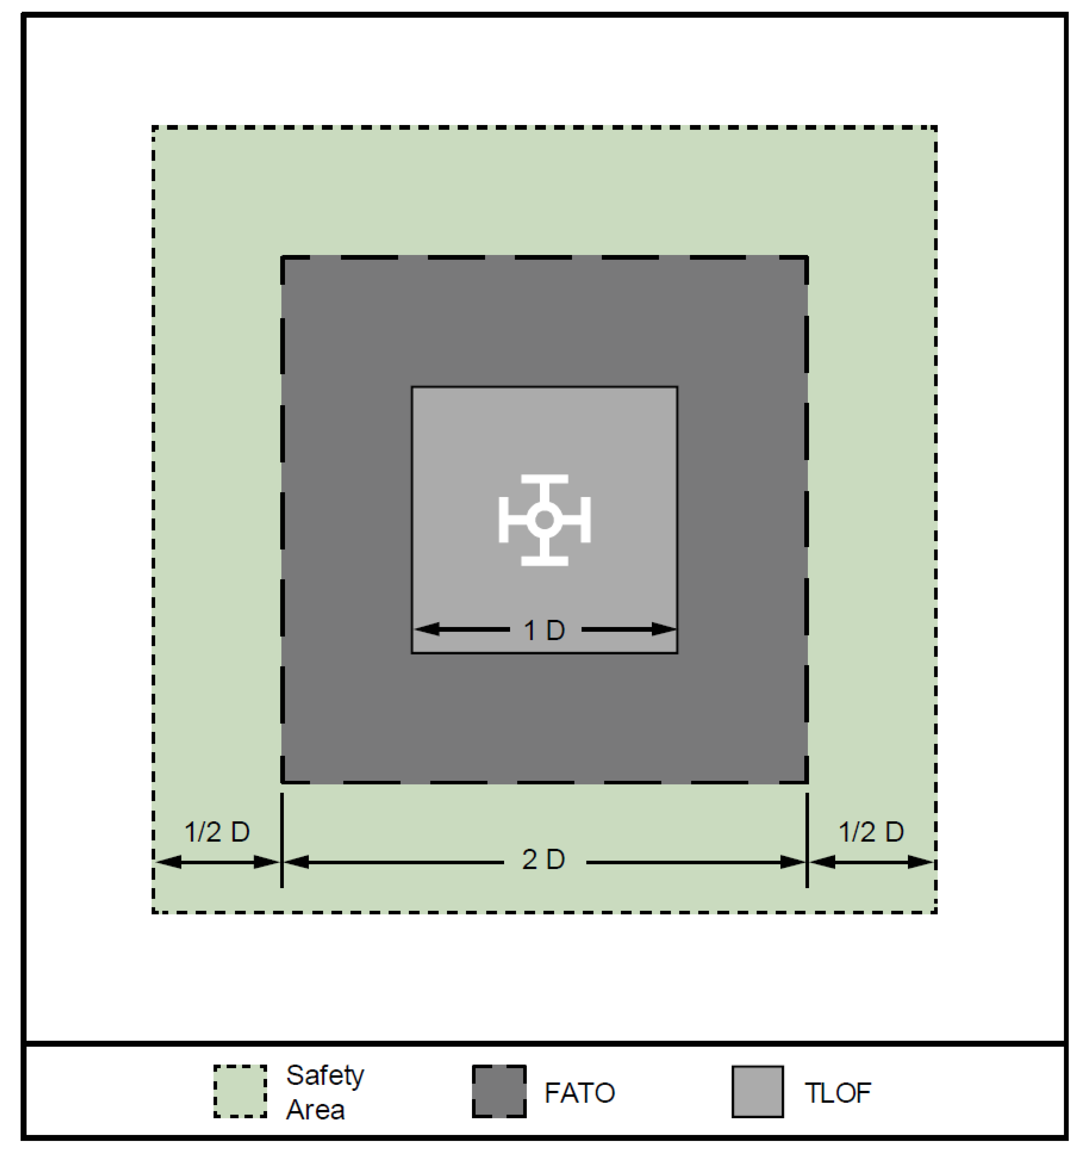
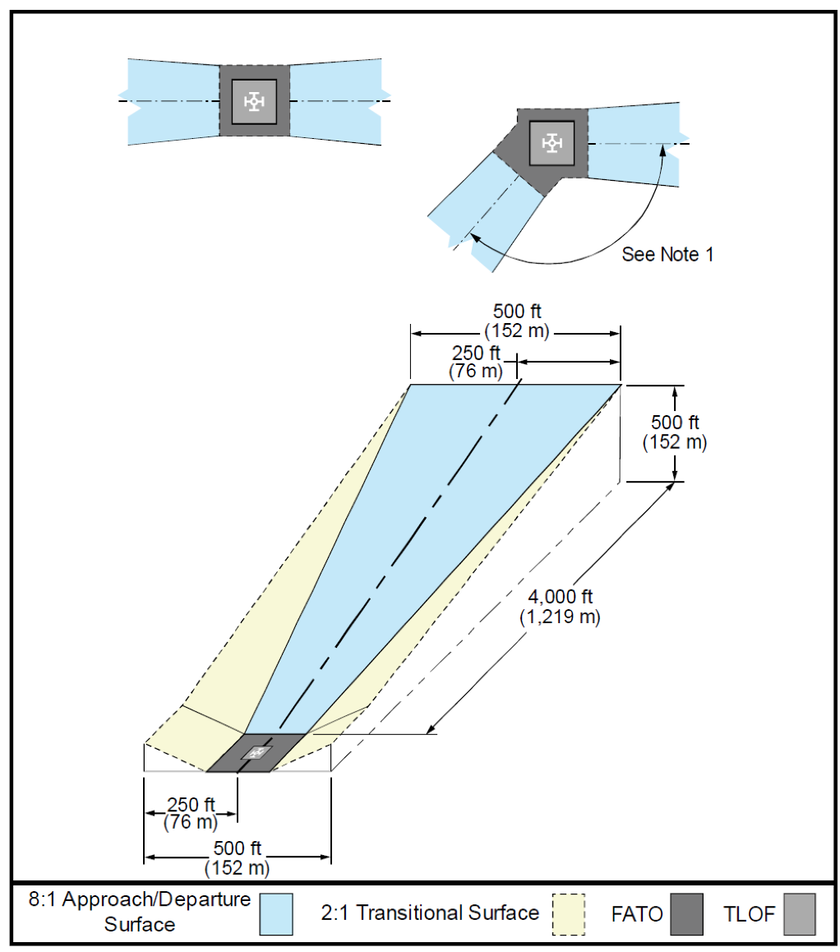
Infrastructure Requirements
FAA Engineering Brief 105 provides interim design standards for vertiports, in the absence of an Advisory Circular expected in the mid-2020s
EB 105 is specific to VFR conditions, eVTOL aircraft that are no more than 50 feet wide/long, have a pilot on board, and are capable of hover out-of-ground effect
Provides the basic minimum safety elements needed for a vertiport
Basic Vertiport Landing Geometry
Basic Vertiport Imaginary Surfaces
Additional Vertiport Infrastructure Considerations
Charging Infrastructure or Battery Swap Capability
Maintenance, repair, and overhaul (MRO) Services
Battery cell recycling
Airport rescue & Fire Fighting (ARFF)
High-speed data
Gaps in Design Guidance
50ft
Piloted, VFR flights only
Distance between TLOFs for simultaneous operations
Taxiway hold lines & independent use of taxiways within a protected surface for a TLOF
Operational requirements (Ex: activities permitted near charging aircraft)
These gaps will need to be filled in with assumptions based on heliport and airport design criteria.
100ft
150ft
TLOF: Touchdown and Liftoff Area
FATO: Final Approach and Takeoff Area
Safety Area: Defined area surrounding the FATO

Slide 9
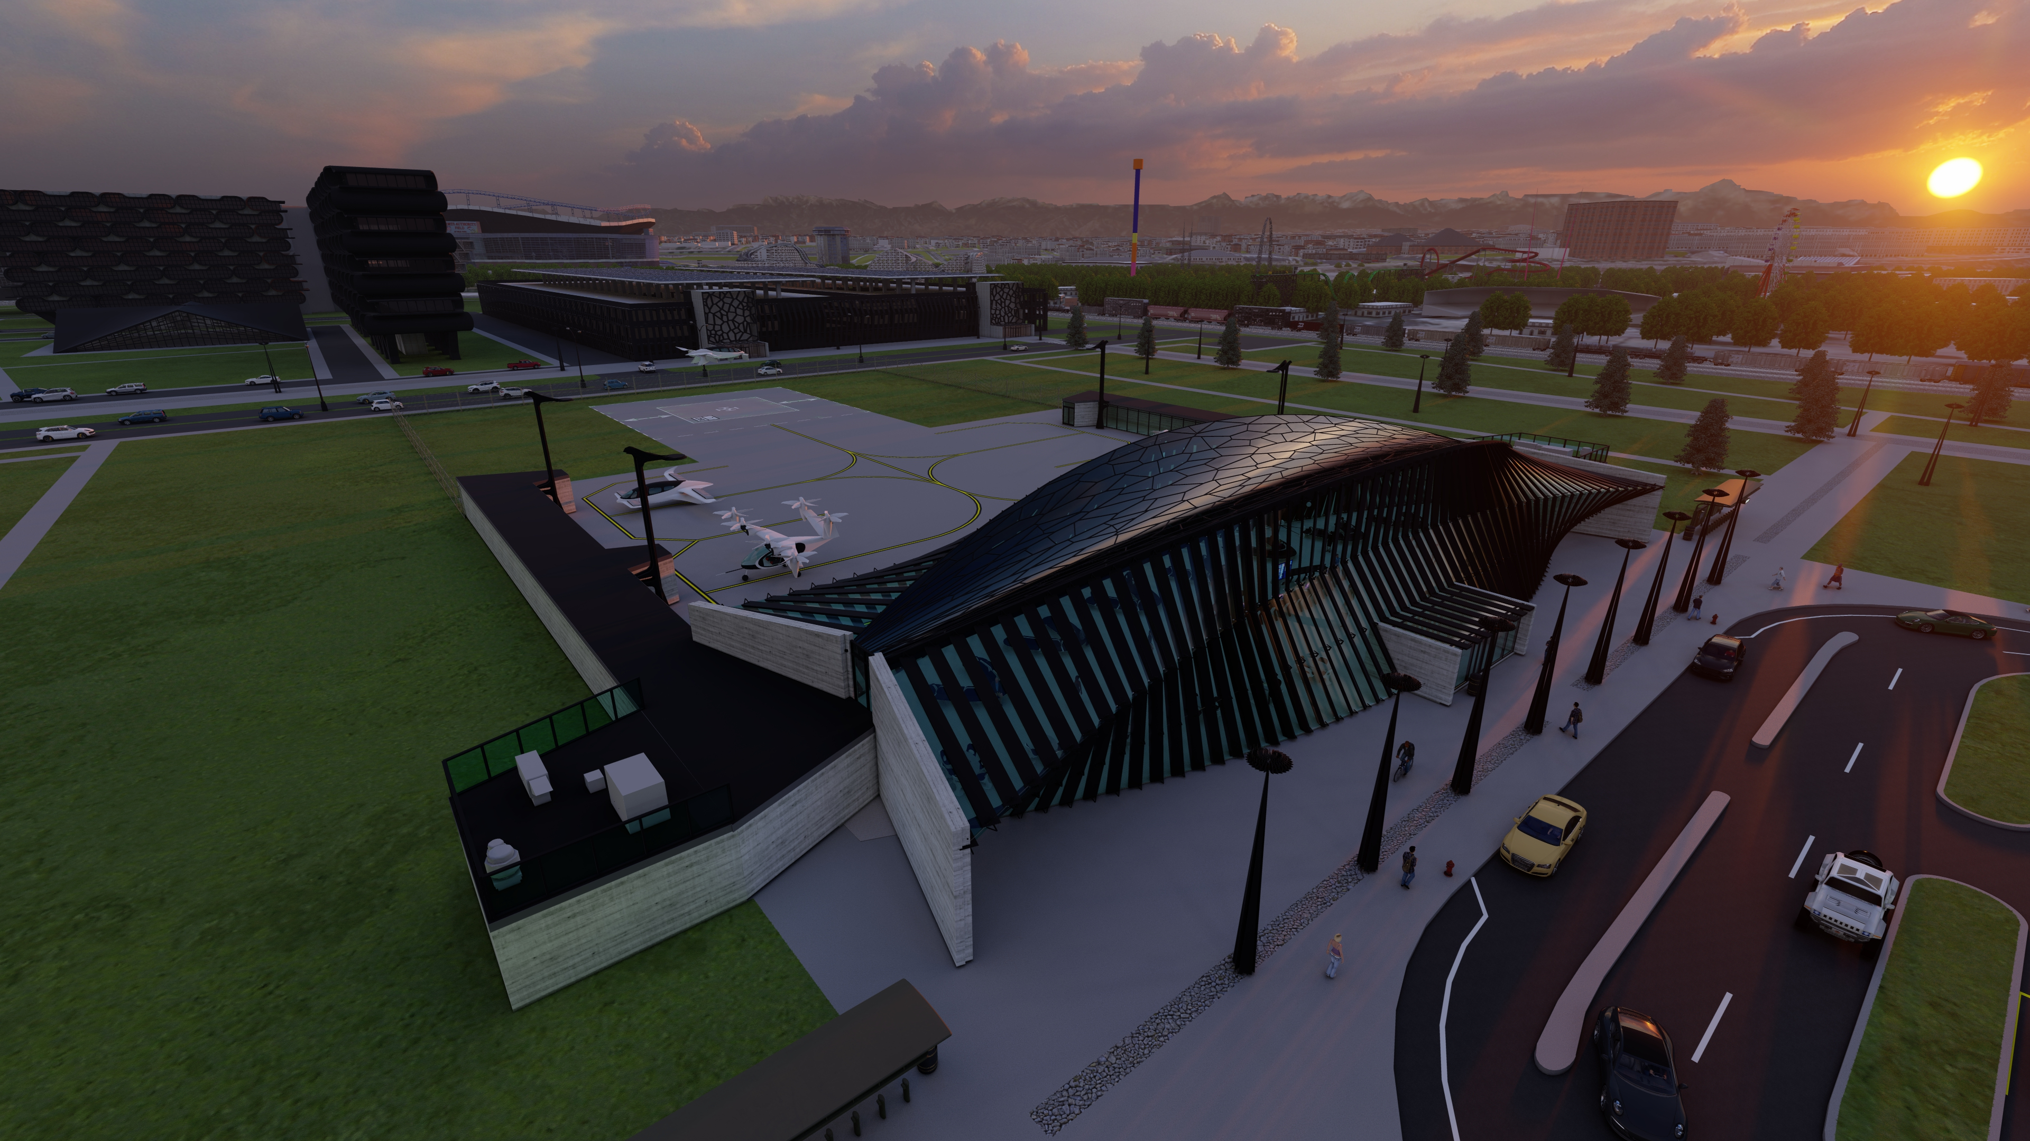
Thank You
Melissa Rank, PLS
Aviation & Emerging Technology Project Manager
Melissa.Rank@Woolpert.com
618.632.2813

