Slide 1
Airport Management Fundamentals
Tracy Arner, M.Ed., CPA, CPFO
tarner@uga.edu

Slide 2
Learning Objectives
At the end of this session, you will be able to
Discuss audit requirements
Recall activities to prepare for audit

Slide 3
Audit Requirements

Slide 4
Audit Requirement
OCGA 36-81-7(a)
Annual audit for those governments with population of more than 1,500 or
Annual expenditures of $550,000 or more
Others require audit every two years that covers both fiscal years

Slide 5
Official Code of Georgia Annotated OCGA
O.C.G.A. §36-81-7
Audit must be completed and sent to the state auditor within 180 days after fiscal year-end
Must submit corrective action plan in response to findings within 30 days of the six-month due date

Slide 6
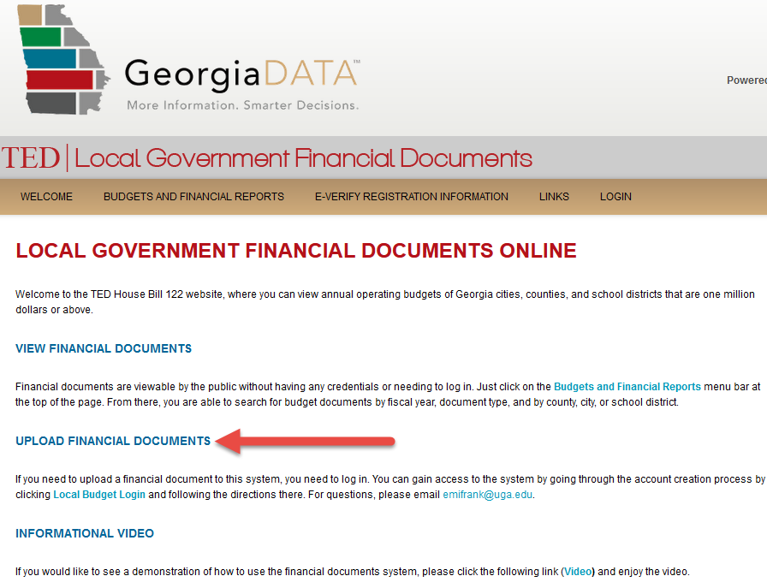
Georgia Data
https://georgiadata.org/financialdata

Slide 7
Single Audit
Threshold for audit is $750,000 federal funds in a fiscal year (www.ecfr.gov )
Compliance with eligibility and timing requirements
Compliance supplement
www.whitehouse.gov
Provision for counties receiving <$10 million ARPA funds and less than $750,000 in non-ARPA funds can opt for attestation instead of single audit
Notes:
Notably, OMB also released guidance earlier this year allowing counties that received less than $10 million in Recovery Funds and spent less than $750,000 of non-ARPA federal in a single fiscal year to opt for attestation instead of audit under the Single Audit Act. This process would evaluate counties based on two compliance factors: (1) whether the county uses Recovery Funds for eligible uses and (2) whether the county properly reports costs incurred by the pandemic.
https://www.naco.org/blog/omb-issues-information-single-audit-compliance-requirements-arpa-recovery-funds-and-era-program

Slide 8
Other Audit Requirements?
Conducted in accordance with Generally Accepted Government Auditing Standards (GAGAS)
www.gao.gov (Yellow Book)
O.C.G.A. 36-81-7(b)
Notes:
Also, per Georgia law, audits must be conducted in accordance with GAGAS – generally accepted auditing procedures – more commonly known in auditing and accounting circles as the Yellow Book – yes, because the book cover is Yellow! These requirements are issued by the GAO - the Government Accountability Office - for the Comptroller General of the United States.
These auditing standards provide a framework for conducting high quality audits with competence, integrity, objectivity, and independence.

Slide 9
Other Audit Requirements?
Financial statements in conformity with Generally Accepted Accounting Principles (GAAP)
Opinion of auditor with respect to financial statements
Material violations of state or local law discovered during audit
O.C.G.A. 36-81-7(c)
Notes:
§36-81-7(c) All annual audit reports of local units of government shall contain at least the following: (1) Financial statements prepared in conformity with generally accepted governmental accounting principles, setting forth the financial condition and results of operation of each fund and activity of the local government and such financial statements shall be the representation of the local government; and (2) The opinion of the performing auditor with respect to the financial statement; in addition to an explanation of any qualification or disclaimers contained in the opinion, such opinion shall also disclose, in accordance with generally accepted government auditing standards, any apparent material violation of state or local law discovered during the audit.
Another audit requirement required by Georgia law is that the audit report must be sent to the State Auditor within 180 dates of the fiscal year end. In addition, if there are audit findings, management (you) must develop a Corrective Action Plan (CAP) and send that plan, along with written comments on the findings and recommendations to the State Auditor within 30 days after the audit report due date.

Slide 10
Consequences of Not Meeting Requirements
O.C.G.A. §36-81-7(c)(3) states
Audits not received within 180 days, audits not conducted, or failure to correct noted auditing deficiencies requires State Auditor to notify local government and each member of the General Assembly which represents districts within the local government’s jurisdiction
Notes:
(3) If the state auditor has not received any required audit or written comments by the date specified in paragraph (1) of this subsection, the state auditor shall within 30 days of such date notify the unit of local government that the audit has not been received as required by law. A copy of this notification shall also be sent by the state auditor to each member of the General Assembly whose senatorial or representative district includes any part of the unit
(4) The state auditor, for good cause shown by those local units in which an audit is in the process of being conducted or will promptly be conducted, may waive the requirement for completion of the audit within 180 days. Such waiver shall be for an additional period of not more than 180 days and no such waiver shall be granted for more than two successive years to the same unit of local government. (5) No state agency shall make or transmit any state grant funds to any local government which has failed to provide all the audits required by law within the preceding five years.
(e) A copy of the report and of any comments made by the state auditor pursuant to paragraph (2) of subsection (d) of this Code section shall be maintained as a public record for public inspection during the regular working hours at the principal office of the local government. Those units of local government not having a principal office shall provide a notification to the public as to the location of and times during which the public may inspect the report. (f) Upon a failure, refusal, or neglect to have an annual audit made, or a failure to file a copy of the annual audit report with the state auditor, or a failure to correct auditing deficiencies noted by the state auditor, the state auditor shall cause a prominent notice to be published in the legal organ of, and any other newspapers of general circulation within, the unit of local government. Such notice shall be a prominently displayed advertisement or news article and shall not be placed in that section of the newspaper where legal notices appear. Such notice shall be published twice and shall state that the governing authority of the unit of local government has failed or refused, as the case may be, to file an audit report or to correct auditing deficiencies, as the case may be, for the fiscal year or years in question. Such notice shall further state that such failure or refusal is in violation of state law.

Slide 11
Auditor Competence
Knowledge of:
GAGAS – Generally Accepted Government Auditing Standards
GAAP – Generally Accepted Accounting Principles as established by the Governmental Accounting Standards Board
Notes:
Yellow Book page 56-57
3.72 The staff assigned to conduct an audit in accordance with GAGAS should collectively possess the technical knowledge, skills, and experience necessary to be competent for the type of work being performed before beginning work on that audit. The staff assigned to a GAGAS audit should collectively possess
a. knowledge of GAGAS applicable to the type of work they are assigned and the education, skills, and
experience to apply this knowledge to the work being performed;
b. general knowledge of the environment in which the audited entity operates and the subject matter;
c. skills to communicate clearly and effectively, both orally and in writing; and
d. skills appropriate for the work being performed; for example, skills in
(1) statistical or nonstatistical sampling if the work involves use of sampling;
(2) information technology if the work involves review of information systems;
(3) engineering if the work involves review of complex engineering data;
(4) specialized audit methodologies or analytical techniques, such as the use of complex survey instruments, actuarial-based estimates, or statistical analysis tests, as applicable; or
(5) specialized knowledge in subject matters, such as scientific, medical, environmental, educational, or any other specialized subject matter, if the work calls for such expertise.

Slide 12
Preparing for Audit

Slide 13
Cash
Reconcile all bank statements to corresponding
ending balances in the general ledger
Reconcile petty cash balances to the ending balance on the general ledger
Ensure reconciling items identified have been appropriately addressed
Review outstanding checks on an on-going basis for each financial institution and, if applicable, remit the funds to the Georgia Department of Revenue

Slide 14
Revenues, Receivables and Receipts
Reconcile accounts receivable, subsidiary ledgers, reports to general ledger accounts
Verify cash receipts and deposits using valid documentation, agree to the cash receipts journal
Review monthly activity to ensure amounts received are properly deposited to the correct bank account
Verify amounts received are properly coded to the appropriate revenue receivable general ledger accounts

Slide 15
Typical Revenue Accruals
Local Funding Subsidies
State Grants
Federal grants
Interest earnings
Rents
Charges for services

Slide 16
Expenditures, Liabilities and Disbursements
Reconcile Outstanding Payable Vendor balances to the ending balances on the general ledger (ensure that liabilities are recorded in the correct accounting period)
Examine any purchasing/credit card statements and confirm that each transaction amount is in compliance with the thresholds established by policy and supporting documentation is available
Individual not directly involved in disbursement process should review documentation supporting goods or services received and correct coding of disbursement prior to release of disbursements
Verify all system generated and manual checks issued
during the month are accounted for by numerical sequence
Documentation supporting monthly payroll and fringe benefits payments should
be reviewed and initialed to document approval

Slide 17
Purchasing Cards
O.C.G.A. 36-80-24, Purchasing Cards
No cards issued to elected officials unless governing body by public vote has authorized issuance and adopts policy covering
Authorized and unauthorized purchases
Transaction limits
Card administrator
Review process for purchases
Violations of policy
Notes:
Limitation on elected official's use of government issued purchasing or credit cards; policy development
(a) An elected official of a county, municipal corporation, local school system, or consolidated government shall be prohibited from the use of a government purchasing card or a government credit card unless: (1) Such purchases are solely for items or services that directly relate to such official's public duties; and (2) Such purchases are in accordance with guidelines adopted by the county, municipal corporation, local school system, or consolidated government. (b) Documents related to such purchases incurred by such elected officials shall be available for public inspection. (c) No such county, municipal corporation, local school system, or consolidated government shall issue government purchasing cards or government credit cards to elected officials on or after January 1, 2016, until the governing authority of such county, municipal corporation, local school system, or consolidated government, by public vote, has authorized such issuance and has promulgated specific policies regarding the use of such government purchasing cards or government credit cards for elected officials of such county, municipal corporation, local school system, or consolidated government. Such policies shall include the following: (1) Designation of officials who shall be authorized to be issued such government purchasing cards or government credit cards; (2) A requirement that, before being issued a government purchasing card or government credit card, authorized users shall sign and accept an agreement with the county, municipal corporation, local school system, or consolidated government issuing the government purchasing card or government credit card that such users will use such cards only in accordance with the policies of the issuing governmental entity; (3) Transaction limits for the use of such cards; (4) A description of purchases that shall be authorized for use of such cards; (5) A description of purchases that shall not be authorized for use of such cards; (6) Designation of a government purchasing card or government credit card administrator; (7) A process for auditing and reviewing purchases made with such cards; and (8) Procedures for addressing a violation of such purchasing card or credit card policies and imposing penalties for violations including, but not limited to, revocation of purchasing card or credit card privileges. Nothing in such procedures or any administrative action taken pursuant thereto shall preclude any other civil or criminal remedy under any other provision of law. HISTORY: Code 1981, § 36-80-24, enacted by Ga. L. 2015, p. 266, § 5/HB 192.

Slide 18
Typical Expenditure Accruals
Accounts Payable
Contracts Payable
Grants Payable
Accrued Salaries Payable
Leases Payable

Slide 19
Capital Assets
Capital assets include tangible or intangible assets that are used in operations and that have initial useful lives extending beyond a single reporting period
Capital assets or noncurrent assets are longer-lived assets
Land & Land Improvements
Buildings & Building Improvements
Machinery and Equipment

Slide 20
Capital Asset Activities
Purchases properly authorized by management for service purposes
Purchases recorded timely and accurately
Maintain detailed subsidiary records
Physical inventory
Report and account timely for transfers, retirements, gains/losses
Maintain records accurately
Adequate segregation of duties
Insurance Coverage for Capital Assets

Slide 21
Payroll Reconciling Activities
Reconcile taxable Federal, Social Security, Medicare, and State wages each payroll
Remember that some deductions are pre-tax and others are post-tax; therefore, a deduction report should be run to facilitate the reconciliation
Reconcile salaries per the earnings and deduction register, in total, to salaries posted to the general ledger expenditure accounts, in total

Slide 22
Payroll Reconciling Activities
Ensure that payroll withholding accounts (FIT payable, SIT payable, S.S. and Medicare Payable, retirement and health insurance) ZERO once payment has been transmitted to the appropriate party
At the end of each year perform a summary of salaries – reconciliation of 941’s to trial balance

Slide 23
Compensated Absences
Prepare a schedule by employee for all leave outstanding at year end that would be paid upon employee resignation
Follow personnel policy
Use salary rates in effect at year end

Slide 24
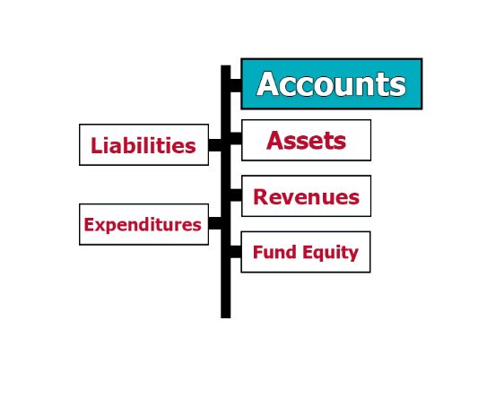
General Ledger Maintenance
Reference chart of accounts to ensure proper coding of transactions
Ensure that all audit adjustments are posted
Ensure that beginning fund balances agree with prior year audited ending fund balances
Ensure that amounts reported in the fund financial statements agree to underlying trial balance and general ledger account balances
Ensure that the trial balance is in “balance” and that accounts have a “normal” balance
Ensure that interfund activity is balanced
Ensure that journal entries are properly supported

Slide 25
Fund Equity
Equity represents the net effect of revenues and expenditures for a fiscal period
Do not post entries to equity
Accounting system should zero revenues and expenditures and post to equity when the fiscal year is closed

Slide 26
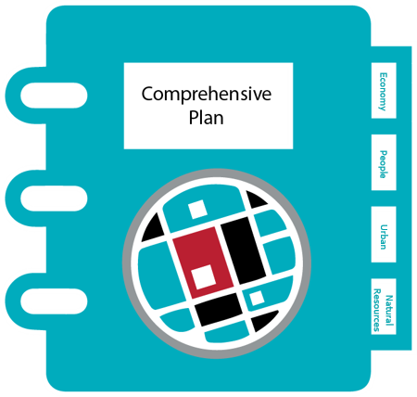
Prior Audit Findings
Ensure all audit findings have been addressed

Slide 27
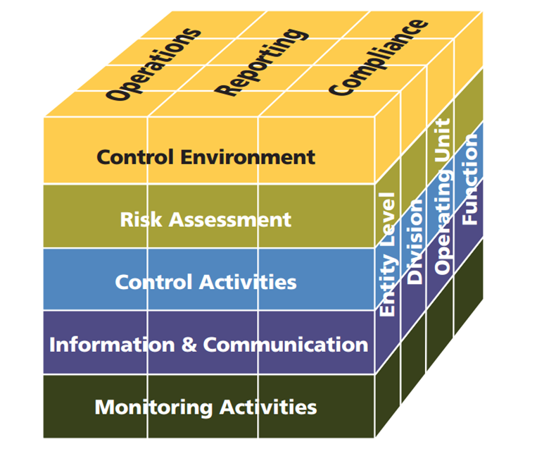
Internal Control – Who is Responsible?
Categories
of Objectives
Levels of
organizational structure
5 Components of
Internal Control
Notes:
Internal Controls are tools and techniques used by management to provided reasonable assurance regarding the achievement of their objectives with respect to effectiveness and efficiency of operations, reliability of financial reporting, and compliance with applicable laws and regulations. Lack of adequate internal controls is one of the most commonly cited reasons that fraud occurs within an organization. There are several valuable reasons for internal controls – they help management to meet their objectives, prevent errors, protect employees, provide checks and balances, establish standards, ensure compliance, preserve integrity, and security of assets.
YOUR ROLE – Elected officials are ultimately responsible for ensuring that management establishes an effective system of internal controls.
Control environment – tone needs to be set at the top, integrity and ethical values, commitment to competence, management’s philosophy and operating style, organizational structure, assignment of authority and responsibility, policies and practices.
Risk assessment – review of processes to determine what could go wrong
Control activities – are the methods used to reduce risk identified during the risk assessment process. Control activities include reviews, information processing, physical controls, segregation of duties (i.e., If I make an error in my work, will someone downstream of me detect it before it becomes a major issue for management and the taxpayers to read about?)
Monitoring – ensure that internal controls are working as planned and designed. Especially important to re-evaluate with the implementation of new systems.
Information and Communication – Information should be communicated between different levels of management and information is communicated with parties outside the government: vendors and citizens.

Slide 28
Importance of Internal Control
Meet objectives
Prevent errors
Protect employees
Checks and balances
Establish standards
Compliance
Preserve integrity
Security of assets
Several valuable reasons for Internal Controls

Slide 29
Steps for Sound Financial Operations
Balance Bank Statements Timely
Segregate Billing, Adjusting and Collecting
Train Finance Personnel Quickly and Continuously
Timely Internal Financial Reporting
Pay Payroll Taxes Timely
Notes:
Train Finance Personnel – Financial staff should participate in relevant professional organizations to keep abreast of developments in the field and best practices (i.e., GFOA & GGFOA).

Slide 30
Since 1927, the Carl Vinson Institute of Government has been an integral part of the University of Georgia. A public service and outreach unit of the university, the Institute of Government is the largest and most comprehensive university based organization serving governments in the United States through research services, customized assistance, training and development, and the application of technology.
2022 © Carl Vinson Institute of Government. All rights reserved.

Slide 31
Connect With Us!

