Slide 1
Georgia Airports Association 2022 Annual Conference
Aviation Program Update
October 14, 2022
Presented By
Colette Williams, Assistant Manager
Michael Giambrone, Planning Manager

Slide 2
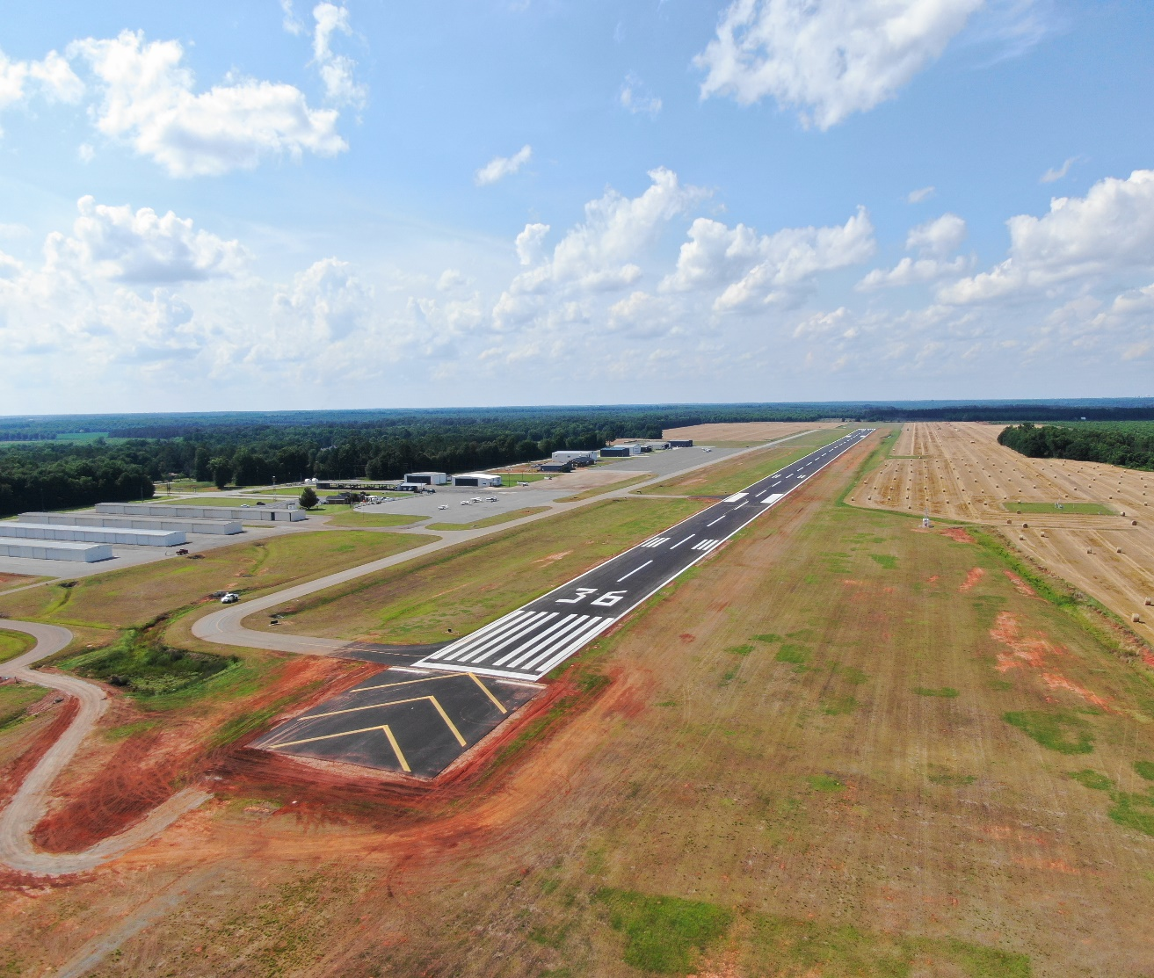
Agenda
Funding Programs
Airport Aid Program (FY22 & FY23)
Review of Historic Airport Funding
Planning Studies
Small Community Air Service Grant
Air Cargo Study
Aviation Program News
A Song of AIP and Sponsors
Perry-Houston County Airport
1
Notes:
1. Funding History State
2. Funding History Federal
3. Sponsor Request History
4. Project Types Funded
5. FY22 Program
6. Project Completed
7. Introduce New Staff
8. Based Aircraft Reporting Importance
9. UAM Potential
10. Infrastructure Bill
11. Airport Study Committee
12. Supplemental Funding
13. DBE Requirements
14. Look at Special Provisions
15. Look at Regional Meeting Agenda
16. Relief Funding Review/Update (CARES, CRRSA, and ARP)
17. Small Community Air Service Grant
18. Exhibit A Property Project

Slide 3
Pandemic Relief Funding
Impact on Georgia General Aviation Airports:
$3.5 million in CARES Act, reimbursed 100% of CARES
$1.5 million in CRRSA Act, reimbursed 100% of CRRSAA
$3.5 million in ARP Act, reimbursed 98% of ARPA
CARES & ARPA provided Non-primary Entitlement (NPE), State Apportionment, and Discretionary Funding for classified NPIAS Airports at 100% Federal Share for FY20 and FY21

Slide 4
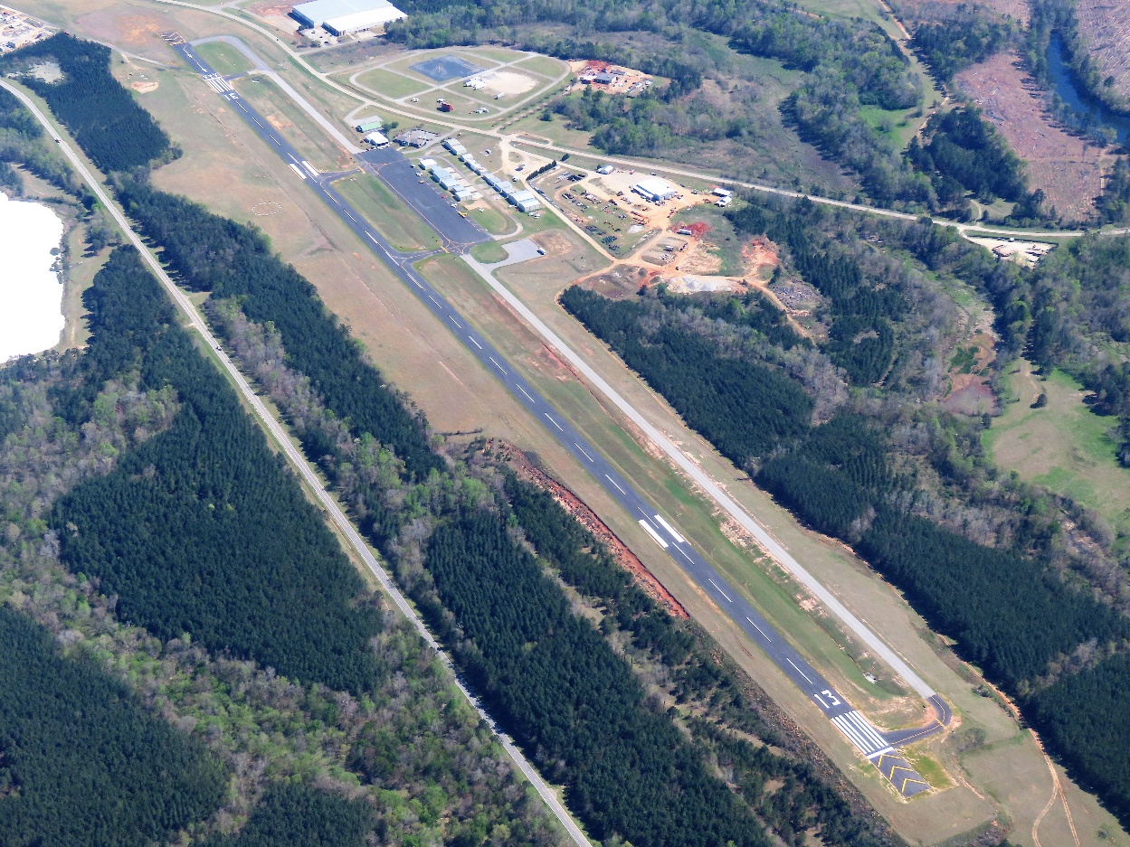
Supplemental Appropriation Funding
Congress can appropriate up to $1B annually
Funds are above normal AIP funding amounts
Impact on Georgia Airports
FY18 $1B; GA received $14.4M
(BHC, CWV, 18A, SAV)
FY19 $500M; GA received $12.6M
(AZE, PXE, OKC, VPC, CSG)
FY20 $400M; GA received $1.1M (SAV)
FY21 $400M; GA received $5.3M
(BGE, VDI, LGC, DNN)
FY22 No projects announced
Kaolin Field

Slide 5
Georgia FY22 Airport Aid Program
 | FY22 Apps | FY22 Program | FY22 Actual
Federal | $162.7M | $46.6M | $41.1M
State | $22.1M | $17.0M | $17.3M
Local | $16.6M | $9.2M | $6.4M
Total | $201.4M | $72.8M | $64.8M
292 applications received
82 CRRSAA contracts=$1.44M; 82 ARPA contracts=$3.4M
242 contracts; approx. 200% increase due to relief programs
66% of Georgia airports received funding
68 out of 103 airports received financial assistance
Received $18.5M in FY22 amended budget; obligate in FY23

Slide 6
Georgia FY23 Airport Aid Program
 | FY23 Apps | FY23 Program | Difference
Federal | $187.7M | $62.0M | $125.7M
State | $71.7M | $26.4M | $45.3M
Local | $35.1M | $10.8M | $24.3M
Total | $294.5M | $99.2M | $195.3M
355 applications received
95 contracts
FY23 budget increased by $9M
All projects in FY23 must have bids opened by March 1, 2023.
Only exception is discretionary projects or projects identified by GDOT.

Slide 7
Project Types by FY
Most Common Types of Projects FY22 FY23
Runway Construction/Rehab 18 22
Airfield Electrical 5 18
Apron Construction/Rehab 6 10
Obstruction Removal 8 10
Taxiway Construction/Rehab 7 9
Crack Seal and Remark 5 8
Planning 6 7
Hangar/Site Development 7 7
Land Acquisition 9 6
Fencing 4 5
AWOS 3 3

Slide 8
Historical Annual Federal Funding to Georgia

Slide 9
Historical Annual State Funding

Slide 10
Georgia Airports Annual Requested vs. Awarded Funding

Slide 11
National Highway Construction Cost Index (NHCCI)
Index 2003 Q1=1
58% Increase Over 10 Years

Slide 12
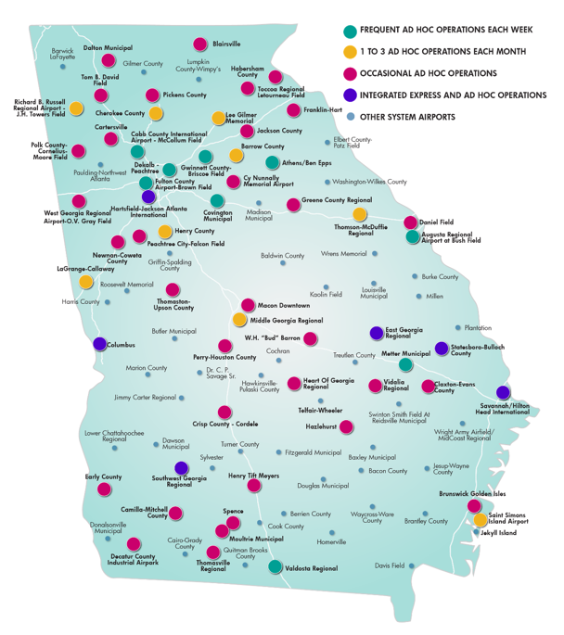
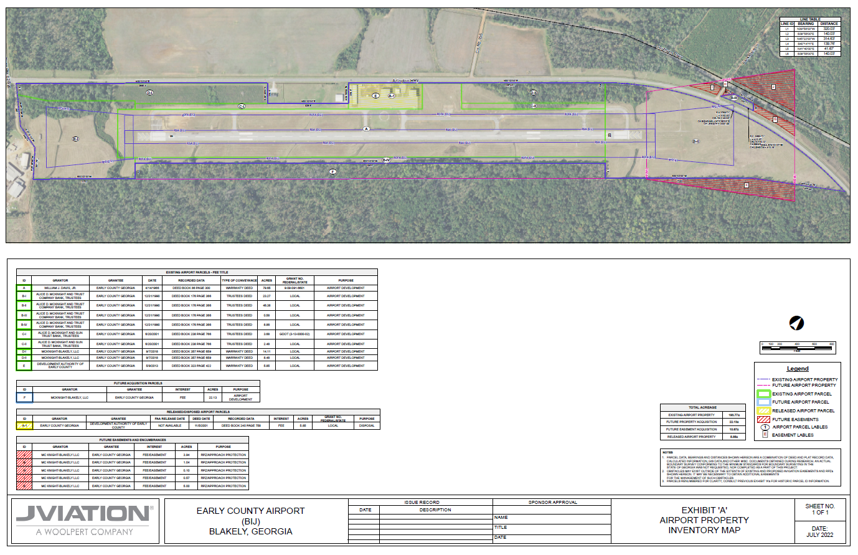
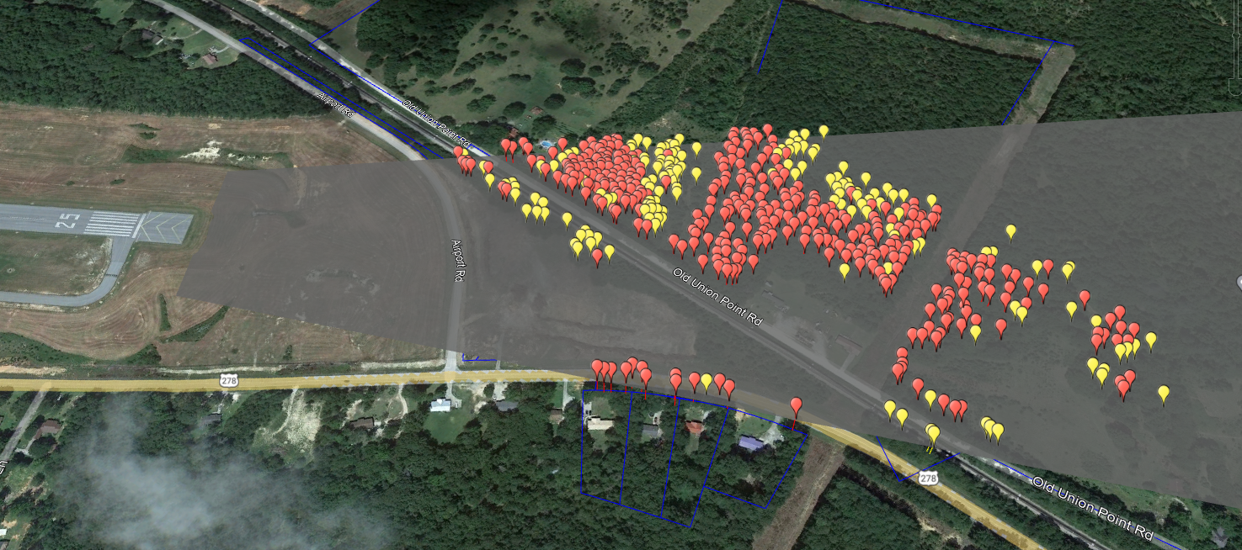
Aviation Program Planning Studies
Exhibit A Property Map Updates
Obstruction Surveys
Small Community Air Service Grant
Air Cargo Study
Future Studies
DeKalb-Peachtree Airport EMAS Project

Slide 13
Exhibit ‘A’ Property Map Updates
Purpose
Update Exhibit ‘A’ Property Maps - 40 airports
^{Deed Research}
Identify Federally Obligated Land
Confirm Sponsor Holds Title to Airport Property
Deliverables
SOP Compliant Exhibit ‘A’ Property Maps
^{Deeds}
Grant Info/Supporting Documentation
^{GIS Database}

Slide 14
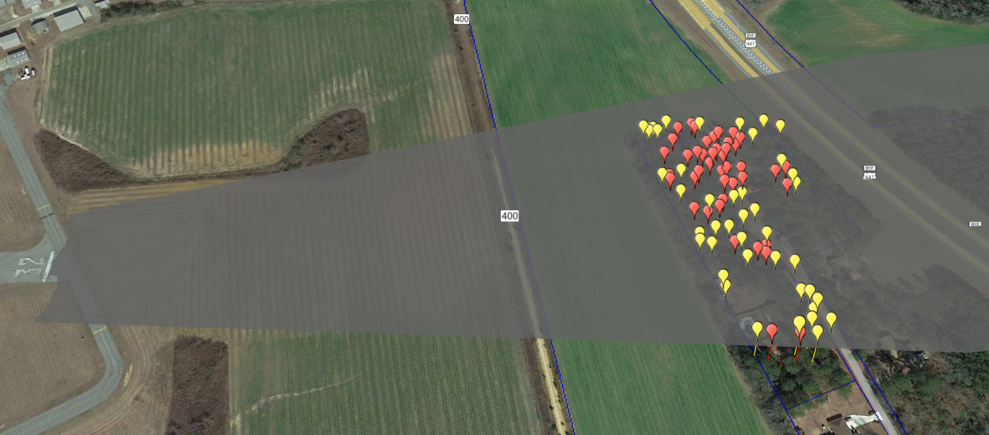
Airport LiDAR Obstruction Surveys
Purpose
Identify Vegetation Obstructions to Runway Approaches - 36 Airports
Use Data to Create Obstacle Action Plans
Deliverables
Obstruction Reports by Surface & Parcel
^{Google Earth Files}
^{Shape Files}
^{Obstruction Spreadsheets}

Slide 15
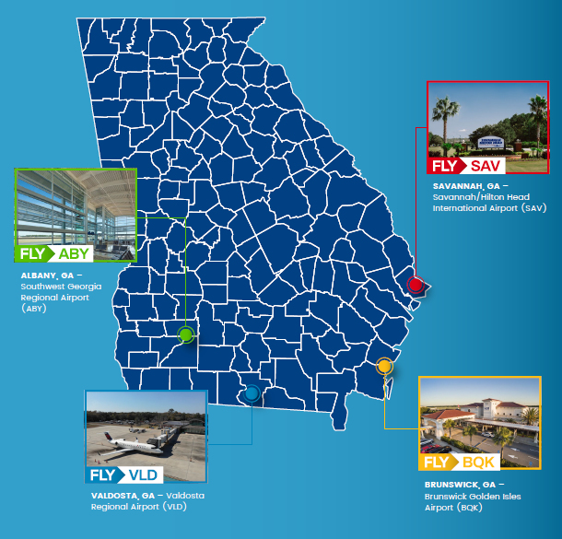
Small Community Air Service Development Program Grant
Purpose
Reduce Passenger Leakage & Increase Enplanements
through Fly Local/Fly Georgia Marketing Efforts for:
- Albany
- Brunswick
- Savannah
- Valdosta
(Augusta & Columbus had open SCASDP grants
& Macon is an EAS airport)
Deliverables
Marketing Toolkit and Advertising Campaign

Slide 16
Notes:
Steve intro

Slide 17
Study Purpose
Provide an overview of the air cargo industry
Identify current air cargo activity
Forecast future air cargo demand
Evaluate facilities at airports served by integrated express carriers
Determine if investment is needed to serve current or forecasted air cargo activity

Slide 18
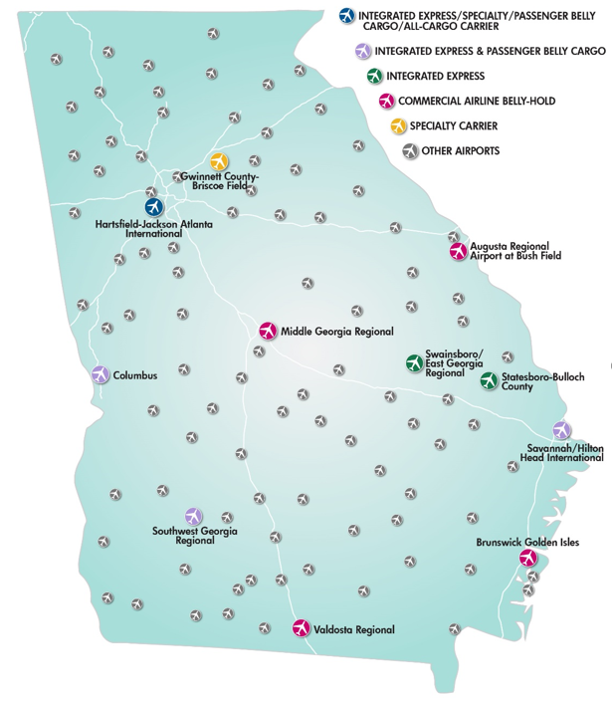
Types of Air Cargo Carriers
Commercial Airline/Belly-Hold
Specialty Carrier
Ad Hoc Carriers
All Cargo Carriers
Integrated Express (Jet/Feeder) Carriers

Slide 19
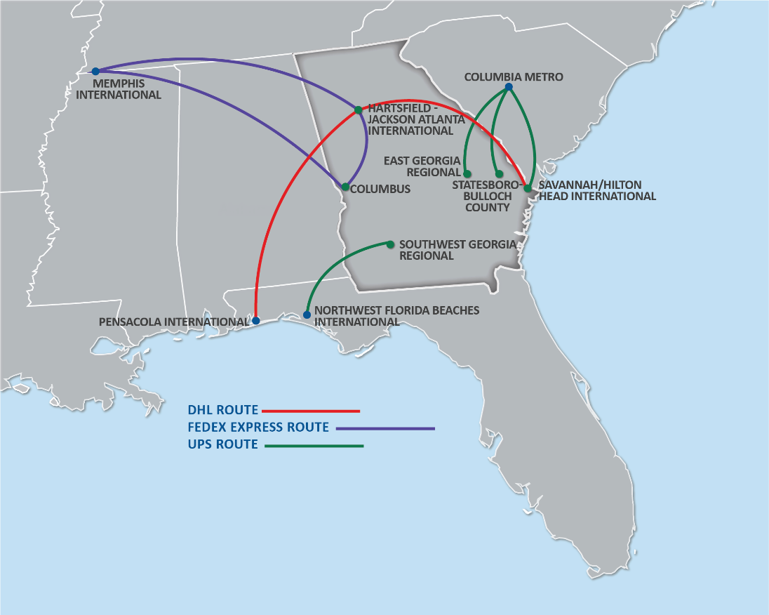
Scheduled Integrated Express Carrier Flights*
FEEDER AIRCRAFT FLIGHTS
JET AIRCRAFT FLIGHTS
*Does not include all ATL Flights

Slide 20
58 Airports Serve Ad Hoc/On Demand Air Cargo Flights

Slide 21
$30 BILLION in Commodities Are Transported Annually by Air To and From Georgia

Slide 22
Georgia Has Almost 900 Air Cargo Demand Generators

Slide 23
Study Identified Gap Areas for Accessibility to Integrated Express Carrier Service

Slide 24
Growth in Air Cargo Demand
2011 – 2020 air cargo grew at average annual rate of 2.6%
E-commerce accelerating air cargo demand
Pre-COVID, e-commerce was 18% of air cargo revenue
By 2022, e-commerce accounts for 22% of air cargo revenue
Boeing Aerospace predicts 4% average annual rate for air cargo
Business as usual indicates cargo tonnage at Georgia airports will at least double over the next 20 years

Slide 25
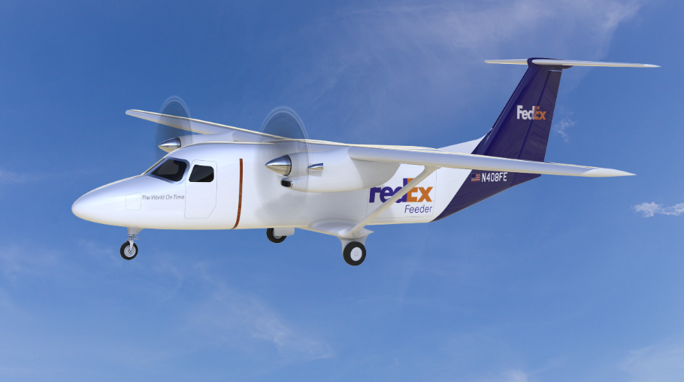
Air Cargo Industry Trends
Integrated express carriers expanding their fleet of feeder aircraft
Electric aircraft on the horizon for cargo carriers
Drones will play an expanded role in air cargo transport

Slide 26
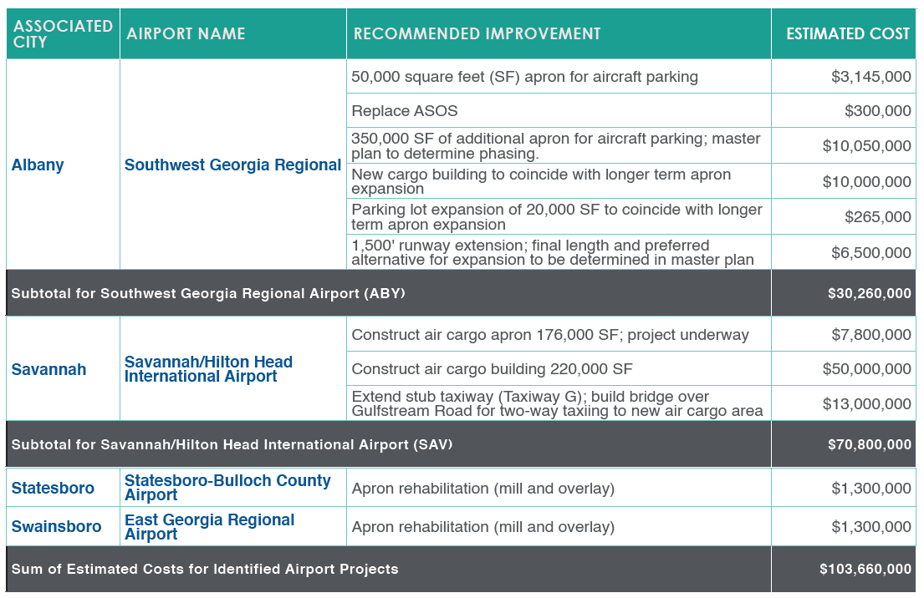
Improvements/Investments at Georgia Airports Serving Integrated Express Carriers

Slide 27
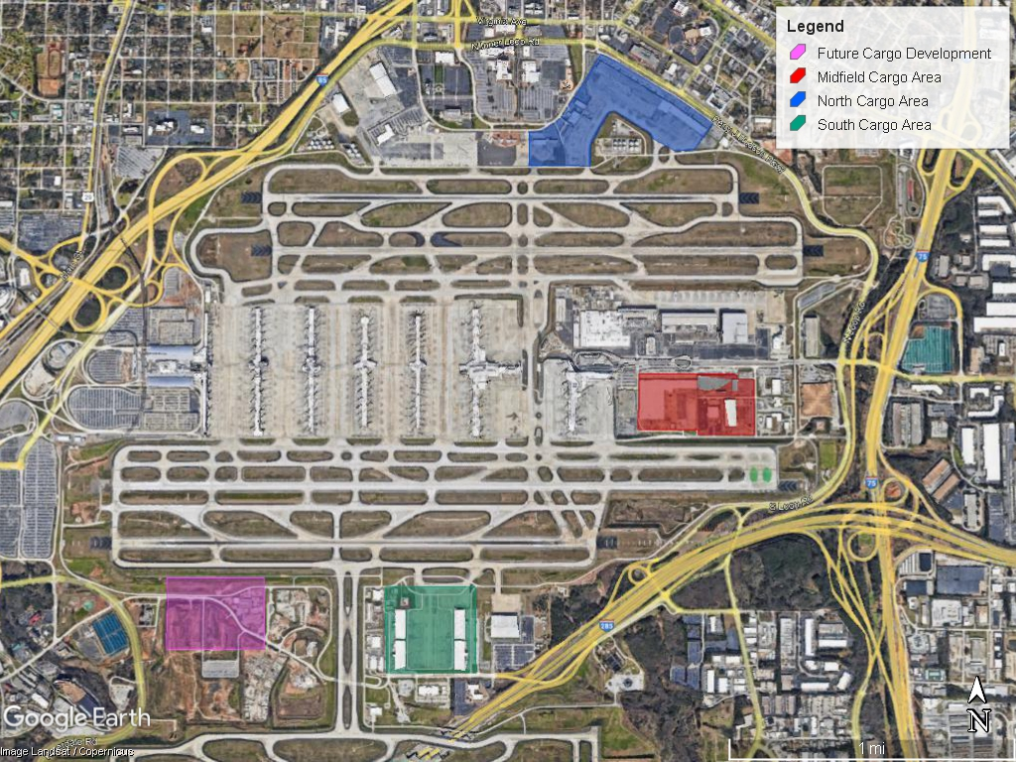
Air Cargo at Hartsfield-Jackson Atlanta International
ATL currently has 150 acres devoted to air cargo
40 additional acres of planned development
13th busiest air cargo airport in U.S.
Capitalizing on technology to improve air cargo efficiency
Projects needed to address ground access constraints

Slide 28
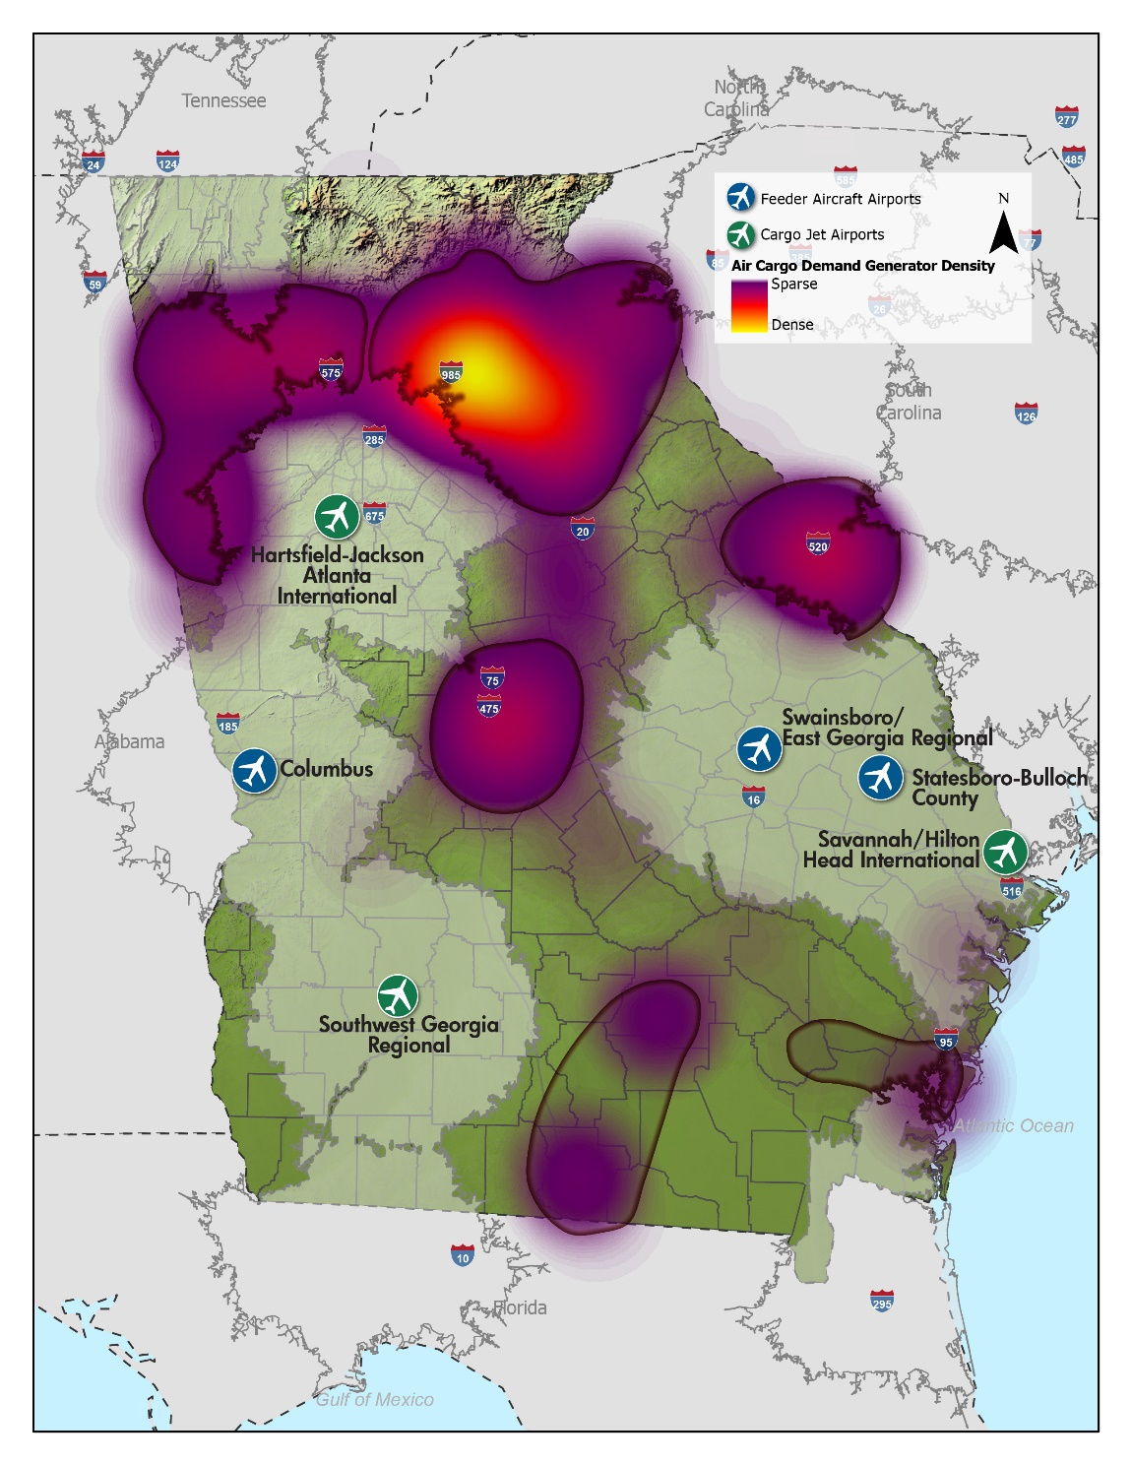
Observations, Findings, and Conclusions
Airports with scheduled air cargo activity need an estimated $103.7 million in improvements (excluding ATL)
Implementing projects would support $202 million in economic impact and support 1,400 jobs
Growth in demand and ground constraints in urban areas may support the need for additional air cargo service
Carriers will determine which airports best meet their expansion needs

Slide 29
Follow-On Activities
Monitor
Monitor how economic growth influences air cargo demand
Keep
Keep tabs on the implementation of this study’s identified air cargo facility improvements
Track
Track changes in technology that influence air cargo
Help
Help the state stay abreast of air cargo expansion opportunities
Advocate
Advocate for funding for air cargo projects
Establish
Establish an Air Cargo Working Group

Slide 30
Future Planning Studies
Advanced Air Mobility (AAM)
Determine Georgia’s role in AAM and potentially licensing vertiports
Hangar Needs Analysis
Determine statewide demand for aircraft hangars
Rates and Charges
Survey public use airports on rates, charges, and related activities
Air Carrier Investment Study
Review available funding compared to airport needs and economic impacts

Slide 31
2022 Aviation Program Customer Survey
Background and Response Rate
The survey received 96 responses, resulting in a 30% participation rate. The survey was sent to 321 recipients (112 sponsors, 163 managers, 46 consultants)
For reference, we received 104 responses from 279 survey invitations in 2019.
Questions focus on the following areas:
Aviation Project Manager
Aviation Program
Aviation Program Website
BlackCat Aviation Application
Notes:
Sent to 42 more recipients compared to 2019
Received 104 responses in 2019 (37%)
Will cover the response breakdown in a few slides
An average of 96 responded to the questions in ‘19; compared to 89 in 2022.
Sent to 321 recipients: 112 sponsors, 163 managers, 46 consultants

Slide 32
Overall Customer Service
Overall Customer Service Ratings (Weighted Scores)
 | 2019 | 2022
Rate the overall customer service you receive from your Aviation Project Manager | 4.3 | 4.5
Rate the overall customer service you receive from the Aviation Program | 4.1 | 4.5
Weighted Scores throughout the presentation are provided on a 5-point scale, with 5 indicating the highest rated response (Excellent or Strongly Agree).

Slide 33
Communication
How frequently do you communicate with your APM?
Typical Response Time
 | Sponsor/Manager | Consultant | All
4 hours or less | 60% | 25% | 55%
5 - 24 hours | 32% | 50% | 35%
25 - 48 hours | 7% | 8% | 7%
3 - 5 working days | 0% | 8% | 1%
A week or longer | 0% | 8% | 1%

Slide 34
Aviation Project Managers
Aviation Project Manager Section (Weighted Scores)
 | 2019 | 2022
Responds in a timely manner to my inquiries. | 4.4 | 4.6
Provides sufficient information on State and Federal regulations and policies. | 4.2 | 4.4
Is proactive in identifying problems/issues. | 4.2 | 4.3
Assists me in solving problems and/or resolving issues when they arise. | 4.3 | 4.5

Slide 35
Aviation Program
Aviation Program Section (Weighted Scores)
 | 2019 | 2022
Is a valuable partner in assisting my airport. | 4.4 | 4.6
The resources provided regarding regulations and policies for State and FAA compliance are adequate. | 4.2 | 4.4
Does a satisfactory job of balancing my airport's needs with those across Georgia's 102 other airports. | 4.0 | 4.1
Effectively helps Georgia's airports leverage all state and federal resources. | 4.0 | 4.3
Process for reviewing and commenting is reasonable. | 4.0 | 4.0
Process for reviewing and commenting is completed in a timely manner. | 4.0 | 4.2
Consistently pays my approved and complete project pay requests within 30 days. | 4.2 | 4.4

Slide 36
Sponsor Risk/Performance Assessments
Sponsor Self Assessment
Assess Airport Sponsor Policies, Procedures, & Internal Controls
Procurement
Grants oversight
Disbursement
Business Continuity
Information Technology Infrastructure
GDOT Assessment
Past Performance
Projects completed on-time
Payments & Processing
Improper Contracting
Contract Amendments
Single Audit/Improper Practices
Documentation
Sponsor Demographics
Frequency of turnover
Knowledge of AIP, federal regulations/requirements

Slide 37
New Contract Provisions
Airport Sponsor Certifications
Construction Project Final Acceptance
Drug Free Workplace
Equipment and Construction Contracts
Project Plans and Specifications
Real Property Acquisition
Selection of Consultants
Certification & Disclosure Regarding Potential Conflicts of Interest
Certification Regarding Lobbying
Additional Provisions
Copy of Airport Sponsor Grant Assurances
Notification of Federal Single Audit Requirements
Payment Frequency
Special Conditions

Slide 38
A song of AIP and Sponsors
Audits
Revenue producing projects
Projects eligible and justified
Compatible land use around airports
Good title to land & airport sponsorship
FAA is coming
A sponsor always pays their debts
When you play the game of AIP, you win or you die
You know nothing Jon Doe
The documents are dark & full of terrors
FY24 applications and FY24-28 CIPs due 11/11/22
Have your house of documentation in order

Slide 39
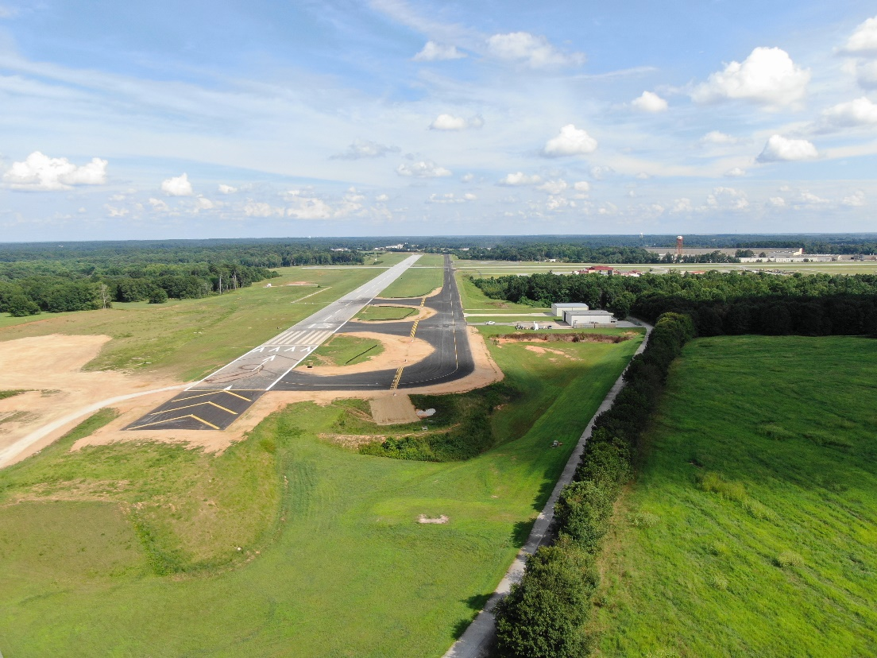
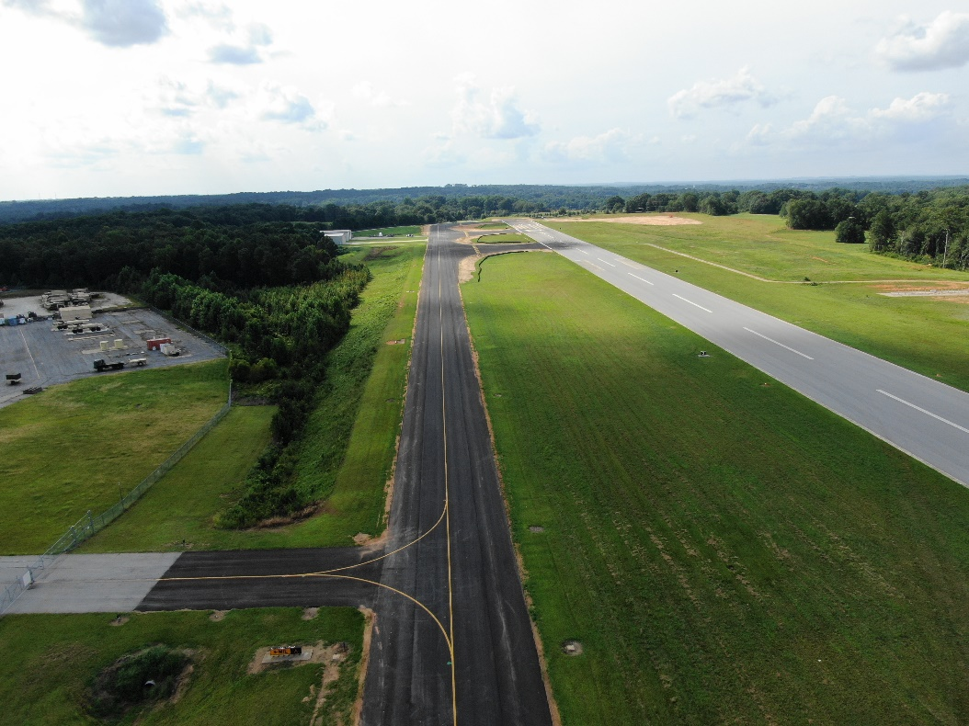
Barrow County Airport Rehabilitate and Extend Taxiway A, Taxiway Fillets, Construct Blast Pad and Remark Runway 13 End Total Project Cost $2,974,998

Slide 40
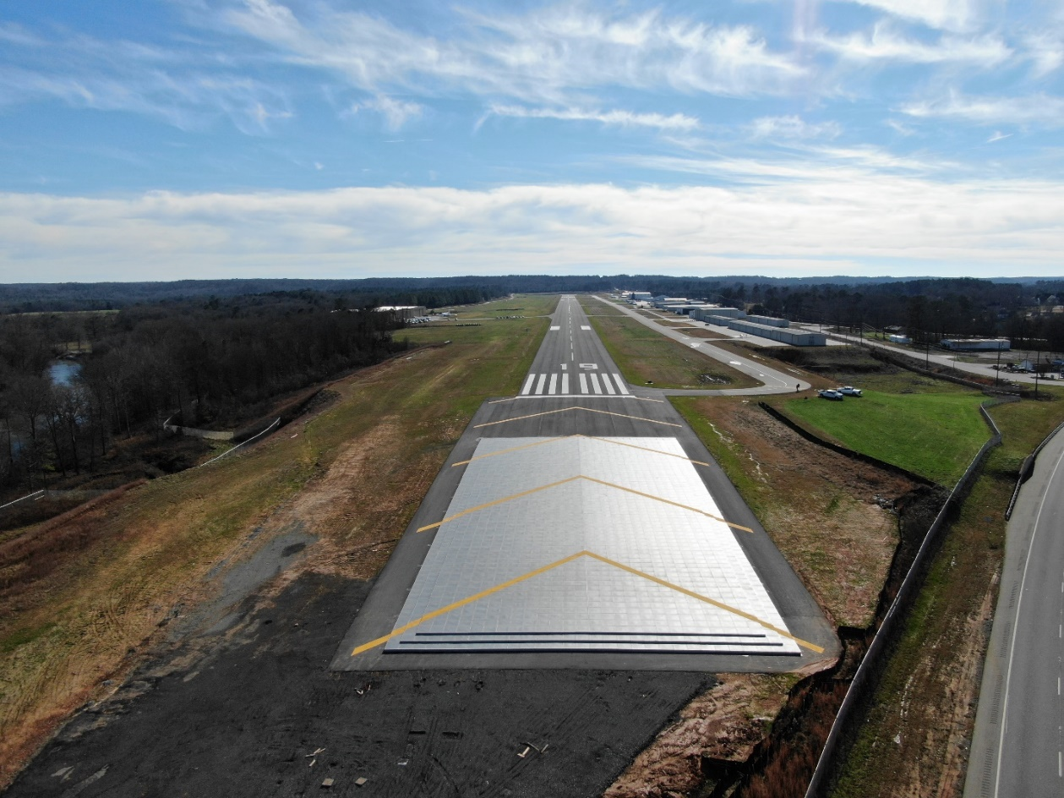
Cartersville Airport Construct EMAS and Rehabilitate Runway Total Project Cost $10,513,409

Slide 41
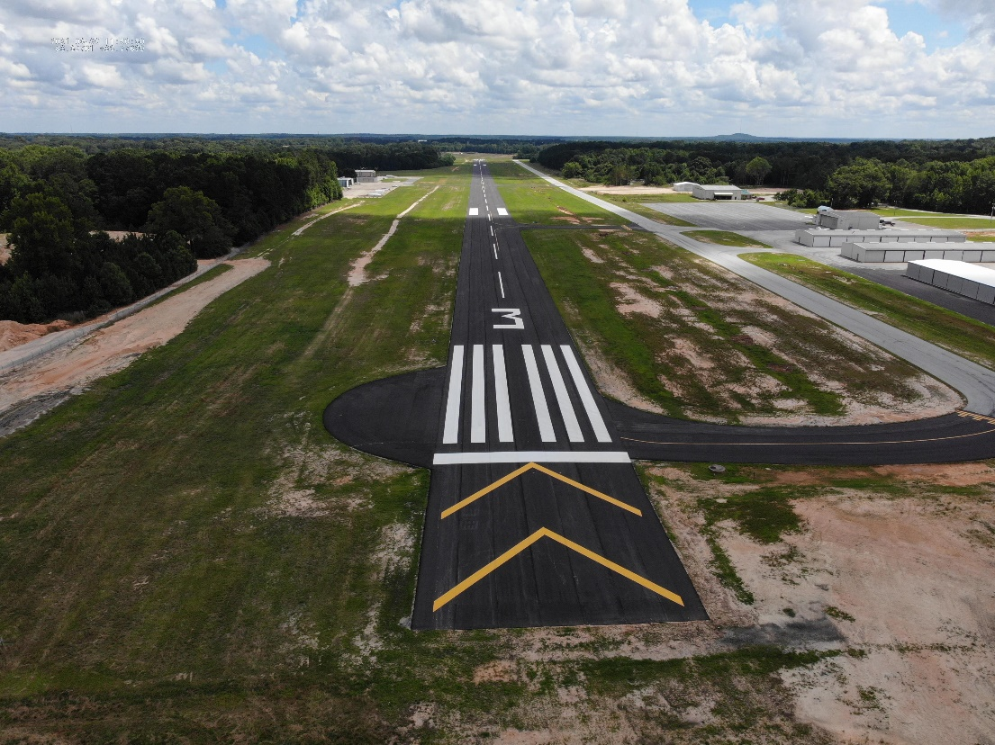
Monroe – Cy Nunnally Memorial Airport Rehabilitation of Runway 3-21 Total Project Cost $993,164

Slide 42
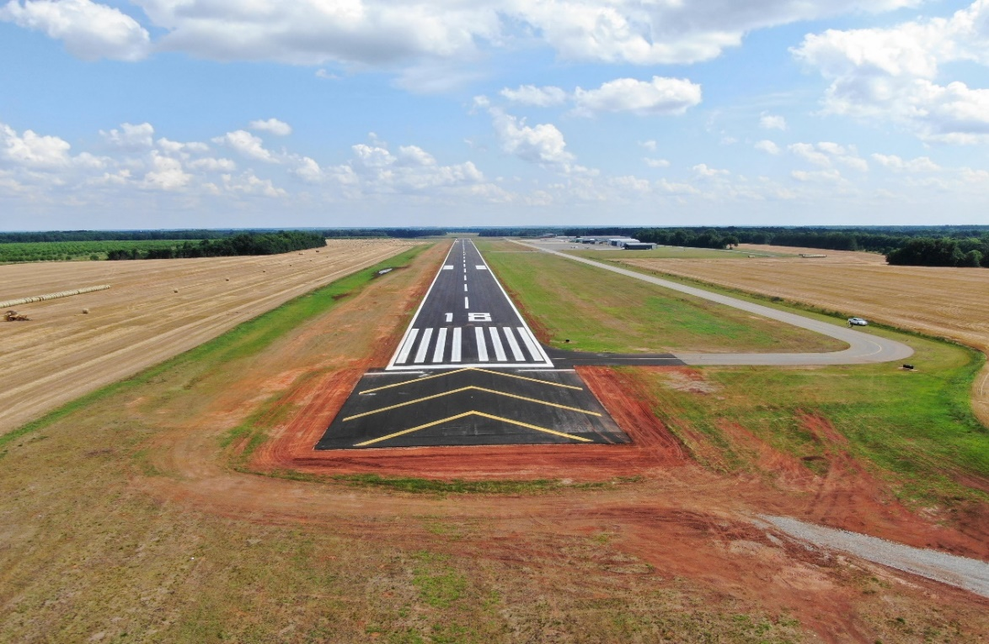
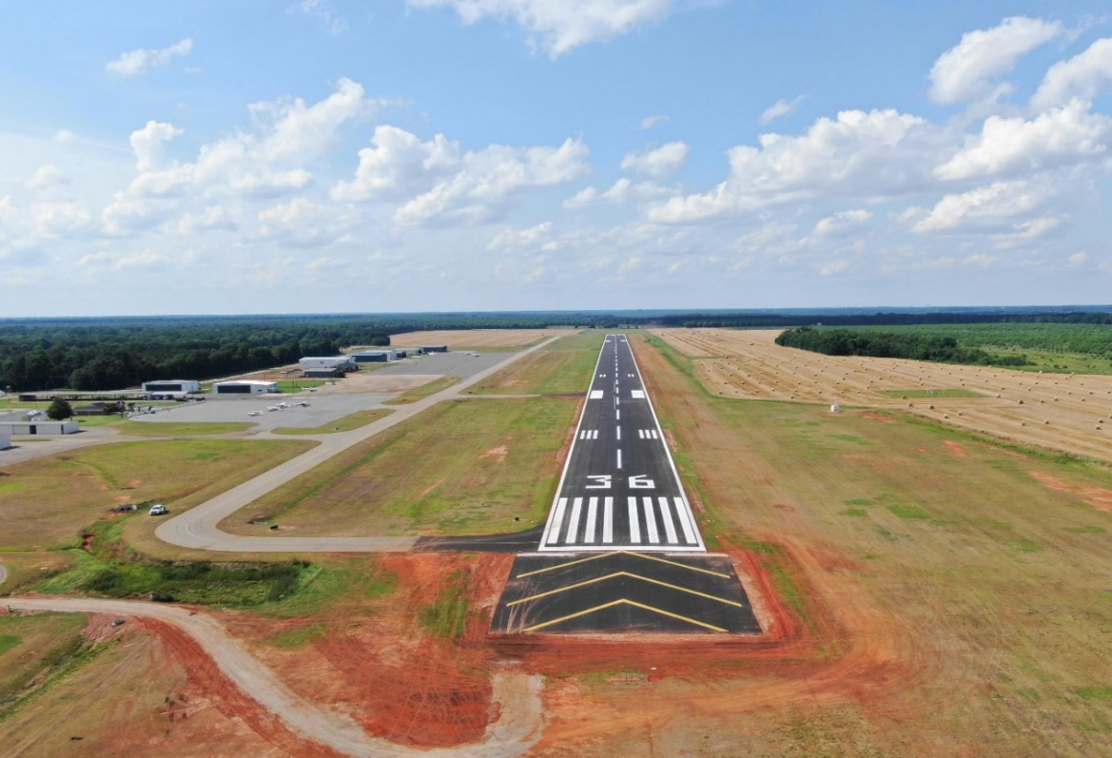
Perry-Houston County Airport Rehabilitation and Improve Runway 18-36 Total Project Cost $2,373,635

Slide 43
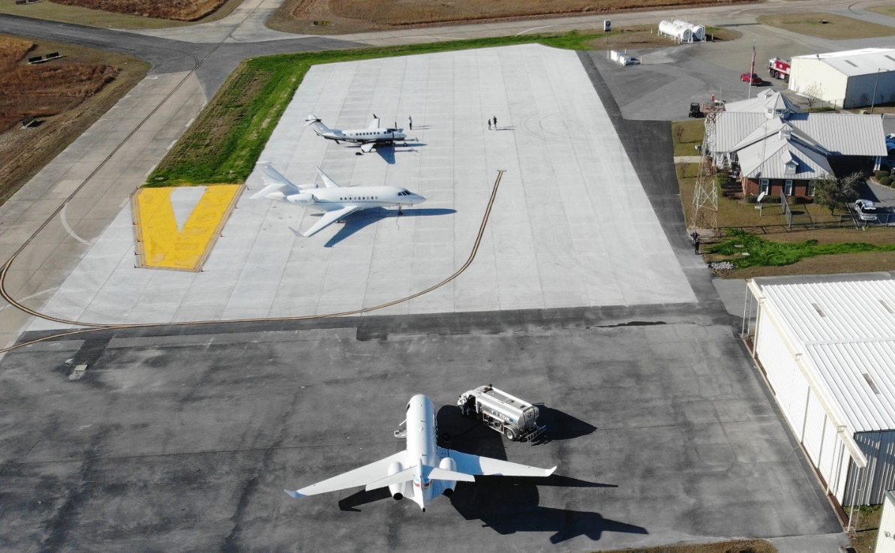
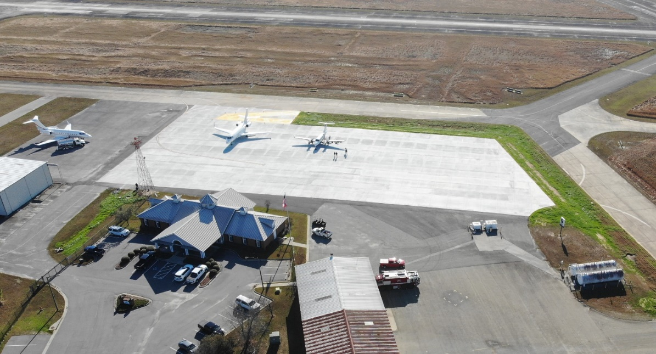
Vidalia Regional Airport Rehabilitate Apron Total Project Cost $1,909,940

Slide 44
Questions?
Colette Williams, Assistant Manager
Michael Giambrone, Planning Manager
Visit us
dot.ga.gov/aviation

