Slide 2
HOLT CONSULTING COMPANY, LLC
HOLT CONSULTING COMPANY, LLC
SERVICE | SOLUTIONS | SUCCESS
SERVICE | SOLUTIONS | SUCCESS

Slide 3
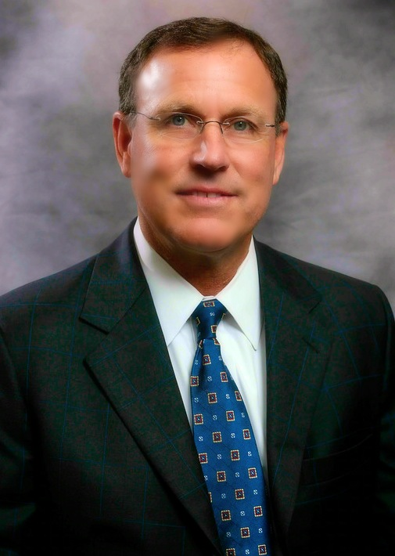
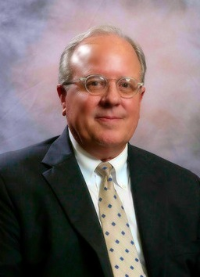
INTRODUCTION
FOUNDERS
Transportation Specialists
Just over 8 years in business
Two founders have 70 YEARS of combined experience
Client Service Focus
Employee Centric Work Environment
Relationships with Industry Partners
Paul A. Holt, PE
Principal
R. Kennedy (Ken) Holt
Principal

Slide 4
AVIATION CAPABILITIES
Design Services:
Prepare Contracts w/ Owner and Subconsultants
Conduct Project Management and General Coordination
Conduct Site Visits
Prepare Permits
Prepare 60%, 90%, & 100% Design Development
Grant Services:
Update 5-Year Capital Improvement Plan (CIP)
Prepare FAA Grant Pre-Application and Application Package
Prepare GDOT Grant Application
Prepare FAA Grant Quarterly Reports
Prepare FAA Grant Closeout Documentation
Bidding Services:
Compose Advertisement
Distribute Plans and Specs to Potential Bidders
Conduct Pre-Bid Conference
Issue Addenda
Conduct Bid Opening
Evaluate Bids and Recommend Award
Construction Services:
Prepare Contractors’ Contract
Issue Conformed Construction Documents
Conduct Pre-construction Conference
Review Shop Drawings and Submittals
Prepare Construction Management Plan
Conduct Construction Admin. and Inspection
Prepare Construction Closeout Documentation

Slide 5
OFFICE LOCATIONS
EMPLOYEES
35
OFFICE LOCATIONS
6
LICENSED PE’S
12
ENGINEER’S-IN-TRAINING
4
CURRENT GEORGIA AIRPORT CLIENTS
17
Headquarters
Holt Consulting Company, LLC
2801 Devine Street | Suite 201
Columbia, South Carolina 29205
Metro Atlanta-Area
Holt Consulting Company, LLC
2915 Premiere Parkway | Suite 125
Duluth, Georgia 30097
Knoxville
Holt Consulting Company, LLC
123 Center Park Drive | Suite 211
Knoxville, Tennessee 37922
South Carolina - Upstate
Holt Consulting Company, LLC
10 Patewood Drive | Suite 220
Greenville, South Carolina 29615
Charleston-Area
Holt Consulting Company, LLC
1156 Bowman Road | Suite 200
Mt. Pleasant, South Carolina 29464
Florida Panhandle
Holt Consulting Company, LLC
202 Sawbuck Drive
Inlet Beach, Florida 32461

Slide 6
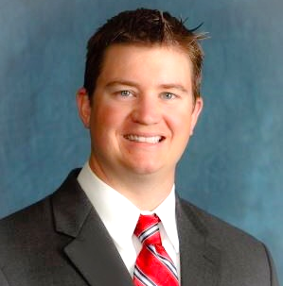
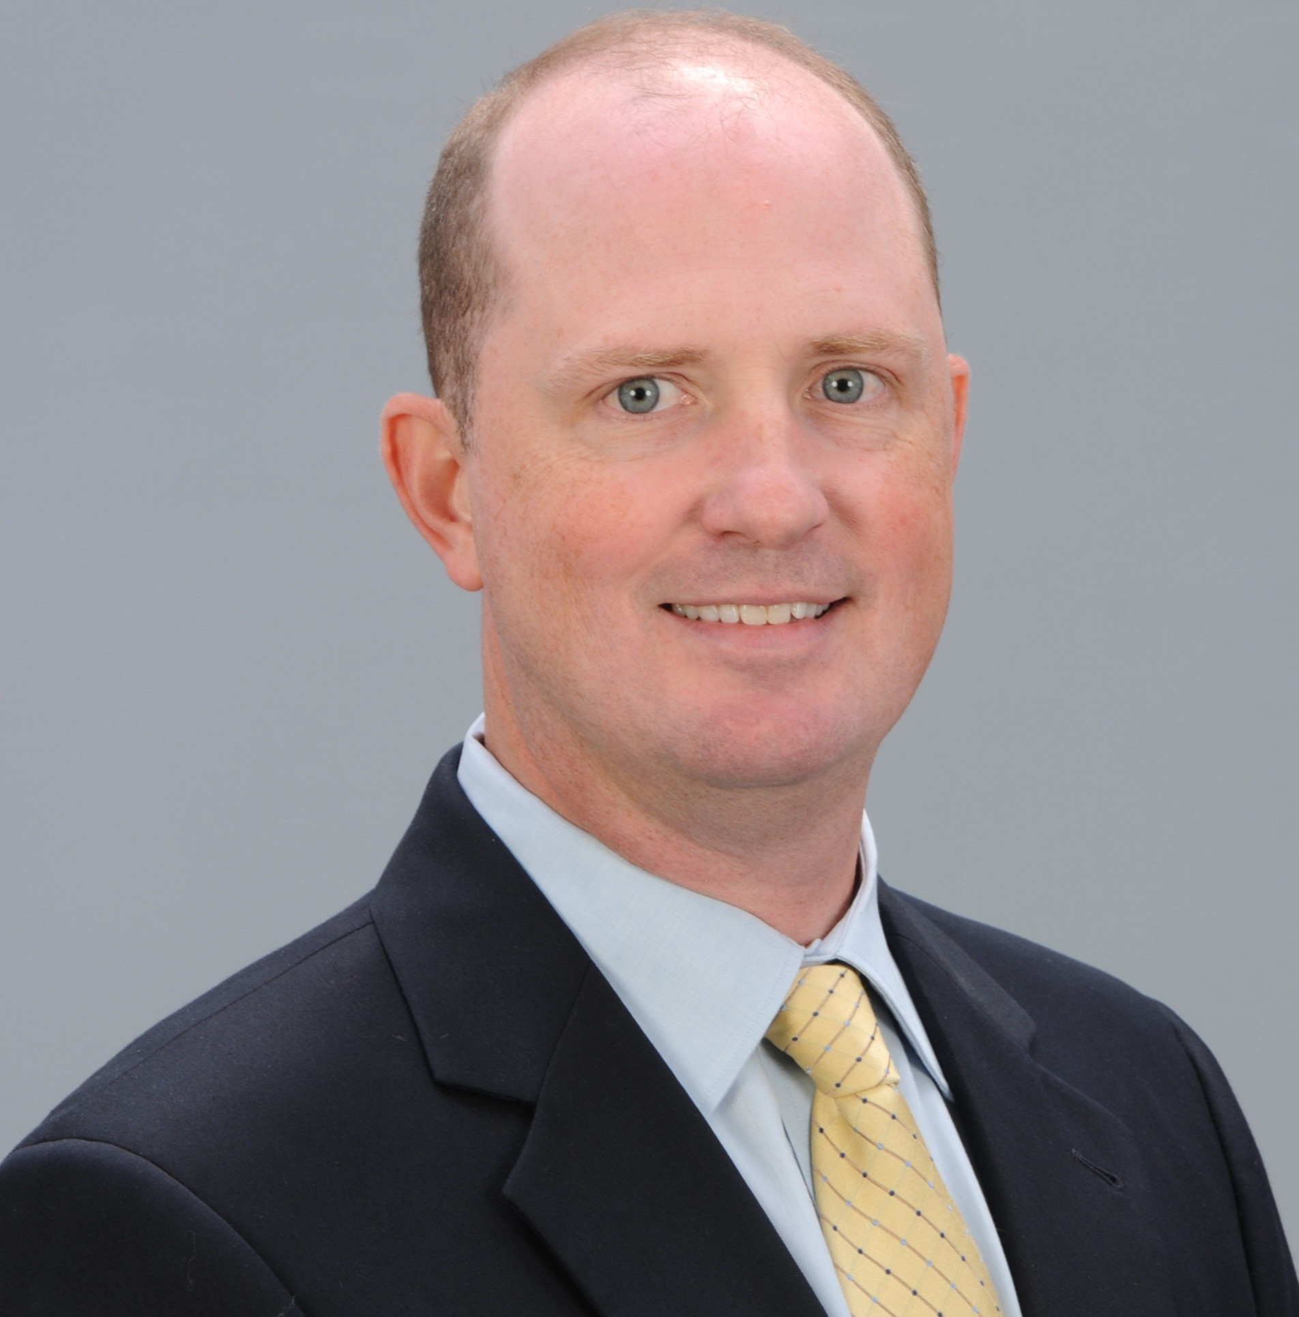
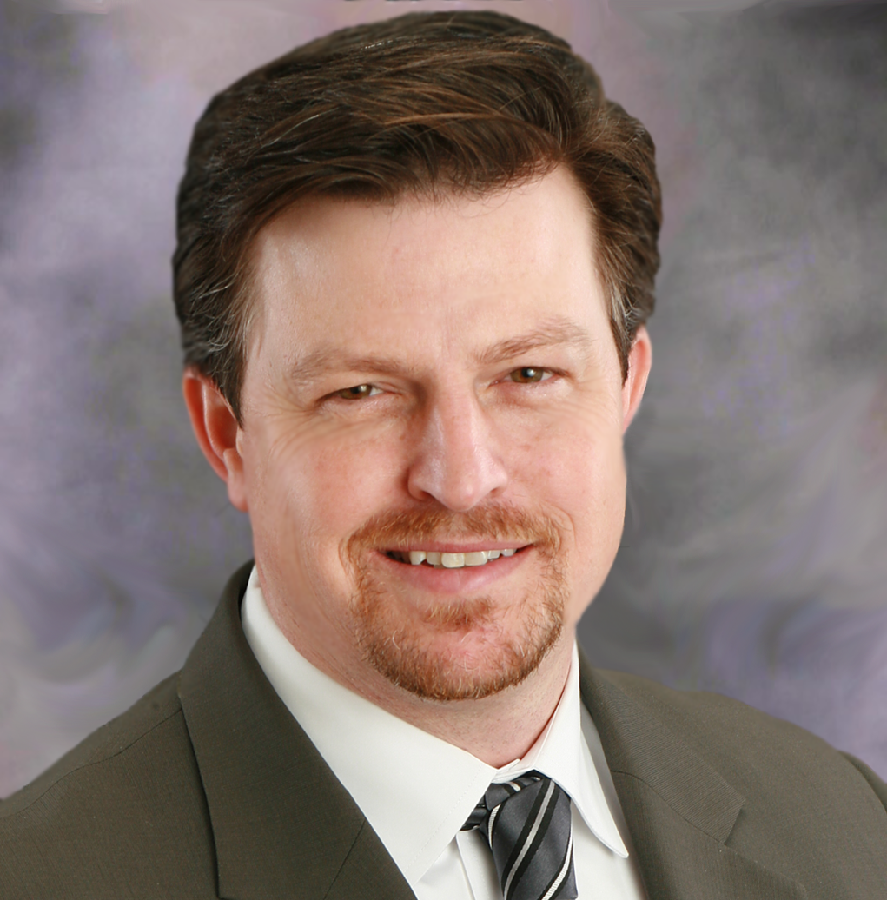
5
5
Mark Counts
Experience: 34 Years
Paul A. Holt, PE
Experience: 37 Years
Chris Lowery, PE
Experience: 13 Years
Aviation
Project Managers
in Georgia
Jeff Pike, PE
Experience: 23 Years
Jacob Redwine, PE
Experience: 23 Years

Slide 7
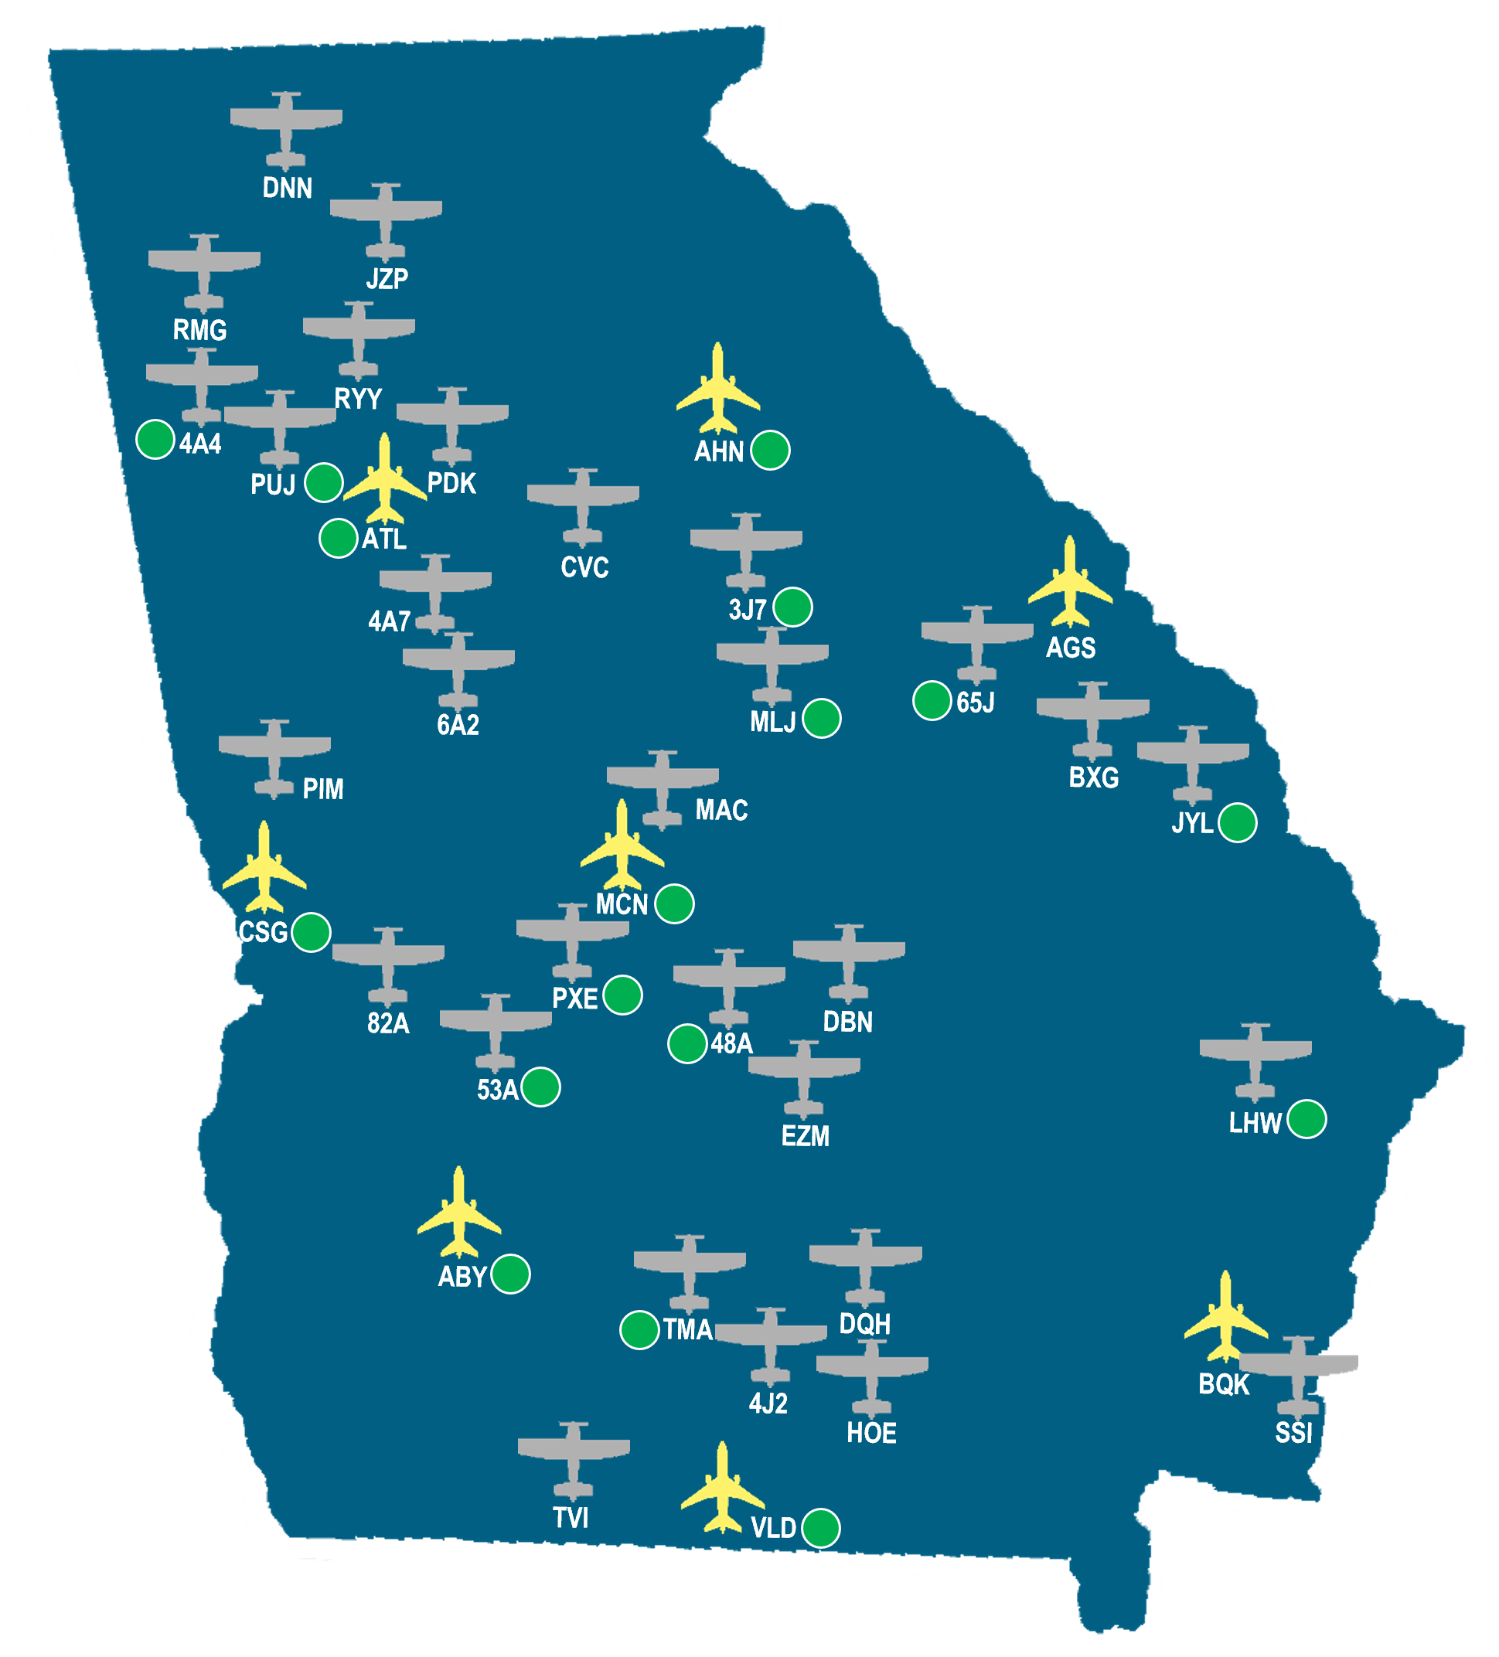
GEORGIA AIRPORT EXPERIENCE
General Aviation Airport (30)
Air Carrier Airport (8)
Current Holt Client (17)
The Holt Team KNOWS Georgia Aviation!
The Holt Team KNOWS Georgia Aviation!

Slide 8
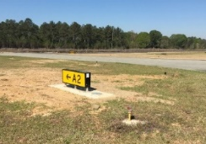
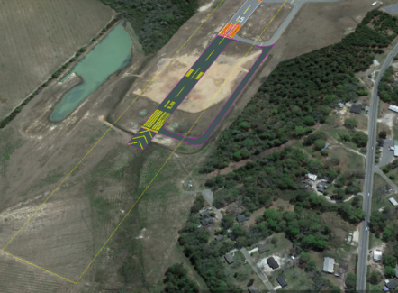
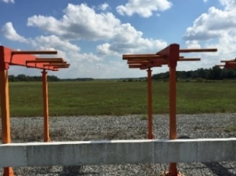
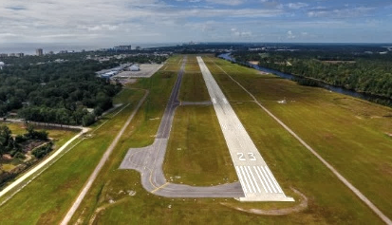
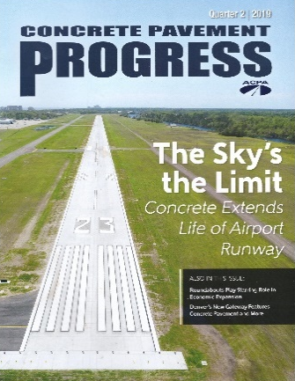
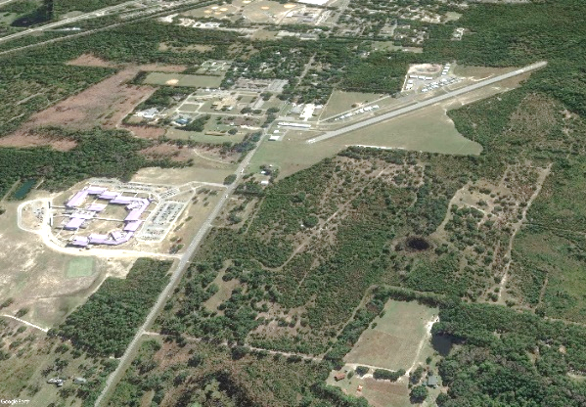
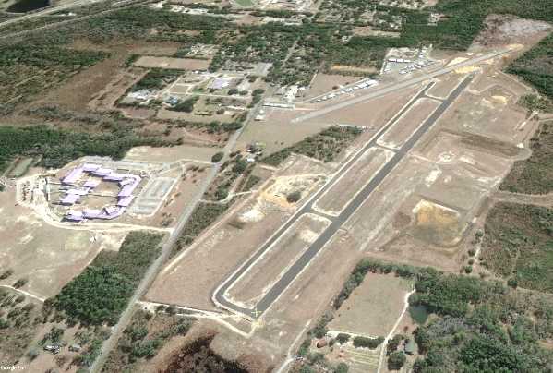
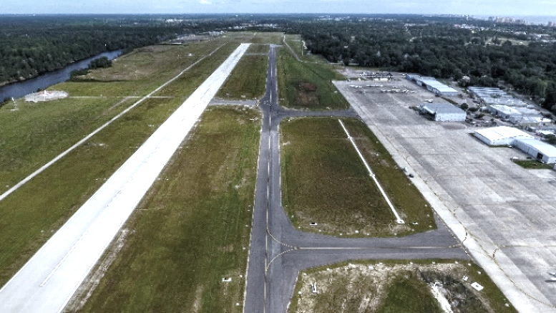
AWARD WINNING PROJECTS
Henry Tift Myers Airport (TMA)
Tifton, GA
RW 15 Safety Area Improvements
and RW Extension Program
Grand Strand Airport (CRE)
North Myrtle Beach, SC
RW 5-23 Rehabilitation, Taxiway Rehabilitation
and Airfield Improvements Program
AWARD:
Georgia Airports Association (GAA)
2015 Project of the Year
AWARD:
American Concrete Paving Association (ACPA)
2019 Project of the Year: Airport Paving Category
Ridgeland-Claude Dean Airport (3J1)
Jasper County, SC
New Runway Program
AWARD:
American Association of Engineering Companies (ACEC)
2021 Engineering Excellence Award
BEFORE
AFTER

Slide 9
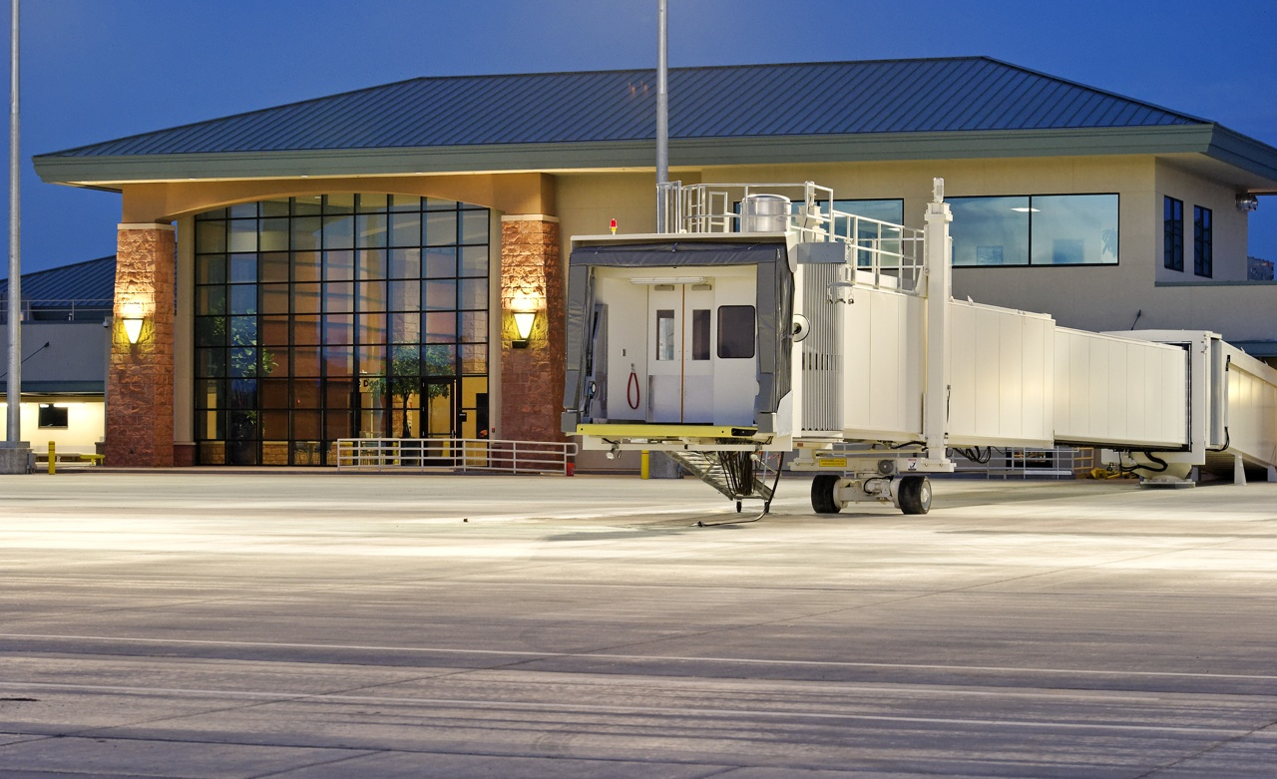
JBT AeroTech – Jetway Systems

Slide 11
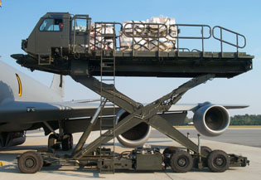
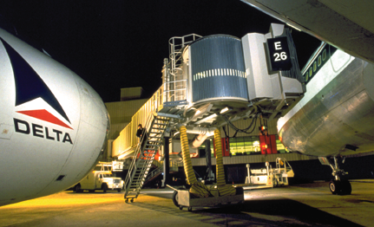
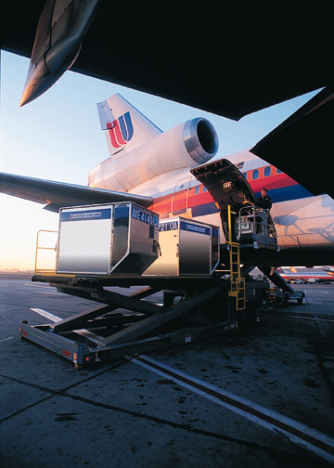
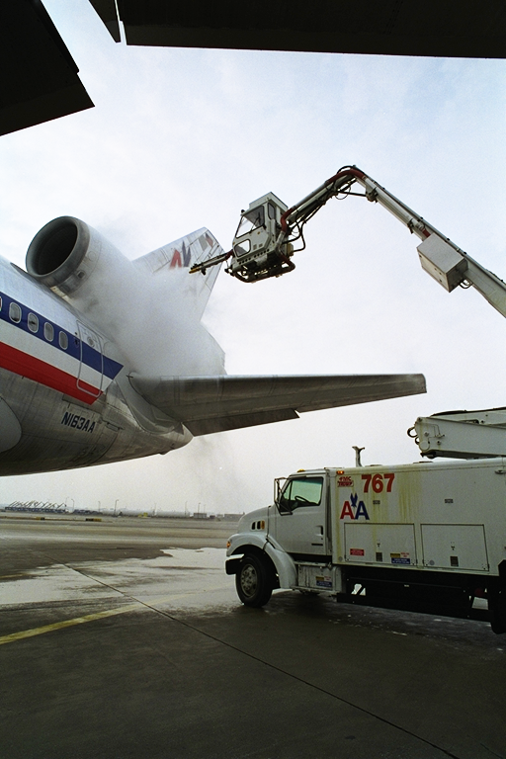
JBT AeroTech
Military Loader
Passenger Boarding Bridge
Commercial Loaders
Pushback Tractors
Deicing Systems
Airport Services

Slide 12
Jetway Systems
Gate Equipment and After Market Products
Passenger Boarding Bridges
Point of Use and Central GPU
Point of Use and Central PCA
Refurbishment and resale of experienced PBB’s
iOps Monitoring
JBT Aviation Service Equipment
Military
PCA for the AF and Navy
Central PCA and GPU for Hard Stand and Hangar Applications
PCA and Power for Airframe Manufacturers
Mobile Commercial PCA/GPU

Slide 13
Installed Base
More than 7,000 built
More than 6,000 built
More than 6,000 built

Slide 14
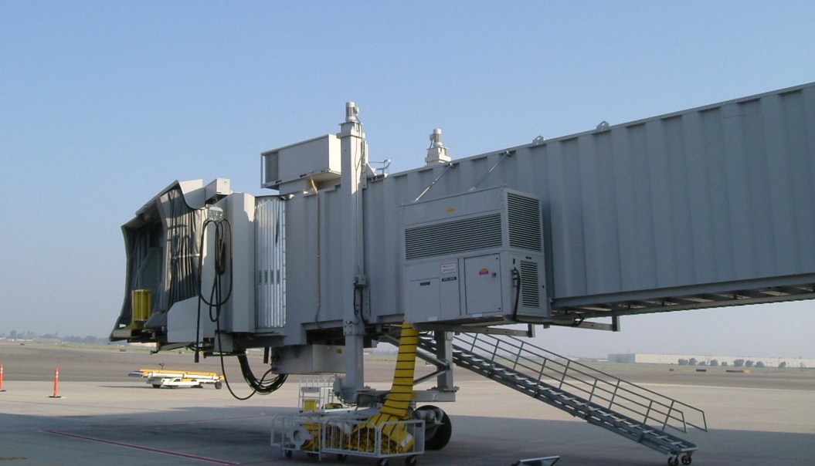
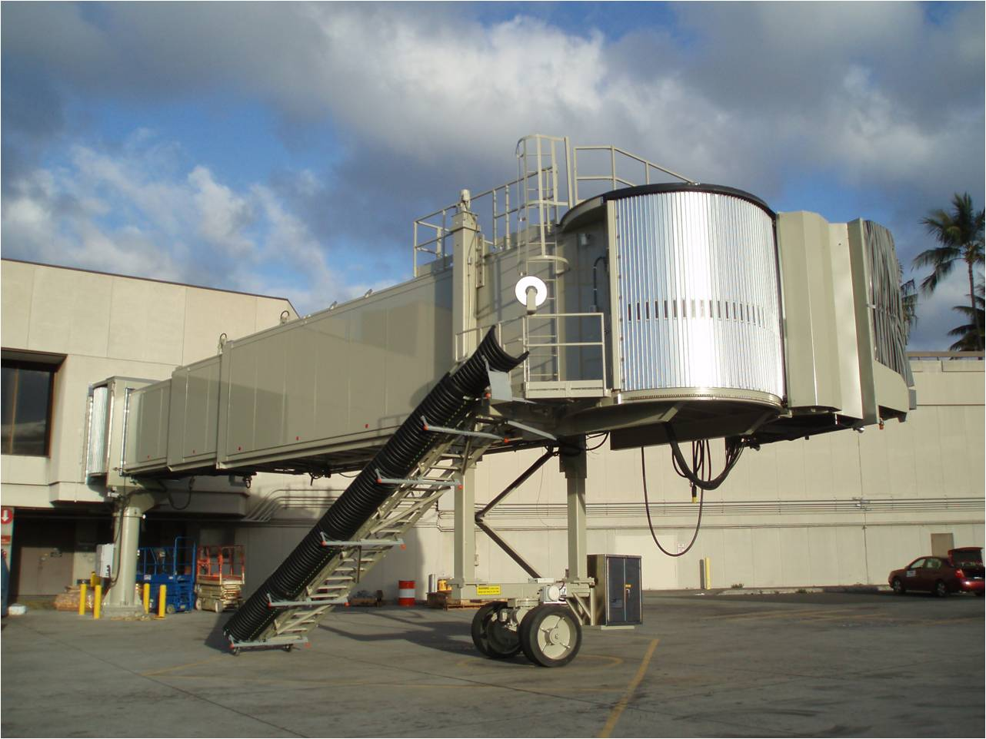
Apron Drive Truss and Corrugated Designs

Slide 15
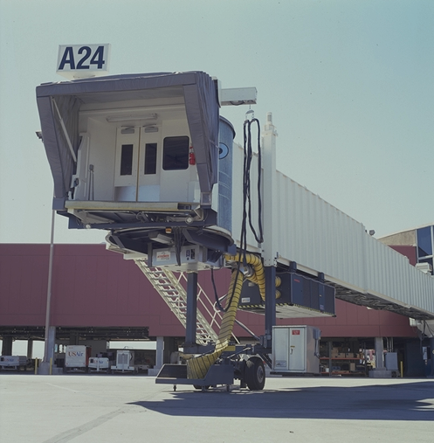
JBT AeroTech – Jetway Systems
JetLink
Jetway Boarding Bridge
Jetpower Ground Power Unit
Jetaire Preconditioned Air

