Slide 1


Slide 2



https://youtu.be/M-1C1wfejDk
2021 GAA Annual Conference & Expo | St. Simons Island, GA | Sept 29 – Oct 1

Slide 3

Goodwyn Mills Cawood

Slide 4
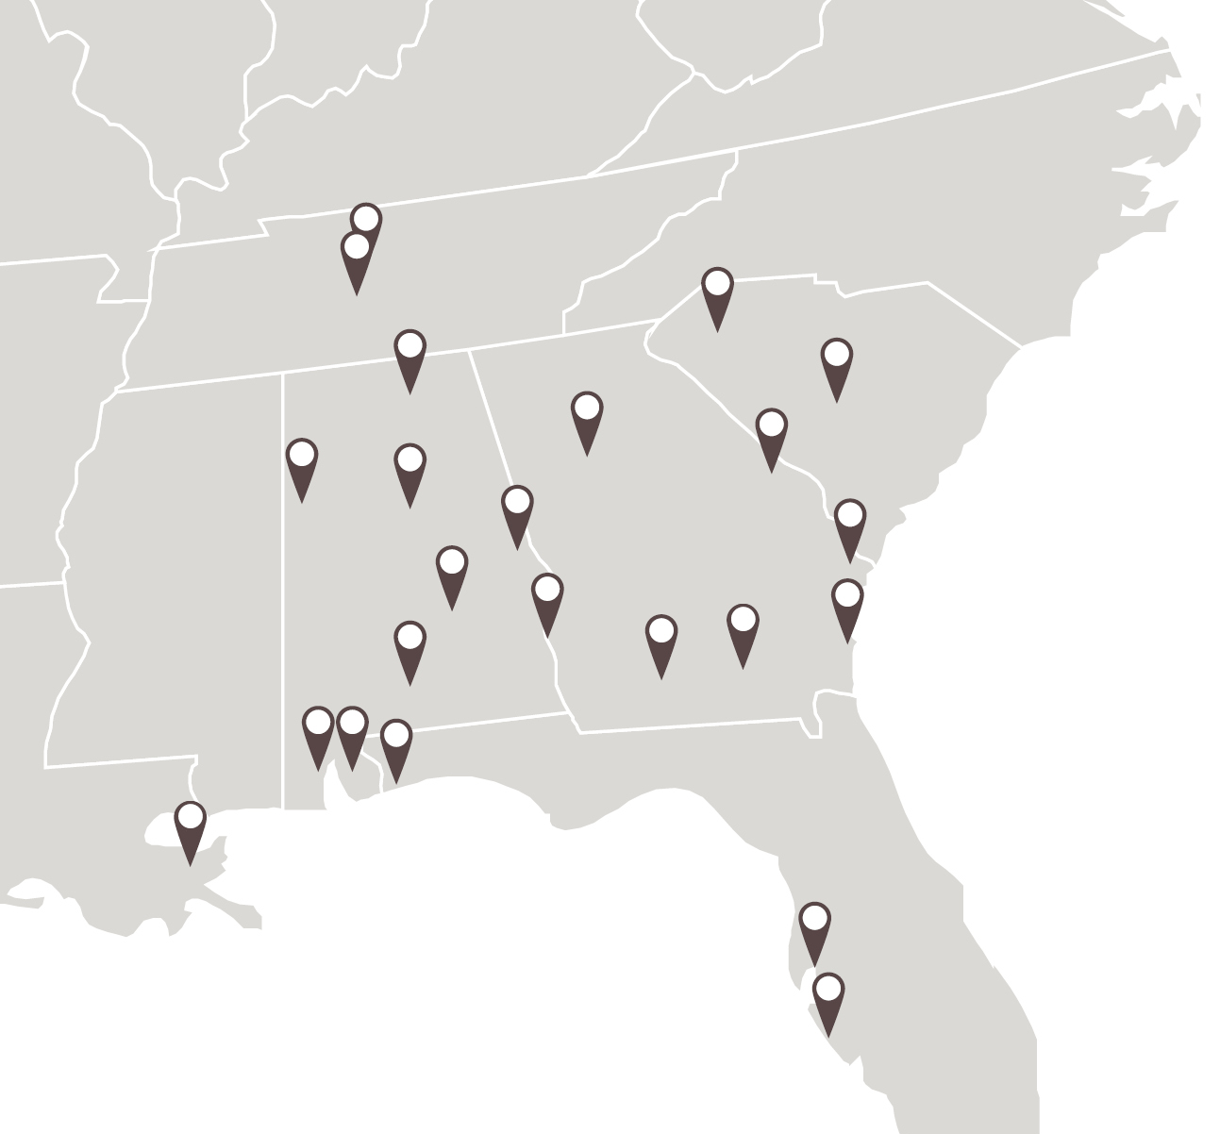



1947
Founded
+425
Professionals
22
Offices

Slide 5
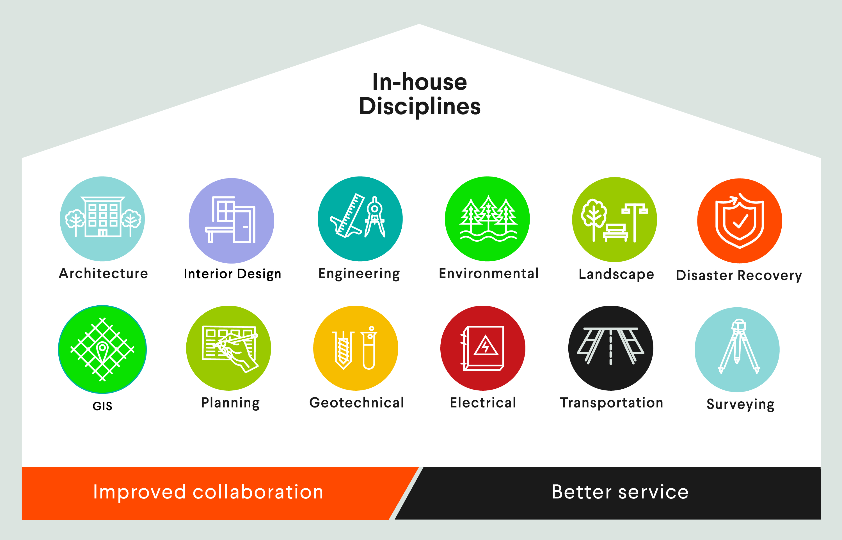

Slide 6
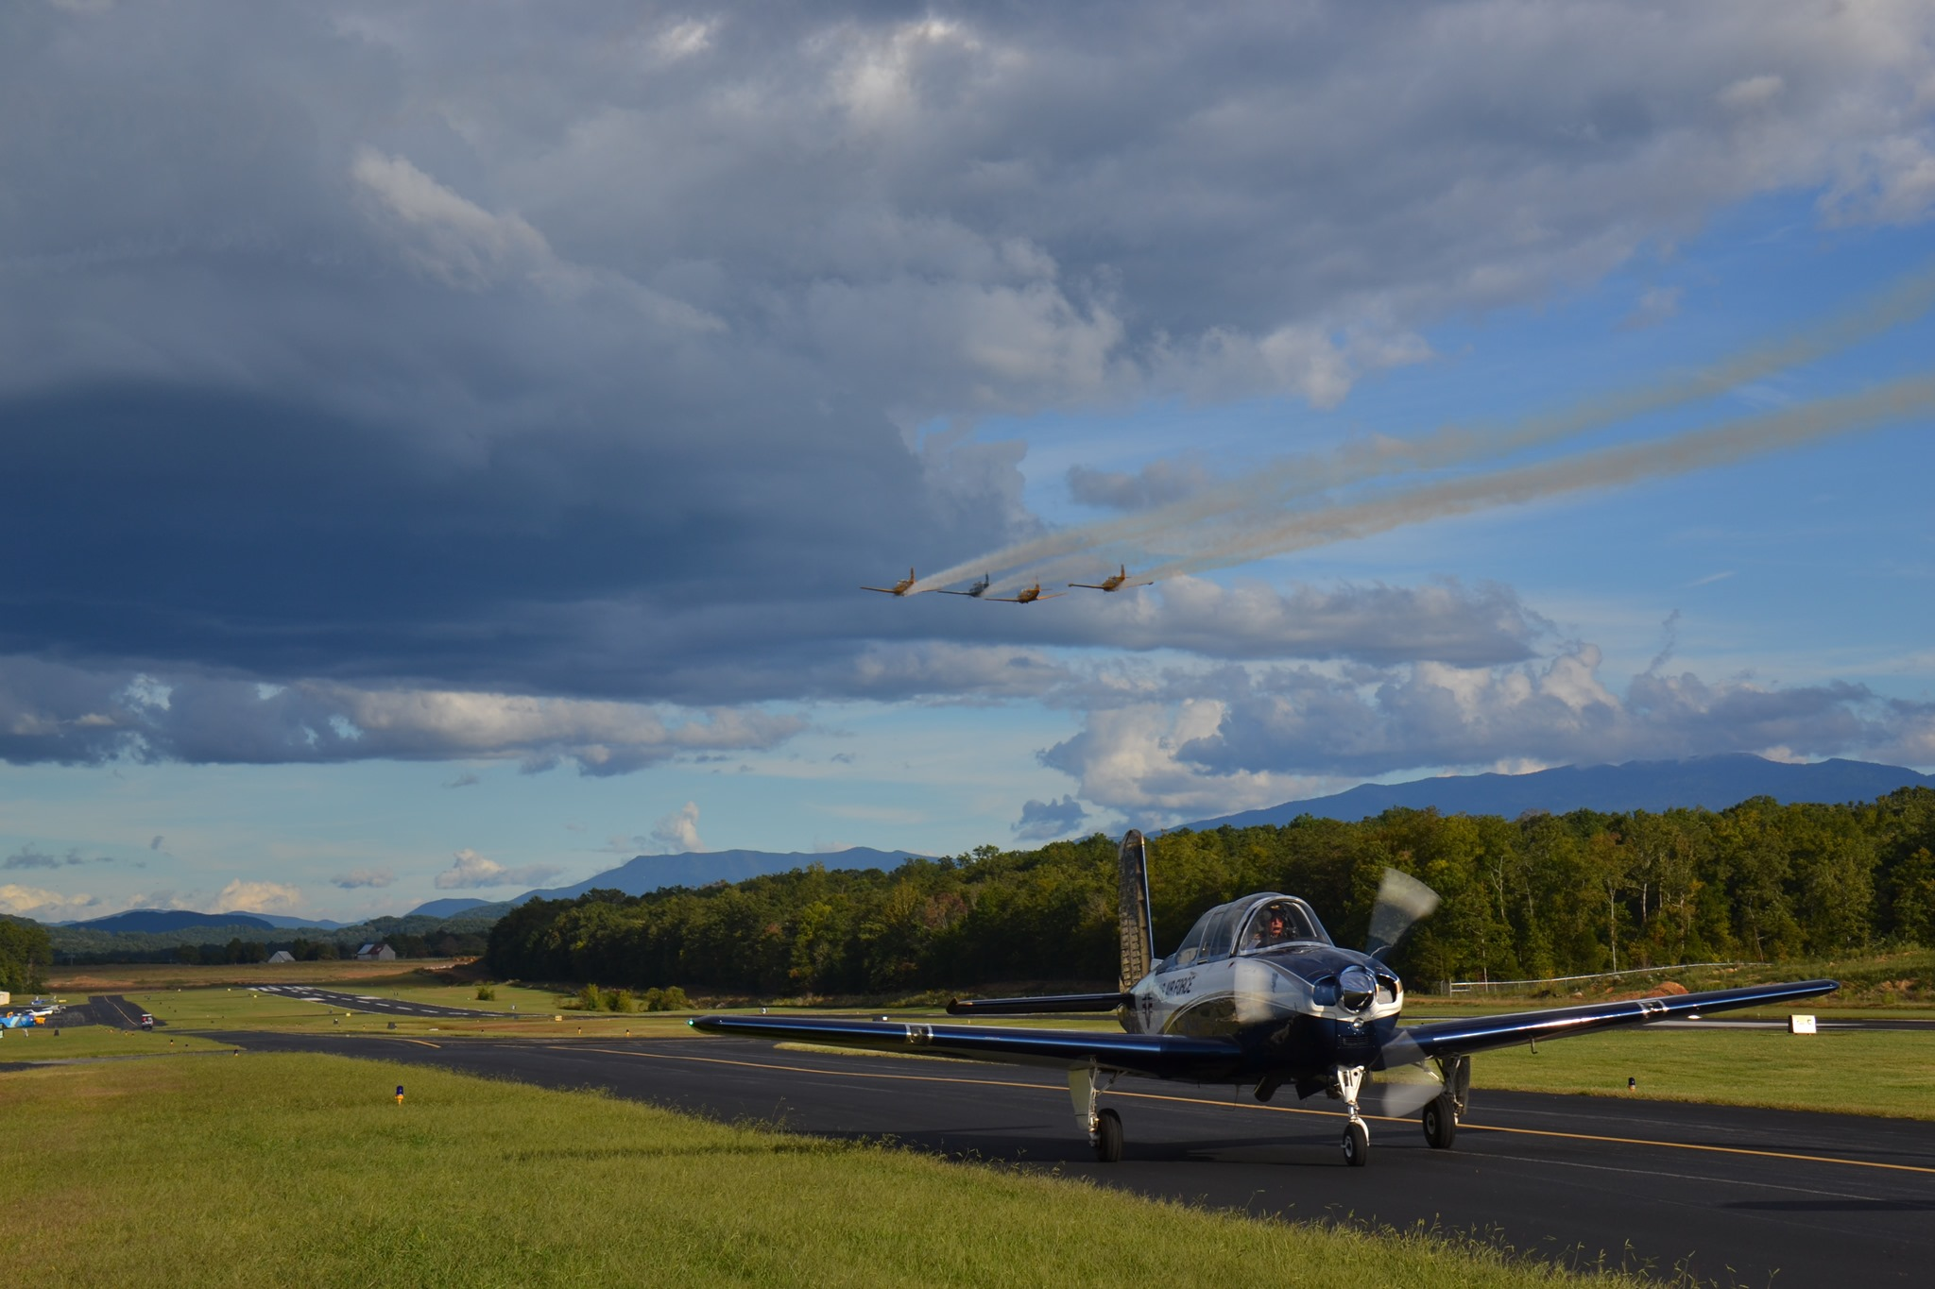


Slide 7
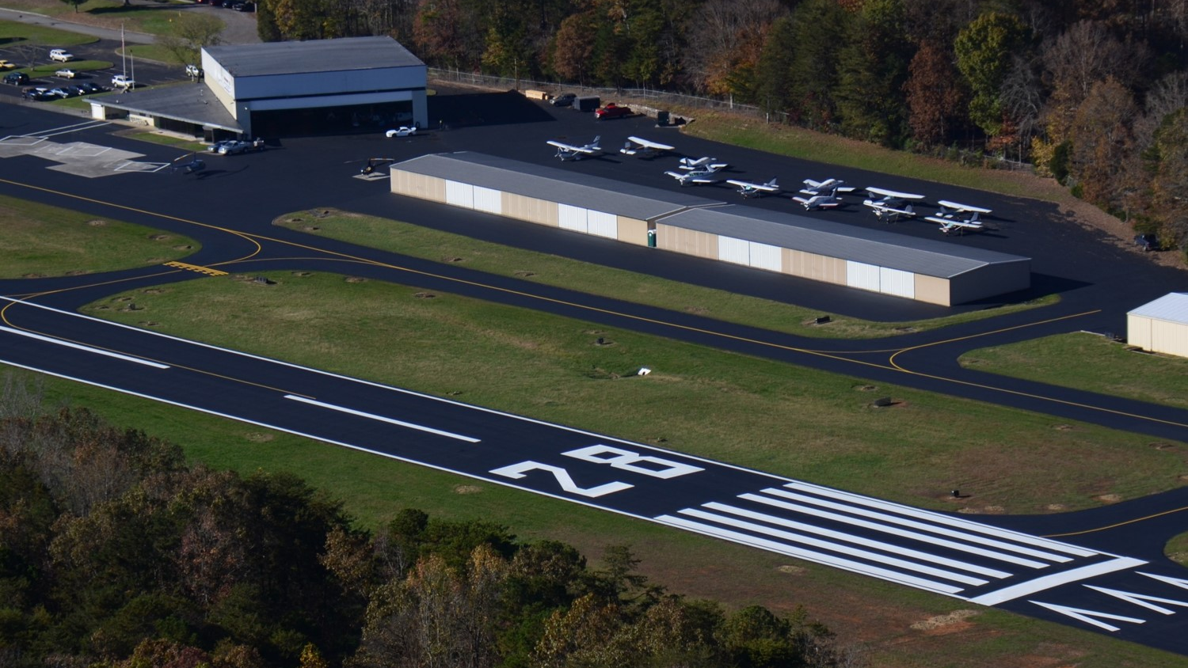

Slide 8
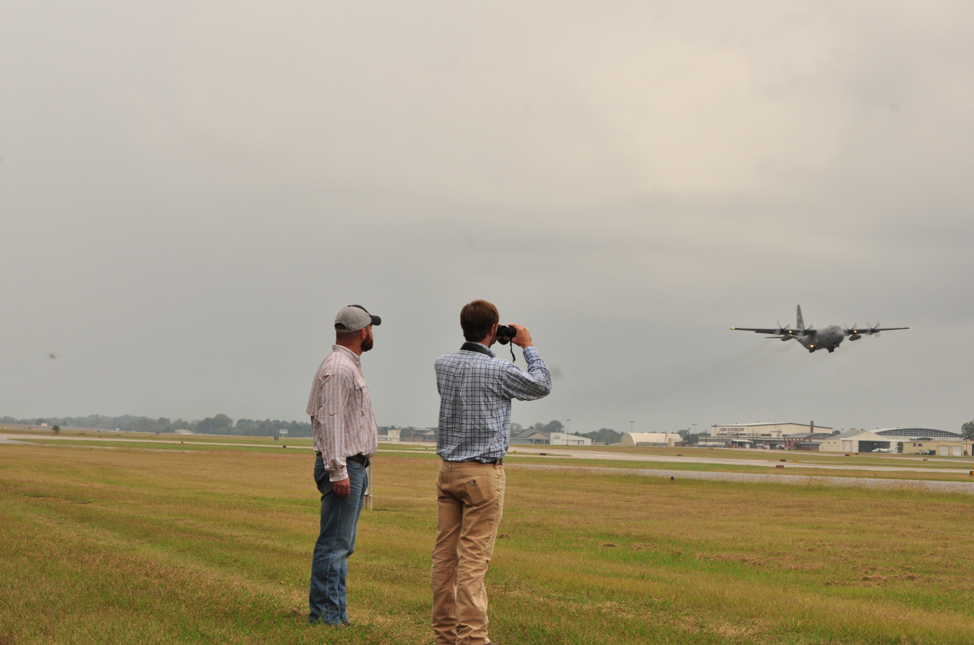

Slide 9
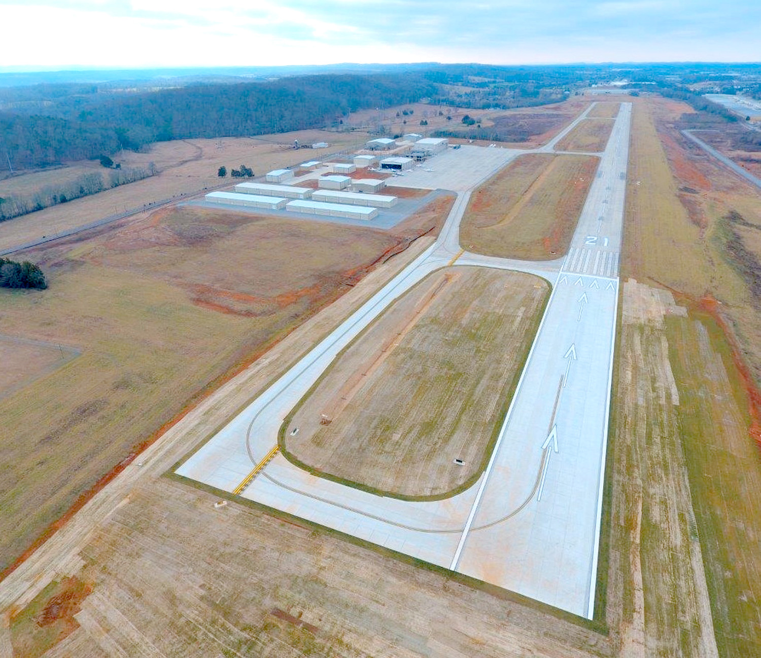

Slide 10
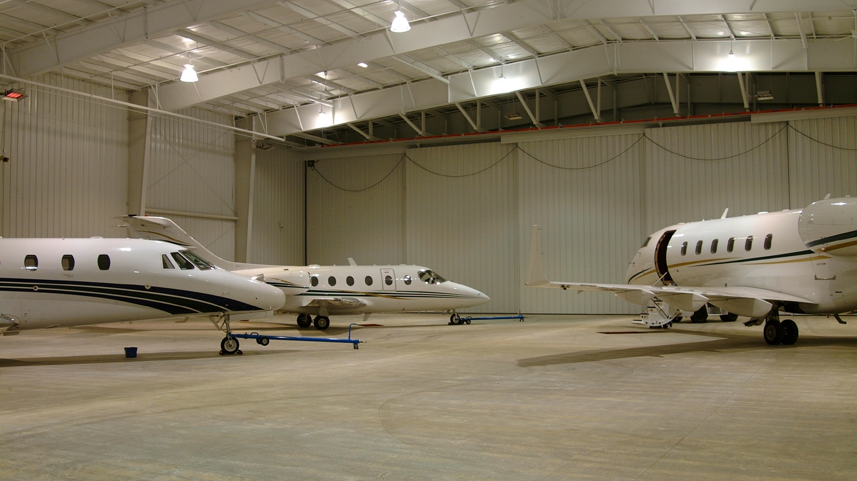

Slide 11
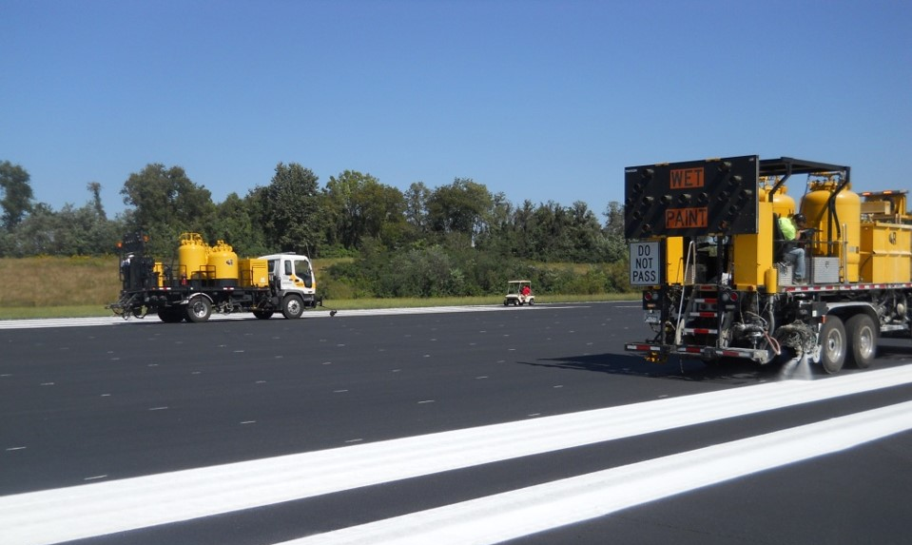

Slide 12
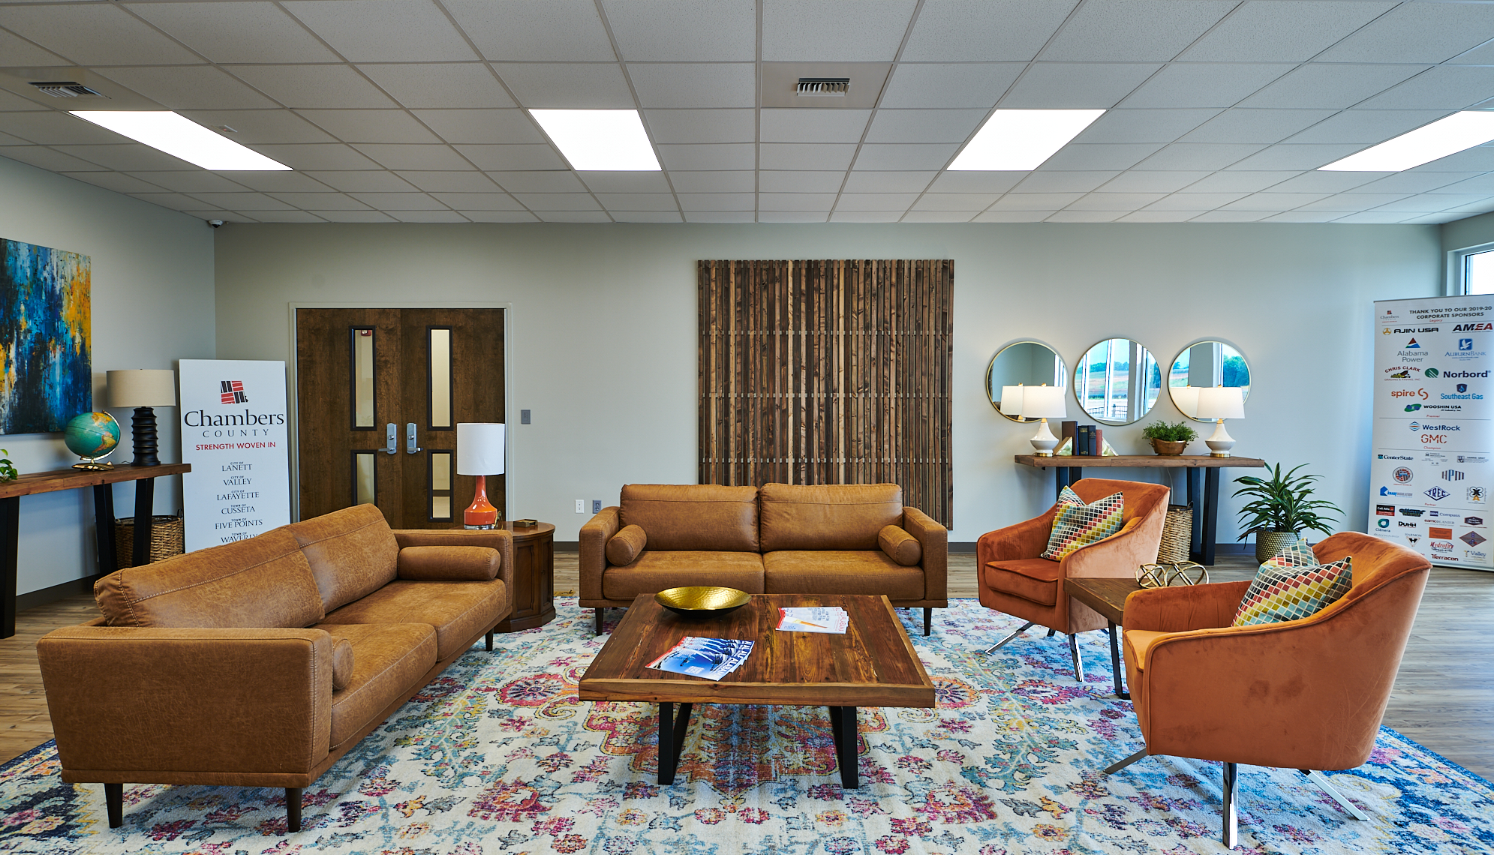

Slide 13
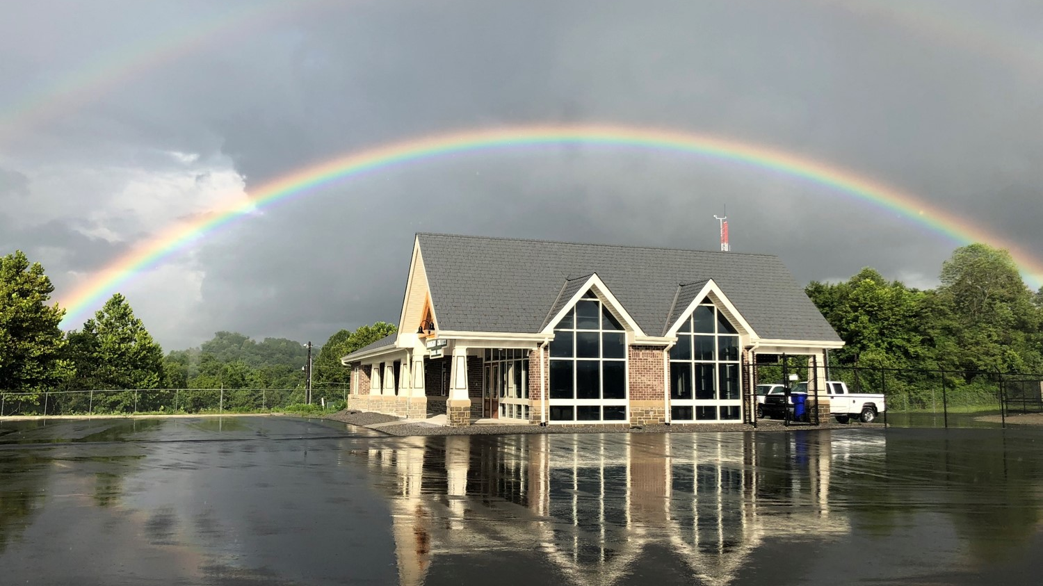

Slide 14
THANK YOU

